Slide 1
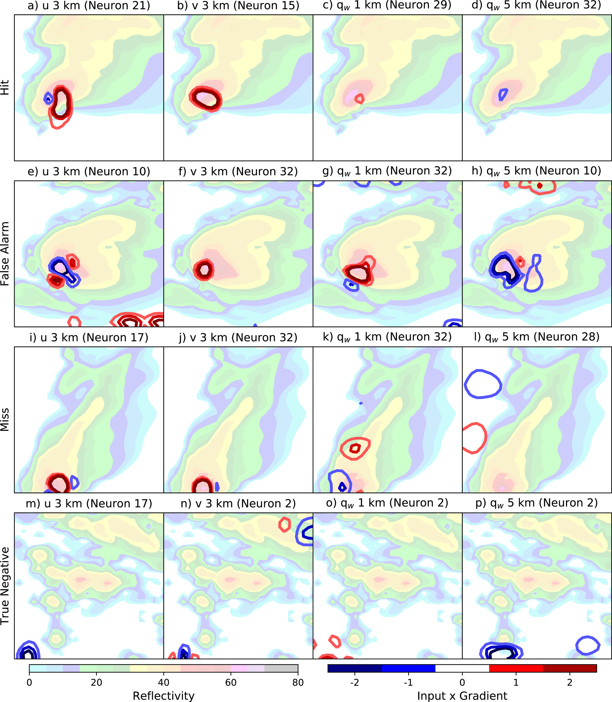
Generalization capabilities of deep learning to classify severe convective storms in a changing climate
Molina, M. J., D. J. Gagne, and A. F. Prein, 2021. A benchmark to test generalization capabilities of deep learning methods to classify severe convective storms in a changing climate. Earth and Space Science, 8(9), p.e2020EA001490. https://doi.org/10.1029/2020EA001490. (DOE-supported authors in bold face)
OBJECTIVE
Deep learning models trained during today’s climate may not perform skillfully when they encounter extremes or patterns that have not been previously seen. In this study, we perform an evaluation of deep learning models, specifically convolutional neural networks, that tests their ability to generalize to future climate extremes.
APPROACH
This is a test case study assessing the ability of deep learning methods to generalize to a future climate (end of 21st century) when trained to classify thunderstorms in model output representative of the present-day climate. Results from this study show that deep learning can generalize to future climate extremes and can exhibit out-of-sample robustness with hyperparameter tuning in certain applications.
IMPACT
A convolutional neural network (CNN) was trained to classify organized thunderstorms from a current climate created using the Weather Research and Forecasting model at high-resolution, then evaluated against thunderstorms from a future climate and found to perform with skill and comparatively in both climates. Explainable AI techniques revealed that the CNN learned physical characteristics of organized convection and environments that were not prescribed during training. Results show that the creation of synthetic data with ground truth is a viable alternative to human-labeled data and that CNNs can generalize a target using learned features that would be difficult to encode due to spatial complexity.
Explainable AI method (input x gradients) applied to predicted storms of future climate, including correctly and incorrectly predicted examples from the convolutional neural network.

