Slide 1
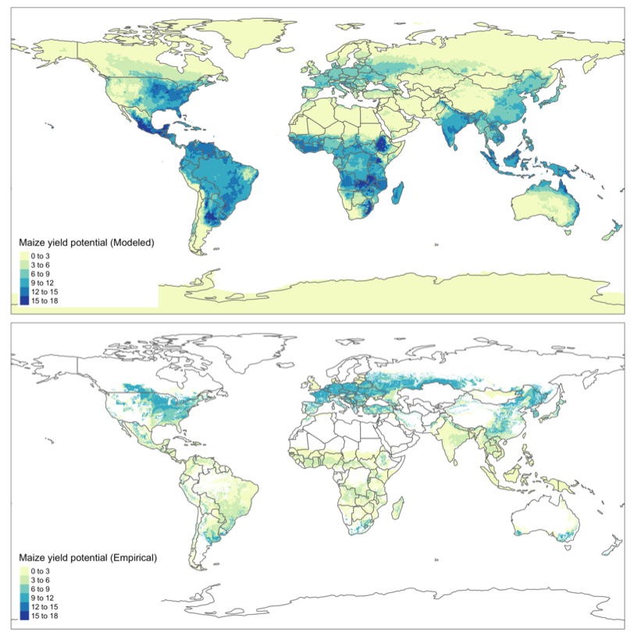
Mind the (Yield) Gap: the Importance of Potential Yield Estimation Methods
Objective
Compare estimation methods for potential yields of agricultural crops and assess how global yield gap closure would affect both food security and the agricultural sector.
Approach
Use global gridded crop models to estimate potential yields of important crops for each terrestrial grid cell.
Compare results with existing empirical-based estimates of yield potentials.
Design scenarios in the Global Change Analysis Model based on the yield gap closure projected by both methods and compare the outcomes for key agricultural indicator variables.
Impact
Found that the uncertainty in future potential yields is very large, particularly in tropical regions with low present-day yields.
The potential yields seen in crop model simulations describe an optimistic future for agriculture.
Understanding the barriers to realizing these crop yield levels in upcoming decades is important.
Global potential yields of maize are highly sensitive to estimation methods, with implications for future agricultural commodity production, trade, and food security.
Ollenburger M, Kyle P., and Zhang X. “Uncertainties in estimating global potential yields and their impacts for long-term modeling,” Food Security, 14, 1177 (2022).
DOI: 10.1007/s12571-021-01228-x
Notes:
http://www.pnnl.gov/science/highlights/highlights.asp?division=749

