Slide 1
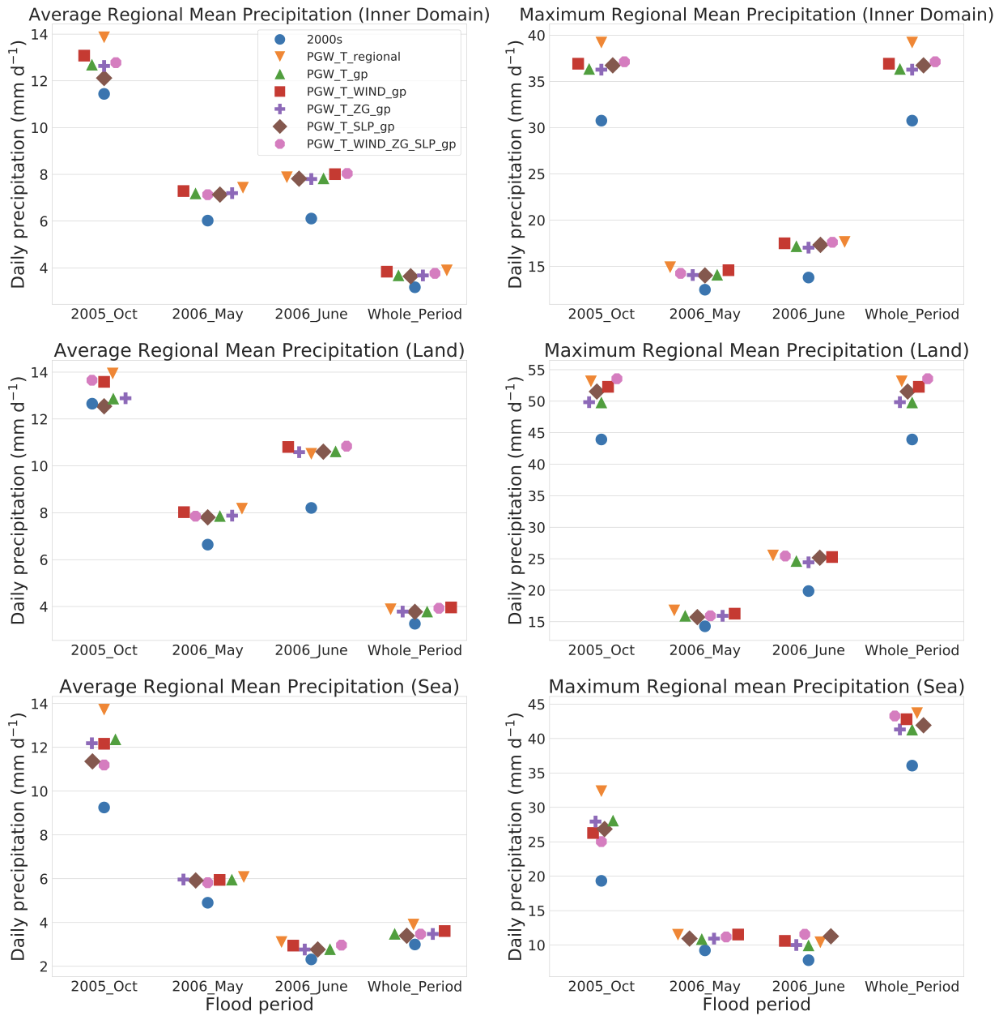
Sensitivity of the pseudo-global warming method under flood conditions: A case study from the Northeastern U.S.
Objective
Addresses unanswered but essential questions in applying the PGW method and provide guidance for this widely used regional modeling method.
Approach
A set of commonly used pseudo-global warming (PGW) experiment designs are applied during three major flood periods to quantify the sensitivity of the PGW method to varied perturbation spatial scales and choice of perturbed meteorological variables, and the meteorological causes of flood events.
Impact
Regional temperature perturbations are shown to overestimate simulated precipitation compared with the simulation with gridpoint scale perturbation due to the land-ocean warming contrast.
Perturbations of sea level pressure and geopotential height are not recommended because of the unrealistic cooling biases introduced and the geopotential self-adjustment within WRF.
PGW experiments with perturbations from temperature or the combination of temperature and wind at the gridpoint scale are both recommended, depending on the research questions.
Period regional mean precipitation (mm/day) over the inner domain, its land area, and sea area from all PGW ensembles with different perturbation modification methods
Xue, Z., Ullrich, P., and Leung, L.-Y. R.: Sensitivity of the pseudo-global warming method under flood conditions: a case study from the northeastern US, Hydrol. Earth Syst. Sci., 27, 1909–1927, https://doi.org/10.5194/hess-27-1909-2023, 2023.

