Slide 1
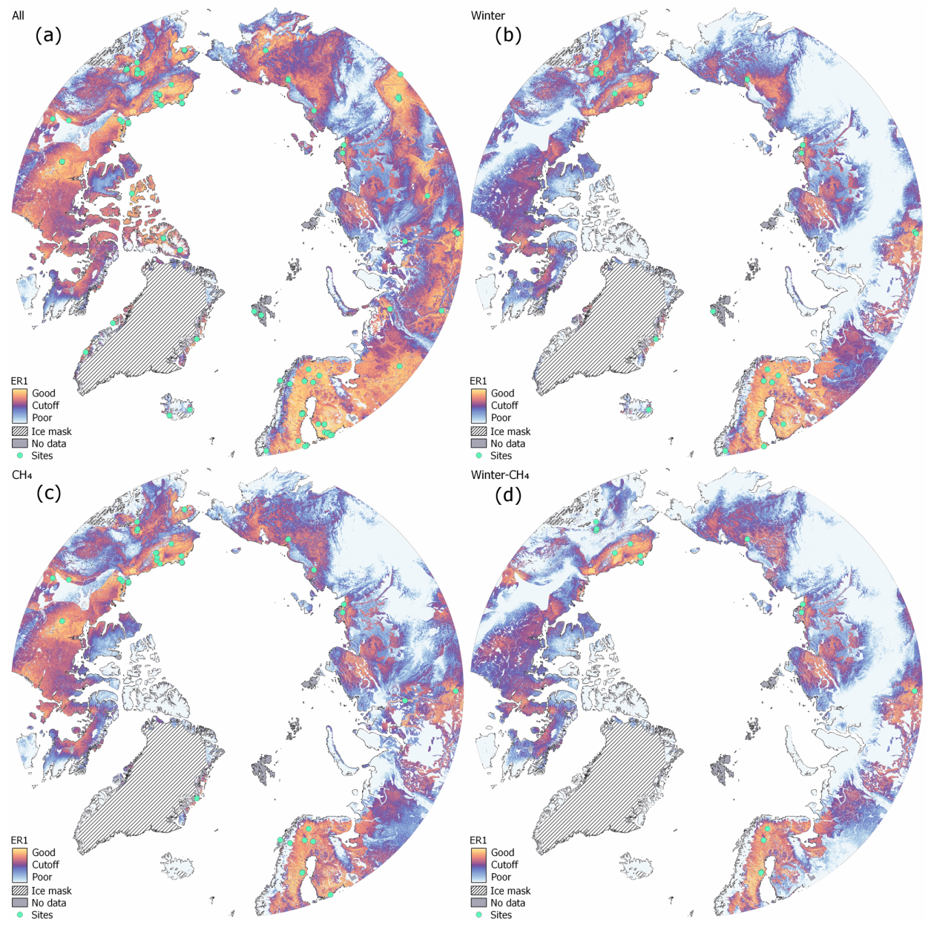
Representativeness Analysis Identifies Arctic Tundra Areas Poorly Represented by CO₂ and CH₄ Flux Measurements
Objective: Determine the extent of the eddy covariance (EC) network across the pan-Arctic biome, evaluate the similarity in environmental conditions at EC locations, and design optimal strategies for upgrades to the network.
Approach: Quantify spatial coverage of existing EC measurements using k-means cluster analysis of surface characteristics.
Results/Impacts:
EC is a common method to measure high-frequency greenhouse gas fluxes.
Half the Arctic tundra biome is represented by at least one EC tower, but many EC locations do not measure CH₄ or wintertime greenhouse gas fluxes.
Environmental conditions in Fennoscandia and Alaska, where the majority of EC towers are located, were well-represented.
However, large parts of Siberia and patches of Canada were poorly represented, as were mountainous regions.
Analysis advances understanding of measurement gaps and guides investments in infrastructure required to improve understanding of the Arctic.
Figure: Representativeness of eddy covariance towers located across the Arctic tundra; cool colors indicate underrepresented areas.
Pallandt, M. M. T. A., Jitendra Kumar, M. Mauritz, E. A. G. Schuur, A.-M. Virkkala, G. Celis, Forrest M. Hoffman, and M. Göckede (2022), Representativeness Assessment of the Pan-Arctic Eddy Covariance Site Network and Optimized Future Enhancements, Biogeosci., 19(3):559–583, doi:10.5194/bg-19-559-2022.

