Slide 1
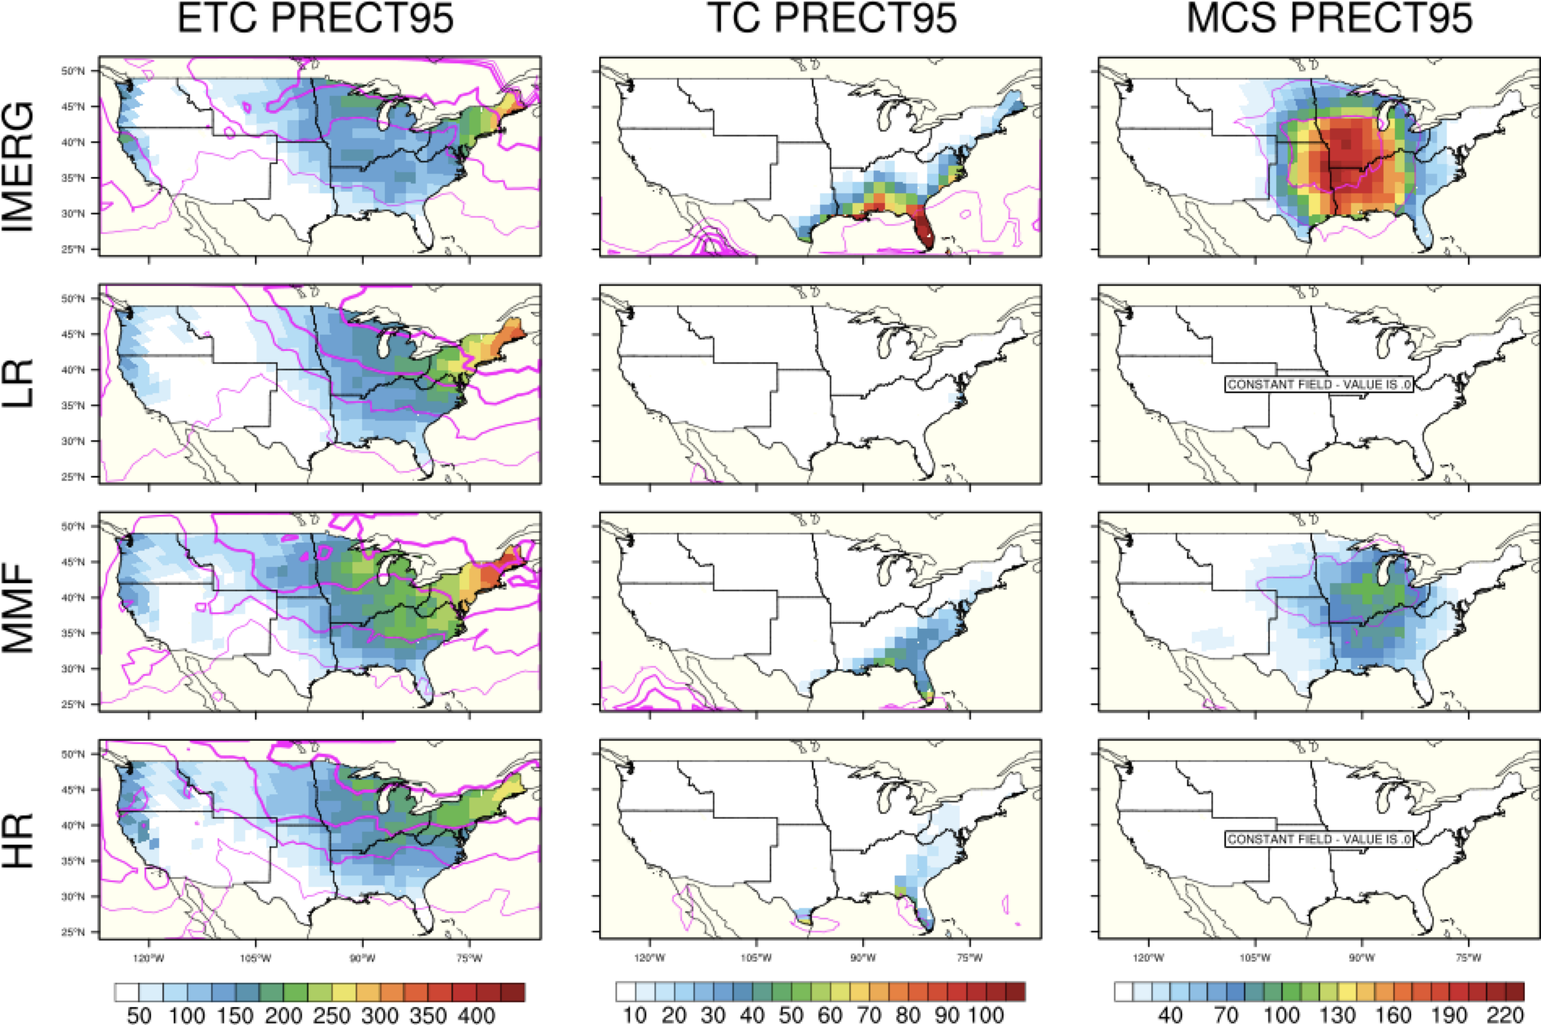
Evaluating the simulation of CONUS precipitation by storm type in E3SM
Objective
Precipitation occurs in many different environments and is produced by a variety of weather phenomena in the United States, including tropical cyclones, extratropical cyclones, and mesoscale convective systems.
This work quantifies the characteristics of precipitation in E3SM configurations associated with these storm-types to better inform future development of the climate model and produce more accurate projections of future precipitation.
Approach
Compare two approaches to next-generation E3SM, high-resolution (HR) and multiscale modeling framework (MMF) configurations, to conventional low-resolution (LR) E3SM and observations (IMERG).
Impact
Multiscale modeling framework E3SMv1 captures precipitation from mesoscale convective systems better than low- and high-resolution.
High-resolution and multiscale modeling framework E3SM improves tropical cyclone precipitation.
All configurations capture realistic extratropical cyclone precipitation in contrast to tropical cyclone and mesoscale convective systems, and conventional low-resolution E3SM does best.
Annual mean accumulated precipitation from events with ≥95th percentile of 6-hourly precipitation (colored shading; units=mm/year) and percentage of annual mean accumulated precipitation from events with ≥95th percentile of 6-hourly precipitation (magenta contour levels) by each storm type (labeled columns) for observations and each E3SMv1 configuration (labeled rows) over CONUS. Magenta contours represent the fraction of total annual precipitation from ≥95th percentile events from 10% (thinnest) to 40% (thickest) in 10% increments.
Reed, K.A., A. M Stansfield, W.-C. Hsu, G. J. Kooperman, A. A. Akinsanola, W. M. Hannah, A. G. Pendergrass, and B. Medeiros (2023), Evaluating the simulation of CONUS precipitation by storm type in E3SM, Geophys. Res. Lett., 50, e2022GL102409, doi: 10.1029/2022GL102409.

