Slide 1
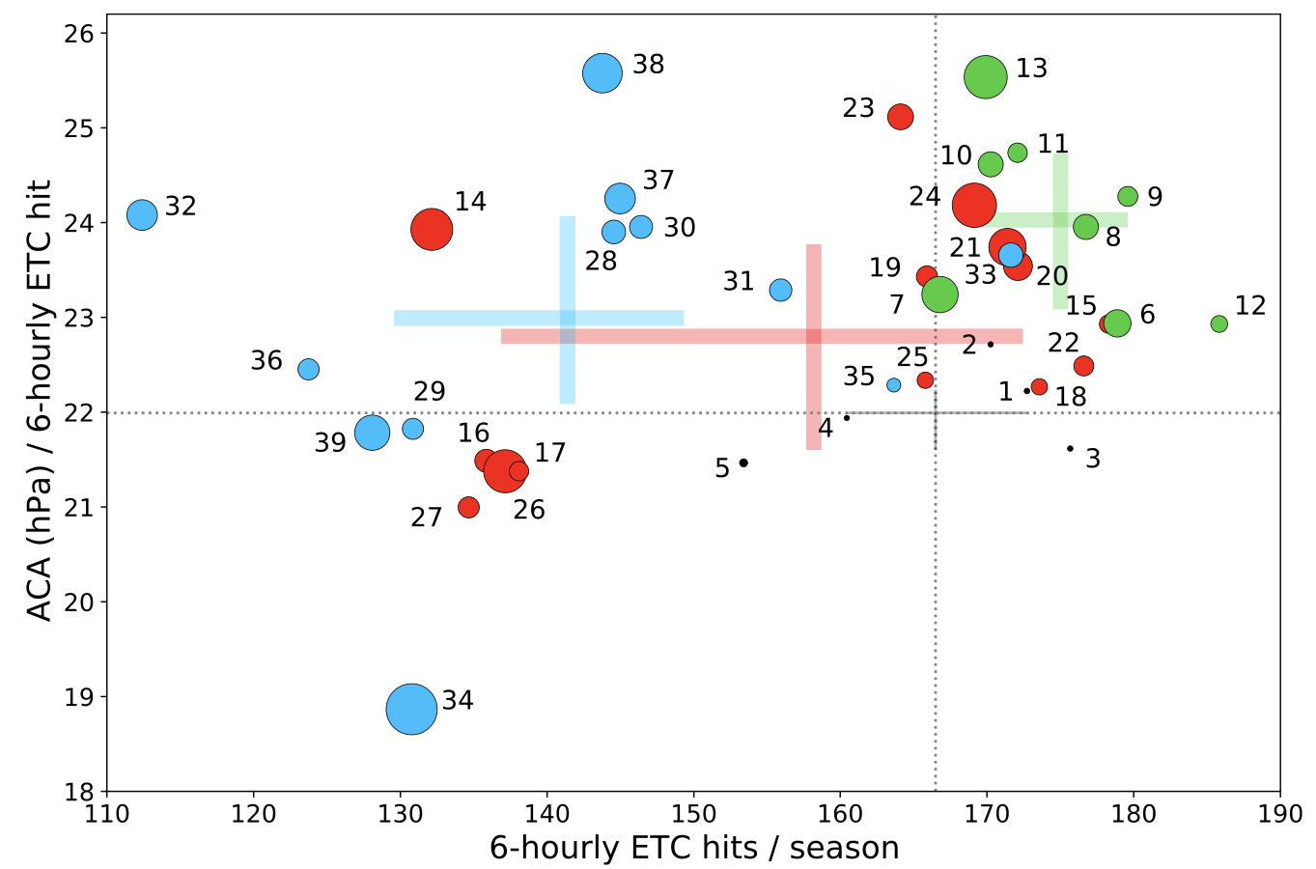
Connecting Large‐Scale Meteorological Patterns to Extratropical Cyclones in CMIP6 Climate Models Using Self‐Organizing Maps
Objective: Characterize the large-scale meteorological patterns (LSMPs) and associated frequency and intensity of extratropical storm activity in the northeastern U.S. (NEUS).
Approach: We utilize self-organizing maps (SOMs) -- an unsupervised machine-learning approach -- to characterize the LSMPs of the historical winter climatology and track cyclone activity using TempestExtremes to investigate the frequency and intensity of discrete ETC events over NEUS. The reanalysis-derived SOM is then used to evaluate the skill of CMIP6 historical experiments in simulating the LSMPs and ETC events identified.
Results/Impact: Our results show that, while model resolution has some impact on simulation credibility, model design and configuration are more important in LSMP representation. Most CMIP6 models struggle to simulate more amplified patterns and tend to favor weaker patterns not as conducive to cyclone formation. As a result, most models simulate too few winter storms, however, the error in storm intensity is more varied, with some models producing stronger storms and others producing weaker storms when compared to reanalyses.
Averaged ETC hits per winter season (frequency, x-axis) and averaged accumulated cyclone activity per ETC hit (intensity, y-axis) associated with reanalyses (black) and CMIP6 climate models (blue = 250 km resolution; red = 100 km resolution; green = HighResMIP). The size of the dots varies according to the mean pattern error in node frequency as measured by the self-organizing map. Models with small dots close to the black cross indicate skill better matched to reanalyses.
Gore, M.J., Zarzycki, C.M. and Gervais, M.M., 2023. Connecting Large‐Scale Meteorological Patterns to Extratropical Cyclones in CMIP6 Climate Models Using Self‐Organizing Maps. Earth's Future, 11(8), p.e2022EF003211. https://doi.org/10.1029/2022EF003211

