Slide 1
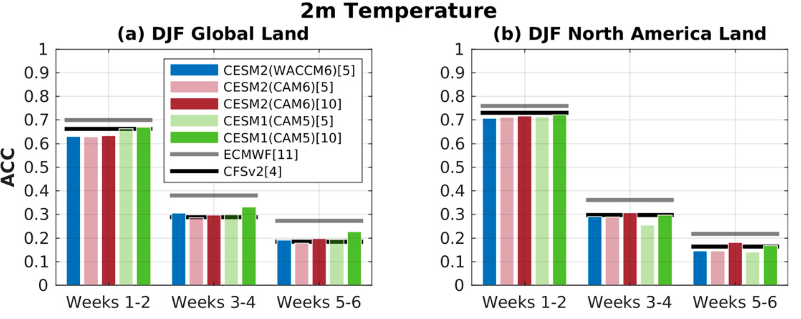
Subseasonal Earth System Prediction with CESM2
J. H. Richter, A. A. Glanville, …, Stephen G. Yeager, Julie M. Caron, et al.(2022): Weather & Forecasting, 37, DOI: 10.1175/WAF-D-21-0163.1
OBJECTIVE
To develop and evaluate subseasonal prediction systems with CESM2 for research purposes
APPROACH
We develop a subseasonal prediction system with CESM2(CAM6) and CESM2(WACCM6) and carry out a historical reforecast set with both prediction systems
IMPACT
There are many unanswered questions with regard to sources of subseasonal predictability and windows of forecast opportunity. The two CESM2 based prediction systems described here provide a foundation for community-based subseasonal prediction research with CESM2(WACCM6) system providing a novel capability to explore the predictability of the stratosphere and mesosphere and their impacts on the surface.
We show that the CESM2-based prediction systems show very similar subseasonal prediction skill to the NOAA CFSv2 model and a little lower than that of ECMWF for surface temperature, precipitation, MJO and the NAO, and hence are credible models for subseasonal prediction research. These models are contributing to the NOAA operational weeks 3-4 outlook.
DJF 2-m temperature ACC averaged over (a) the global land and (b) North American land. All CESM calculations use daily data from 1999 to 2015. The ECMWF model is shown for 1996–2016 and CFSv2 for 1999–2010. In the legend, the number of ensemble members used in the calculations is shown in square brackets. ECMWF and CFSv2 models are shown in gray and black horizontal lines, respectively.

