Slide 1
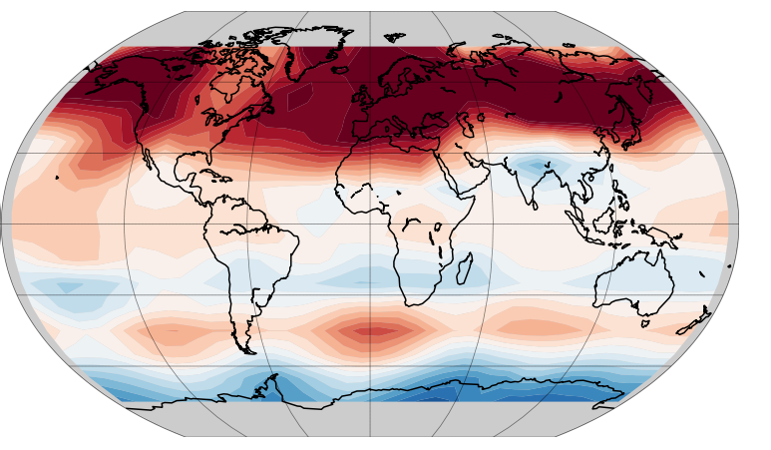
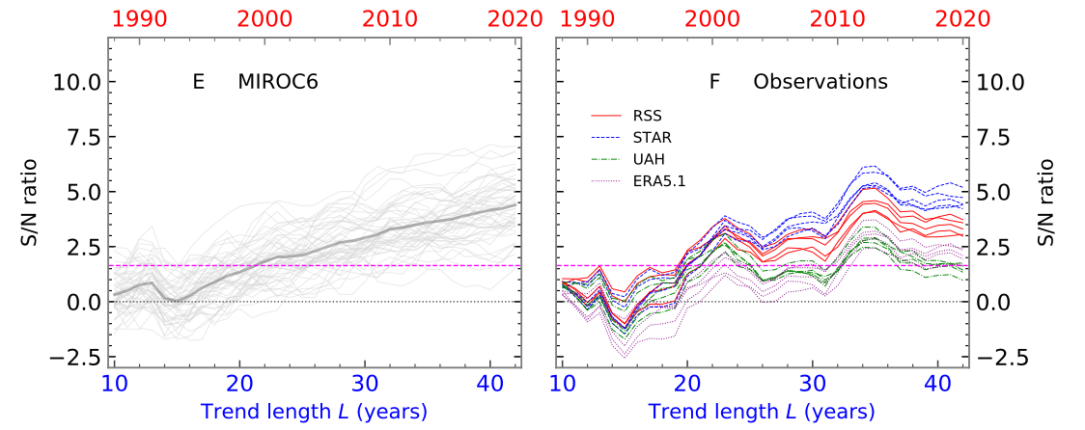
Robust anthropogenic signal identified in the seasonal cycle of tropospheric temperature
Background and Objective
Previous work identified detectable anthropogenic influence on the seasonal cycle of the temperature of the mid-tropospheric (TMT). This work tests whether multidecadal internal variability influences the detectability of annual cycle changes.
Research
Investigated whether the fingerprint of seasonal cycle changes are detectable across 240 model simulations from five climate models.
Impact
Seasonal cycle changes are detectable in 239/240 simulations despite widely varying manifestations of the phase and amplitude of internal climate variability.
The findings were robust to a factor of 3 difference in the amplitude of common modes of decadal variability.
Anthropogenic fingerprints of seasonal cycle changes are evident in both climate models and satellite observations.
A
Leading Signal: ΔTMT Seasonal Cycle
Last year of L-year trend
Last year of L-year trend
B
C
A) Fingerprint of anthropogenic seasonal cycle changes in TMT. Red (blue) areas experience increases (decreases) in the TMT seasonal cycle. Signal-to-noise ratios as a function of trend length (blue lower axis) and end year (red upper axis) for B) the MIROC6 climate model large ensemble and C) satellite observations.
Reference: Santer, B. D., S. Po-Chedley, N. Feldl, J. C. Fyfe, Q. Fu, S. Solomon, M. England, K. B. Rodgers, M. F. Stuecker, C. Mears, C.-Z. Zou, C. J. W. Bonfils, G. Pallotta, M. D. Zelinka, N. Rosenbloom, and J. Edwards, 2022: Robust anthropogenic signal identified in the seasonal cycle of tropospheric temperature, J. Clim., 35 (18) 6075 - 6100, doi: 10.1175/JCLI-D-21-0766.1.

