Slide 1
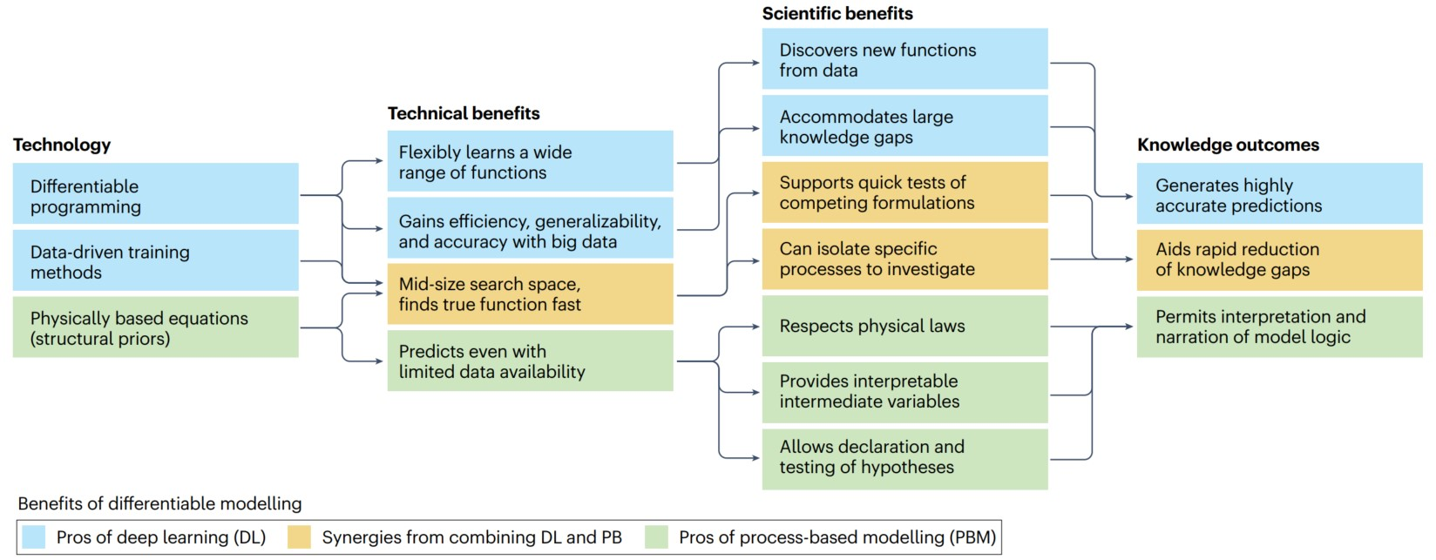
Differentiable modelling to unify machine learning and physical models for geosciences
Objective
Explore differentiable modelling as a pathway to dissolve the perceived barrier between process-based modelling and machine learning in the geosciences and demonstrate its potential with examples from hydrological modelling.
‘Differentiable’ refers to accurately and efficiently calculating gradients with respect to model variables or parameters, enabling the discovery of high-dimensional unknown relationships. Differentiable modelling involves connecting (flexible amounts of) prior physical knowledge to neural networks, pushing the boundary of physics-informed machine learning.
Figure
Conclusions
Differentiable modelling offers better interpretability, generalizability, and extrapolation capabilities than purely data-driven machine learning, achieving a similar level of accuracy while requiring less training data. Differentiable model performance and efficiency scales well with increasing data volumes.
Under data-scarce scenarios, differentiable models have outperformed machine-learning models in producing short-term dynamics and decadal-scale trends owing to the imposed physical constraints.
Differentiable modelling approaches are primed to enable geoscientists to ask questions, test hypotheses, and discover unrecognized physical relationships.
Machine learning (ML, blue boxes) produces accurate results with easy-to-use models, resulting from the complexity of neural networks and the technologies that make it feasible to train such complex models. The most fundamental of these technologies is differentiable programming. Process-based models (PBMs, green boxes) permit human definition and interpretation of model logic. With differentiable modelling (DM), which incorporates differentiable non-ML model components from PBMs such as physically based structural priors, additional features can be obtained (orange boxes) while retaining and augmenting the advantages of both ML models and PBMs.
Shen, Chaopeng, Alison P. Appling, Pierre Gentine, Toshiyuki Bandai, Hoshin Gupta, Alexandre Tartakovsky, Marco Baity-Jesi, Fabrizio Fenicia, Daniel Kifer, Li Li, Xiaofeng Liu, Wei Ren, Yi Zheng, Ciaran J. Harman, Martyn Clark, Matthew Farthing, Dapeng Feng, Praveen Kumar, Doaa Aboelyazeed, Farshid Rahmani, Yalan Song, Hylke E. Beck, Tadd Bindas, Dipankar Dwivedi, Kuai Fang, Marvin Höge, Chris Rackauckas, Binayak Mohanty, Tirthankar Roy, Chonggang Xu, and Kathryn Lawson. (2023). “Differentiable Modelling to Unify Machine Learning and Physical Models for Geosciences.” Nature Reviews Earth & Environment. doi: 10.1038/s43017-023-00450-9.
Department of Energy • Office of Science • Biological and Environmental Research
Notes:
Word highlight text here.

