Slide 1
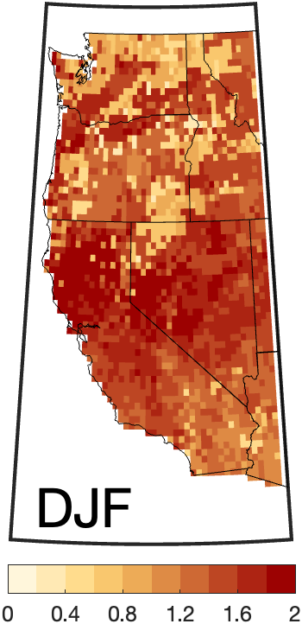
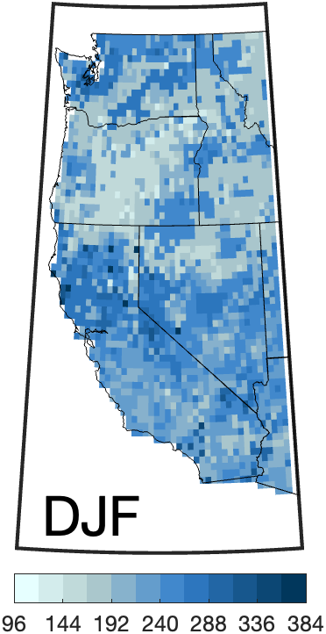
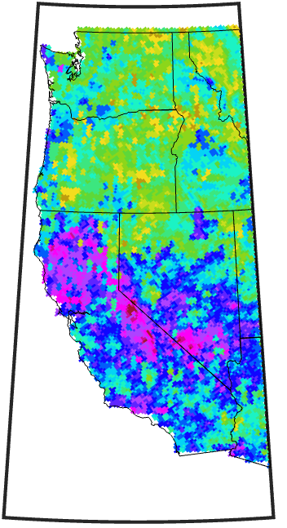
Subseasonal clustering of atmospheric rivers over the western US
Scientific Challenge
The serial occurrence of atmospheric rivers (ARs) along the US West Coast can lead to prolonged and exacerbated hydrologic impacts, threatening flood-control and water-supply infrastructure due to soil saturation and diminished recovery time between storms.
Frequency
Duration
Extreme Precipitation
a)
b)
c)
Approach and Findings
We apply a statistical approach for quantifying sub-seasonal temporal clustering among extreme events to a 41-year (1979-2019) wintertime AR catalogue across the western US. Observed AR occurrence, compared against a randomly distributed AR timeseries with the same average event density, reveals temporal clustering at a greater-than-random rate across the western US, with a distinct geographical pattern. We found, compared to the Northwest, Southwest clusters are longer-lived, consist of more ARs and account for a larger fraction of total AR occurrence. Based on precipitation data from a high-resolution dynamical downscaling of reanalysis, the fractions of total and extreme hourly precipitation attributable to AR clusters are largest along the northern California coast and in the Sierra Nevada.
Figure
%
clusters/season
hours
Significance and Impact
The distinct statistically significant clustering timescales presented here can be leveraged to investigate the dynamics and synoptic environments that favor AR cluster development for improved predictability and situational awareness.
(a) AR cluster frequency (average clusters per season), (b) average cluster duration (hours), (c) fraction of extreme precipitation (i.e., 95th percentile hourly precipitation) associated with AR clusters. Results are shown for December, January, February at each grid point for 1979-2019.
Slinskey, E. A., Hall, A., Goldenson, N., Loikith, P. C., & Norris, J. (2023). Subseasonal clustering of atmospheric rivers over the western United States. Journal of Geophysical Research: Atmospheres, 128, e2023JD038833. https://doi.org/10.1029/2023JD038833
Department of Energy • Office of Science • Biological and Environmental Research
Notes:
Word highlight text here.

