Slide 1
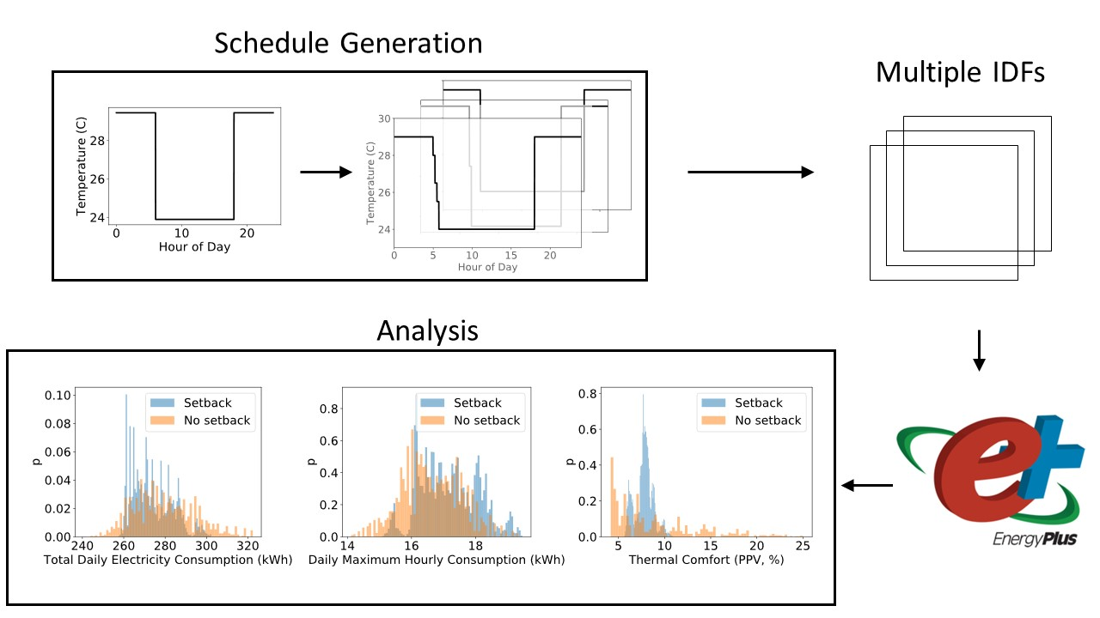
A New Methodology for Generating Building Temperature Setpoint Schedules
Objective
Develop a methodology to generate heating and cooling setpoint schedules to support large-scale building energy modeling.
Approach
Quantitatively define setpoint schedules with a limited set of clearly-defined parameters.
Develop a step-by-step workflow to generate plausible setpoint schedules.
Perform case studies to evaluate the tradeoffs between different outputs, i.e., total electricity consumption, peak electricity consumption, and thermal comfort, due to specific modifications.
Impact
Allows building professionals to understand the feasibility and impacts of a specific setpoint modification during a particular time of the year.
Improves large-scale building energy modeling by capturing the diversity in heating and cooling operations in buildings.
A summary of the analysis workflow was conducted using the proposed methodology to generate temperature setpoints. The methodology generates a distribution of temperature setpoint schedules from a base schedule and a limited set of parameters. Each setpoint schedule is written to an Input Data File (IDF). The IDFs contain the necessary inputs for EnergyPlus, a physics-based energy simulation tool. The EnergyPlus output results are analyzed to quantify the tradeoffs between total consumption, peak consumption, and thermal comfort due to the setpoint modifications. Employing a setback in the cooling setpoint in August, shown above, results in a decrease of median total consumption but an increase in the median daily maximum consumption (an indicator of peak consumption).
Rahman, A., Smith, A. D., Xie, Y., Thomas, J., & Burleyson, C. D. “Methodology and analytical approach to investigate the impact of building temperature setpoint schedules.” Journal of Building Performance Simulation, 15(1), 128-147, (2022). [DOI: 10.1080/19401493.2021.2009031]

