Slide 1
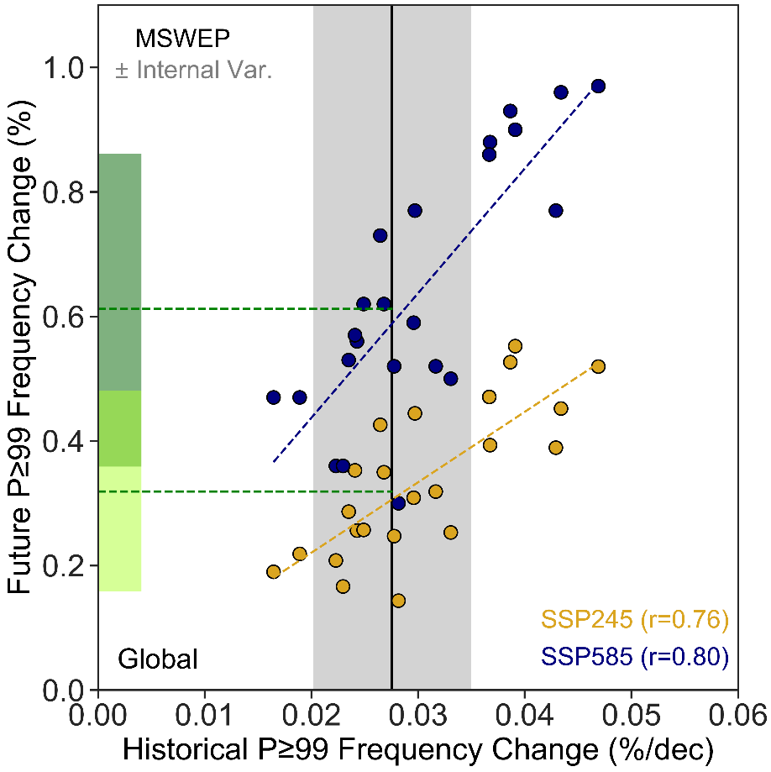
Constraining the increased frequency of global precipitation extremes under warming
Scientific Achievement UCLA scientists developed an emergent constraint (EC) which can be used to reduce uncertainty in climate model projections of future heavy rainfall occurrence. The constraint reduces intermodel spread by 20-40% and suggests that historical global precipitation extremes will occur roughly 32 ± 8% more often than present by 2100 under a medium-emissions pathway (and 55 ± 13% under high-emissions). Significance & Impact
Climate change is causing more frequent and intense precipitation extremes; however, these changes are difficult to project. Our efforts to reduce this intermodel uncertainty rely on simulations and observations of the change in heavy rainfall over the past four decades. The EC suggests that the higher-end projections are unlikely based on the observed change. If we accept the Clausius-Clapeyron explanations, which drive future changes in precipitation, our results provide another independent line of evidence that in many models the climate sensitivity is too strong.
Relationship between the historical rate of global extreme precipitation frequency change and the future change in CMIP6 under two emissions scenarios. If a GCM provides more than one ensemble member, its ensemble mean change is calculated. Historical trends are calculated over the 1980-2017 period. Grey shading is used to illustrate uncertainty in GCM evaluation stemming from natural variability. In the absence of multiple observational products, we show a measure of natural variability derived from a subset of GCMs with at least 8 historical realizations (Table S1). Green shading indicates the 95% prediction interval (PI; range where a percentage of y values are likely to be found given x) for the frequency changes under climate change calculated following the hierarchical emergent constraint framework of Bowman et al. (2018).
Research Details The team compared the frequency change in heavy rainfall events over recent decades with the future change in multiple generations of climate models. Observations of historical change from MSWEP2 are used to assess model performance and form an emergent constraint on future change in heavy rainfall characteristics (both globally and across vast land areas).
Thackeray, C. W., A. Hall, J. Norris, and D. Chen, 2022: Constraining the increased frequency of global precipitation extremes under warming, Nature Clim. Chng., doi:10.1038/s41558-022-01329-1.

