Slide 1
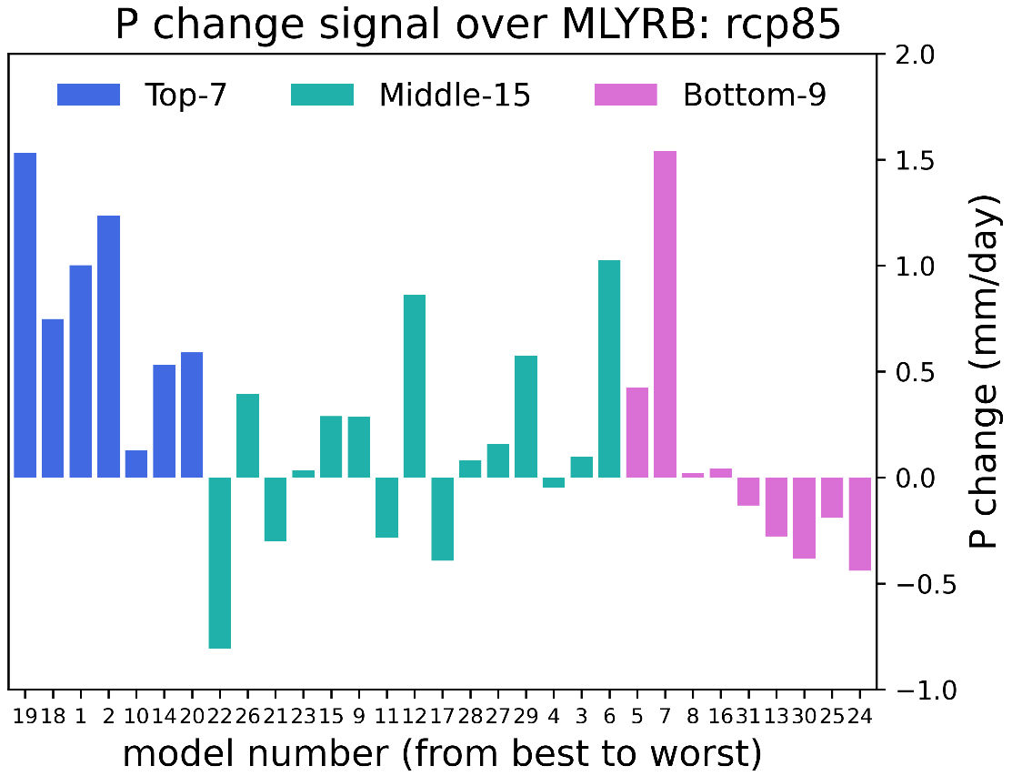
Generating Robust Precipitation Projections from Climate Models
Objective
Reduce uncertainty in the projection of future precipitation by developing metrics to select climate models with good performance simulating precipitation and its drivers.
Approach
Systematically and objectively evaluate climate model performance at simulating precipitation and its large-scale environment in East Asia.
Develop a two-dimensional metric that simultaneously accounts for model skill in simulating the above two aspects.
Compare model projections produced by models with a range of skill levels determined by the metric.
Impact
Using a novel two-dimensional metric of precipitation and its large-scale driver can reduce uncertainty in future projections of East Asian summer monsoon precipitation.
This work motivates future studies exploring the effectiveness of two-dimensional metrics for constraining future precipitation projections in other regions.
Thirty-one climate models are ranked based on their simulated precipitation (P) and P-related processes in East Asia. The top-performing models (in blue) show consistent increases in future precipitation change, while the middle- and bottom-performing groups significantly disagree in their projections.
Wang, L., Qian, Y., Leung, L. R., Chen, X., Sarangi, C., Lu, J., et al. 2021. “Multiple metrics informed projections of future precipitation in China,” Geophysical Research Letters, 48, e2021GL093810.
DOI: 10.1029/2021GL093810

