Slide 1
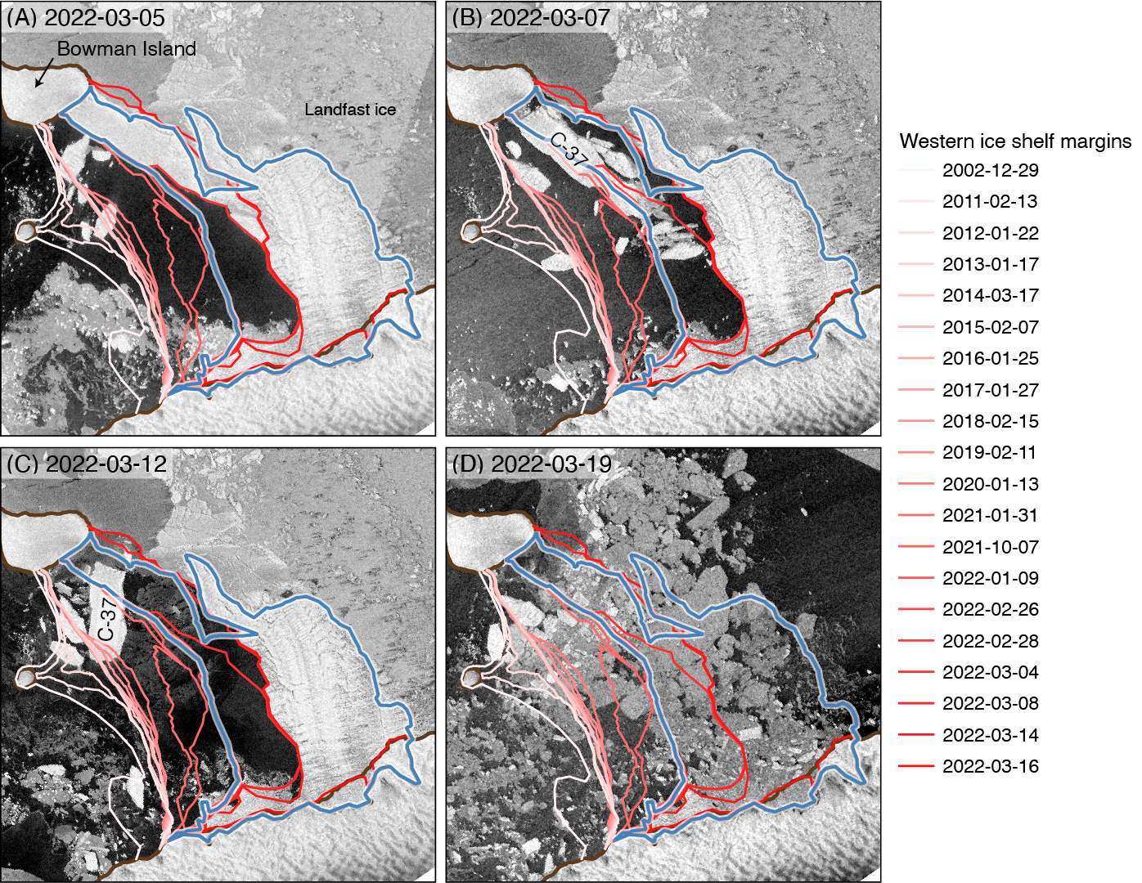
The extraordinary March 2022 East Antarctica “heat” wave, Part II: impacts on the Antarctic ice sheet
Wille, J. D., and Coauthors, including Shields, C.A. 2023: The extraordinary March 2022 East Antarctica “heat” wave. Part II: impacts on the Antarctic ice sheet. J. Climate, https://doi.org/10.1175/JCLI-D-23-0176.1, in press.
OBJECTIVE
Analyze the exceptional heatwave (30-40ºC temperature anomalies across the ice sheet) that occurred between March 15-19, 2022 over East Antarctica. In Part II, the widespread and diverse impacts driven by the AR landfall are explored.
Figure: Twenty years of progressive Conger Ice Shelf retreat followed by its abrupt and near-total collapse in March 2022 as seen in Sentinel 1 radar imagery. Western ice shelf margins over 2002-2022 determined via Landsat imagery. Blue line indicates full ice shelf extent on February 22, 2022. Panels correspond to image dates with (a) March 5, (b) March 7, (c) March 12, and (d) March 19. Brown lines show coastlines and ice sheet grounding lines.
APPROACH
Publishing this study was only possible due to massive international collaboration (54 scientists in 14 countries) that facilitated rapid access to various datasets including reanalysis, models, and station instrumentation.
IMPACT
Antarctic cryosphere is highly sensitive to meteorological extremes originating from the mid- latitudes and sub-tropics. Despite the large positive temperature anomalies driven from strong downward longwave radiation, this event led to huge amounts of snowfall across the Antarctic interior desert. The isotopes in this snow of warm airmass origin will likely be detectable in future ice cores and potentially distort past climate reconstructions. Even measurements of space activity were affected. Also the swells generated from this storm helped trigger the final collapse of an already critically unstable Conger Ice Shelf while further degrading sea-ice coverage.

