Slide 1
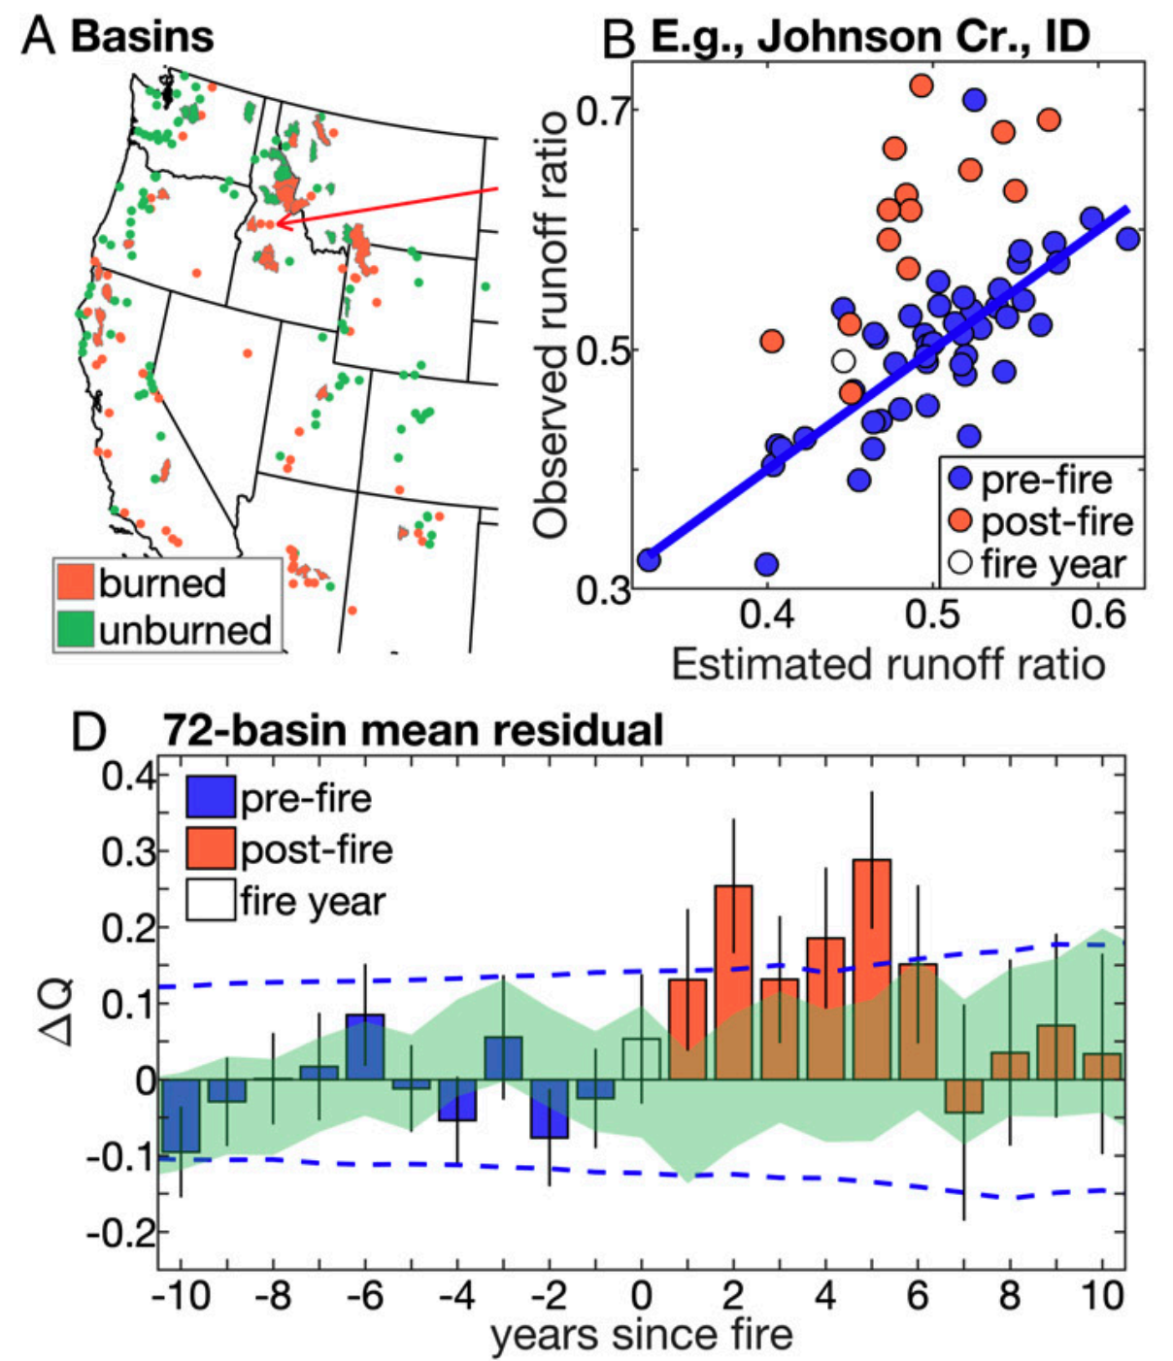
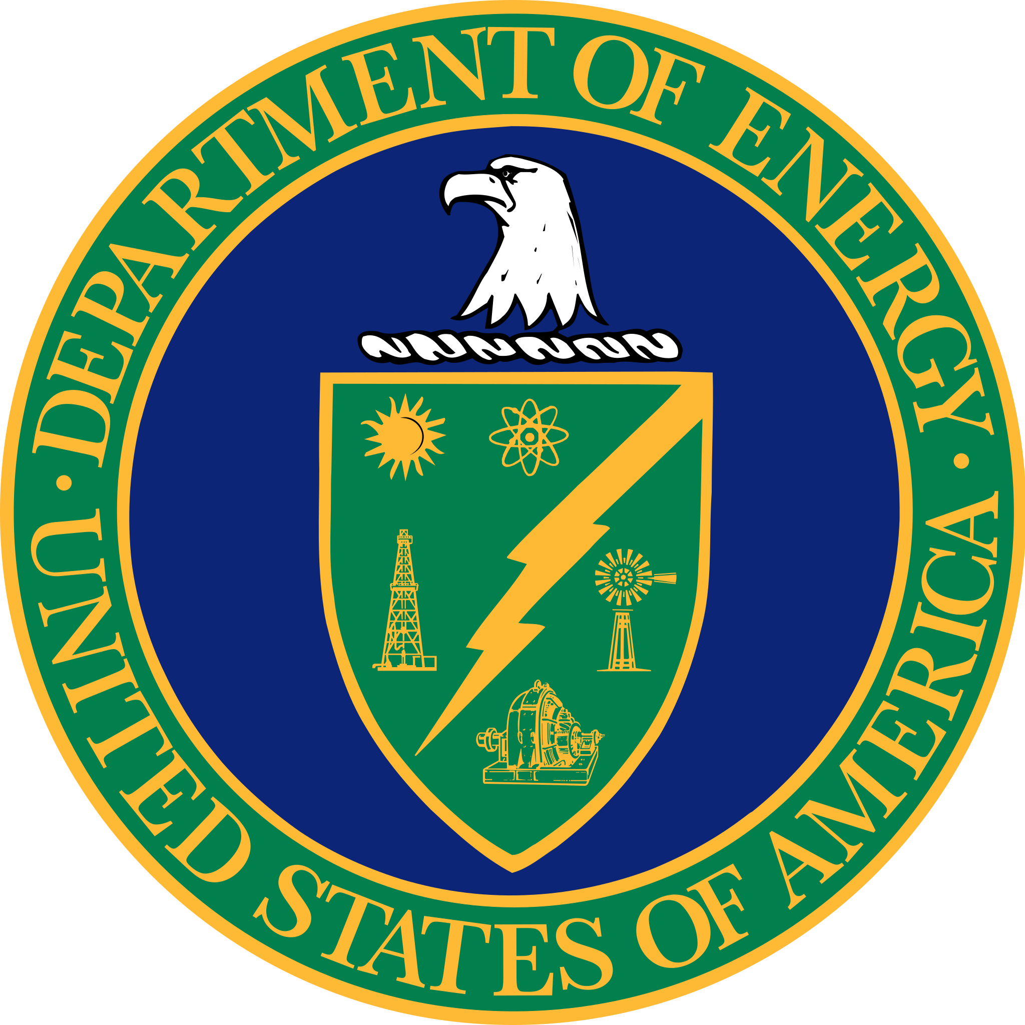
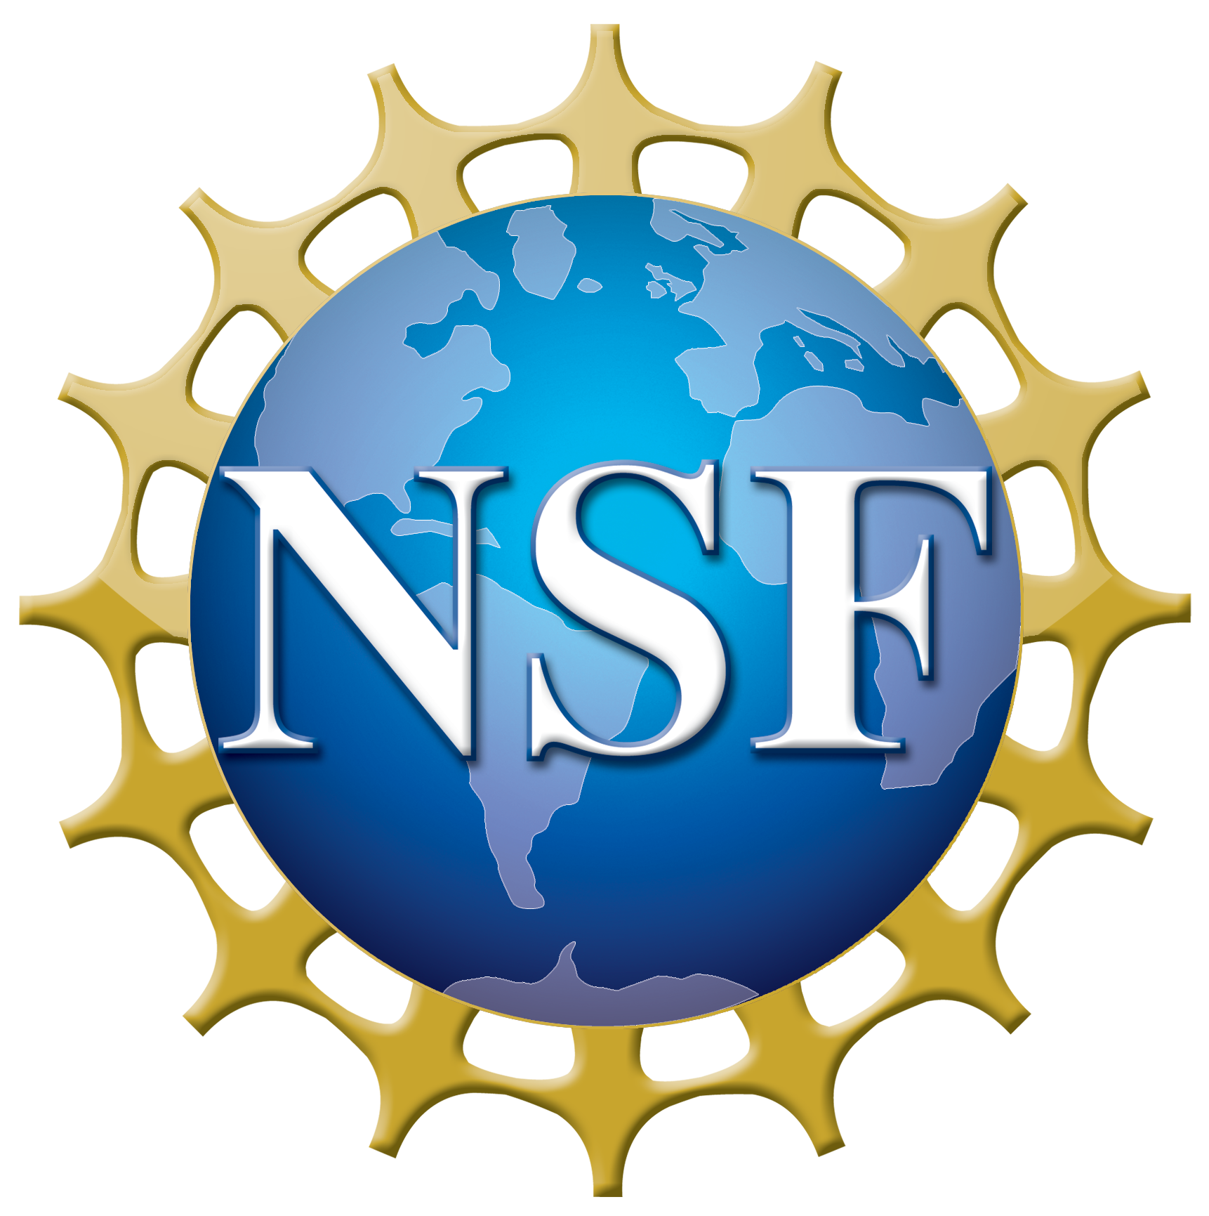
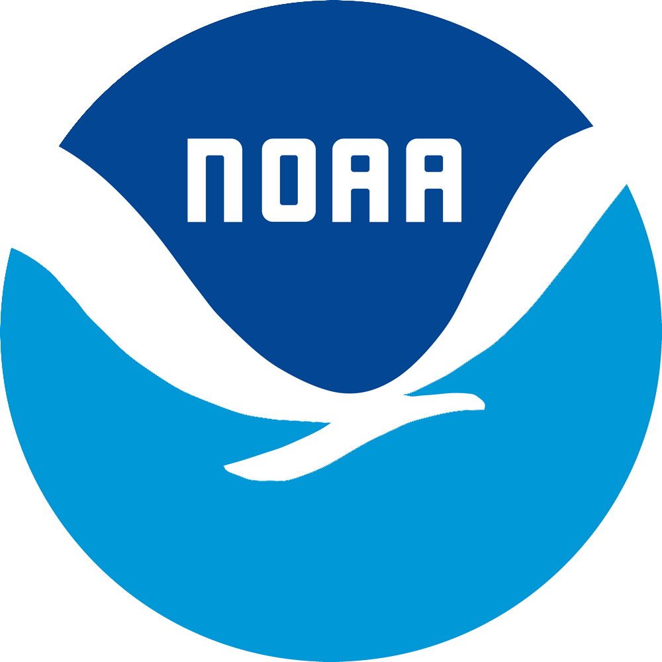
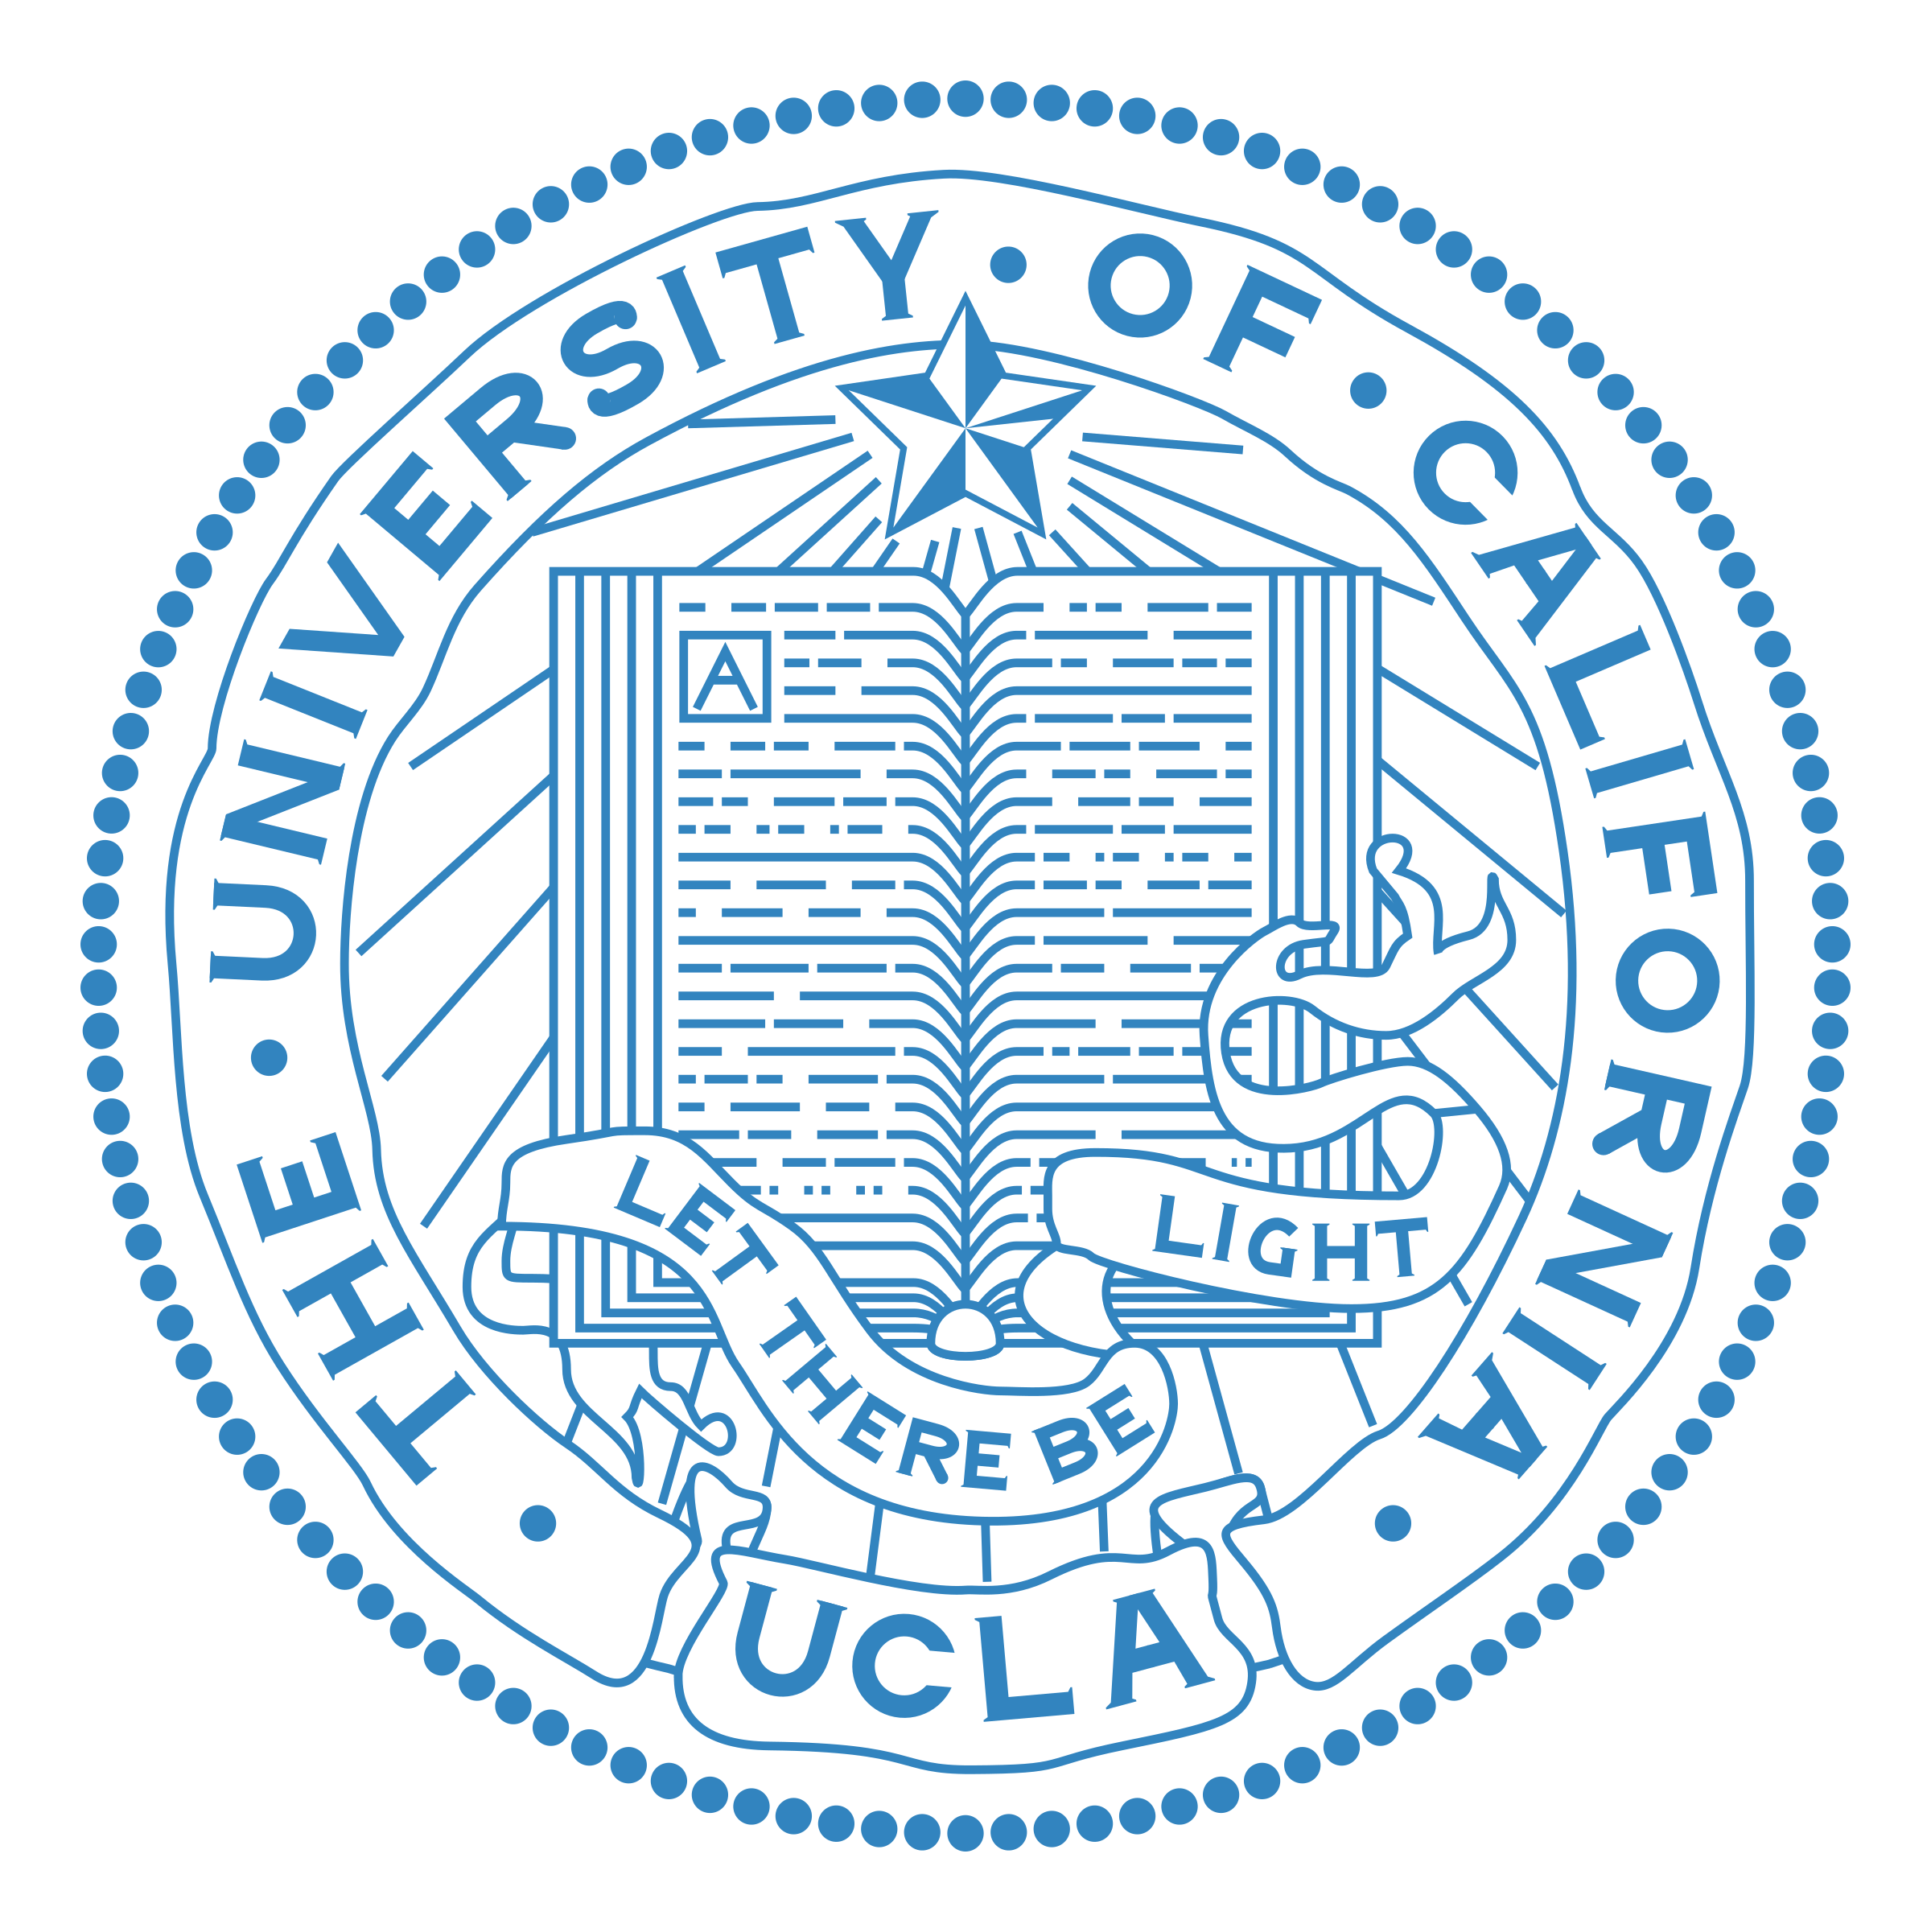
Growing impact of wildfire on western US water supply
Williams, A. P., Livneh, B., McKinnon, K. A., et al., 2022, Proceedings of the National Academy of Sciences, 119(10), e2114069119.
Objective
Wildfire is an emerging driver of runoff change that will increasingly alter climate impacts on water supplies and runoff-related risks. Streamflow often increases after fire, but the persistence of this effect and its importance to present and future regional water resources are unclear. We address this knowledge gap for the western United States, where annual forest fire area increased by more than 1,100% from 1984 to 2020.
Approach
We analyze 72 forested basins across the western US that burned between 1984 and 2019 and show the multibasin mean streamflow was significantly elevated for an average of 6 water years postfire, compared to the range of results expected from climate alone. We find that the streamflow response scales with fire extent: among the 29 basins where >20% of forest area burned in a year, streamflow over the first 6 water years postfire increased by 30%. Postfire streamflow increases were significant in all four seasons.
Figure. Effect of forest fire on water year streamflow. (A) Map of 72 burned (orange) and 107 unburned (green) basins. (B) Observed versus estimated water year runoff ratio for Johnson Creek, ID (blue line indicates prefire regression line). (D) Average runoff among burned basins in years prior to (blue bars), during (clear bar), and after (orange bars) each basin’s fire year. Black vertical lines indicate 90% bounds on means. Blue dashed lines indicate inner 90%.
Impact
Historical fire-climate relationships combined with climate model projections suggest that 2021 to 2050 will see repeated years when climate is more fire-conducive than in 2020, the year currently holding the modern record for forest area burned in the western US. Our results suggest that burned areas will grow enough over the next 3 decades to enhance streamflow at regional scales.

