Slide 1
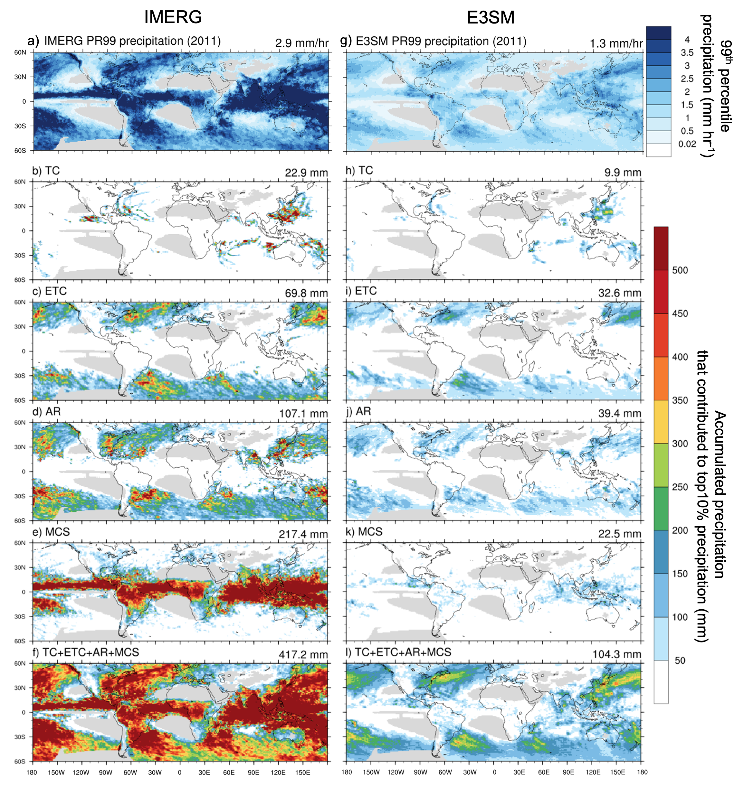
Using Storm Tracking to Evaluate E3SM Short-range Hindcasts
Science Question
How much global annual mean precipitation is associated with four major heavy-precipitating storm systems (tropical cyclones, extratropical cyclones, atmospheric rivers, and mesoscale convective systems)?
What are spatiotemporal characteristics of the storm-associated precipitation?
How well does the E3SM simulate the storm-associated precipitation?
Key Accomplishments
We constructed a high-resolution global observational database for these four major heavy-rain storm systems. The database can be used for model diagnostics and climate resilience assessment.
These four storm systems contribute to over 67% of global annual mean precipitation and over 80% of top 1% precipitation extremes.
Our evaluation shows E3SMv2 short-range hindcasts underestimate the storm-associated precipitation, especially for heavy precipitation extremes.
Impact
This phenomenon-based approach provides a better understanding of precipitation characteristics and can lead to enhanced model evaluation by revealing underlying problems in model physics related to precipitation processes associated with the heavy-precipitating storms.
Wu, W.-Y., Ma, H.-Y., Lafferty, D. C., Feng, Z., Ullrich, P., Tang, Q., et al. (2024). Assessment of storm-associated precipitation and its extremes using observational data sets and climate model short-range hindcasts. Journal of Geophysical Research: Atmospheres, 129, e2023JD039697. https://doi.org/10.1029/2023JD039697
E3SM hindcasts underestimate the extreme precipitation and the contributions from the four heavy precipitating storms.

