Slide 1
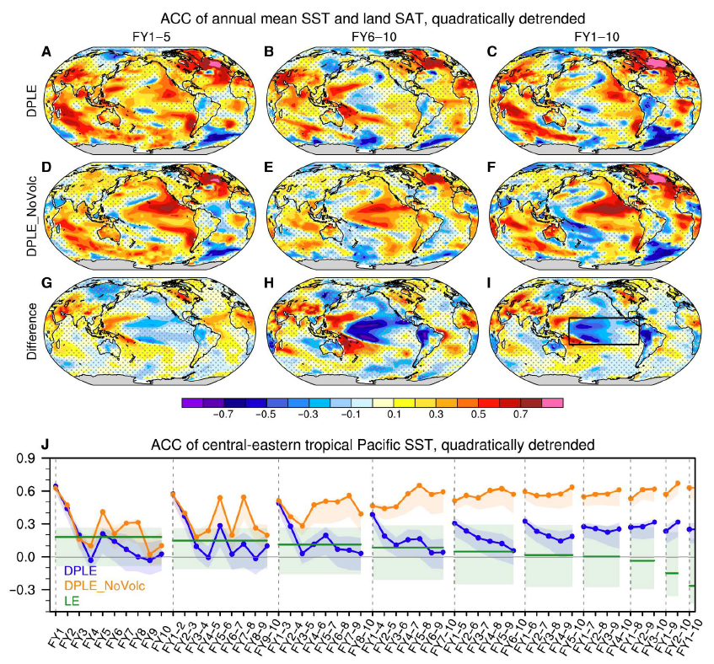
Volcanic forcing degrades multiyear-to-decadal prediction skill in the tropical Pacific
Wu, X., Yeager, S. G., Deser, C., Rosenbloom, N., and Meehl, G., Science Advances, 9, eadd9364, https://doi.org/10.1126/sciadv.add9364 (2023)
OBJECTIVE
To comprehensively explore the sensitivity of decadal prediction skill to volcanic aerosol forcing.
APPROACH
The 40-member CESM-DPLE hindcast set (1954-2015) is compared to an equivalent 10-member set that excludes volcanic forcing. Ensemble size differences are taken into account by subsampling members of DPLE.
IMPACT
The NoVolc hindcast set shows high skill in the central tropical Pacific where the control hindcast set shows little (or negative) skill. The skill difference increases with lead time and is maximum for multiyear averages. The implications are two-fold: 1) the CESM response to volcanic forcing is flawed, due to either forcing or model bias, and 2) there is potential to improve decadal prediction (and historical simulation) of Pacific variability by correcting this flaw. The work highlights the benefits of the initialized prediction framework for identifying model fidelity issues.

