Slide 1
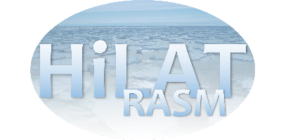
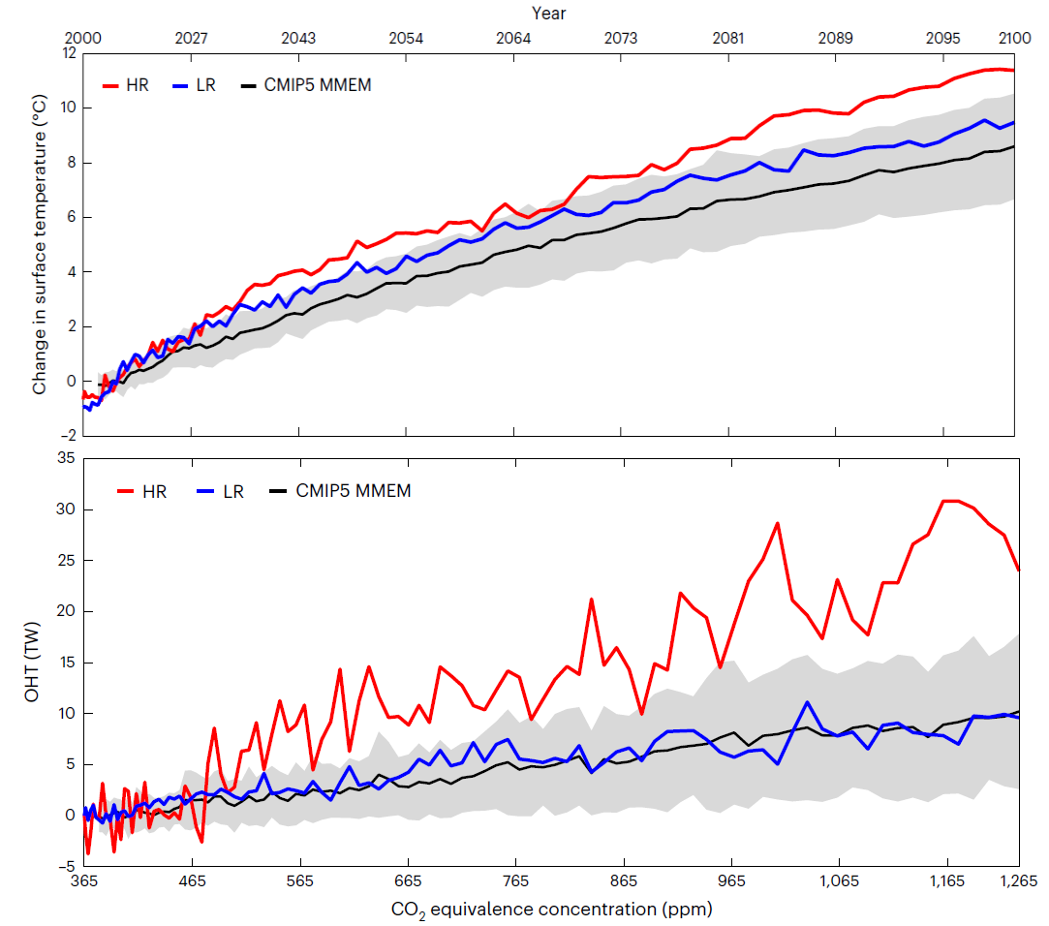
High-Resolution Modelling Identifies the Bering Strait’s Role in Amplified Arctic Warming
Objective
Explore the impact of ocean heat transport (OHT) through the Bering Strait on future Arctic warming.
Research
We analyze a 21st century scenario simulation (RCP8.5) with a high-resolution (HR) and low-resolution (LR) configuration of the Community Earth System Model (CESM1.3).
We compare the Arctic warming response in these simulations with the CMIP5 ensemble.
Impact
We demonstrate that a high-resolution climate model, which faithfully represents Bering Strait transport, has stronger ocean heat transport through the Bering Strait, and stronger 21st Century warming than any low-resolution model from the CMIP5 generation.
We conclude that faithfully representing Bering Strait throughflow in a climate model is critical for accurate projections of future Arctic warming.
Projected Arctic warming (top) and ocean heat transport through the Bering Strait (bottom), for the high-resolution (HR; red) and low-resolution (LR; blue) configurations of the Community Earth System Model (CESM), and for the CMIP6 ensemble (black line: ensemble mean; gray shading: ensemble spread). We argue that faster Arctic warming in CESM-HR is caused by the stronger increase in ocean heat transport through the Bering Strait, which is more faithfully represented in the high-resolution model.
Xu, G., Rencurrel, M.C., Chang, P., Liu, X., Danabasoglu, G., Yeager, S.G., Steele, M., Weijer, W., Li, Y., Rosenbloom, N., Castruccio, F., and Zhang, Q., 2024. High-resolution modelling identifies the Bering Strait’s role in amplified Arctic warming. Nature Climate Change, pp.1-8. doi: 10.1038/s41558-024-02008-z

