Slide 1
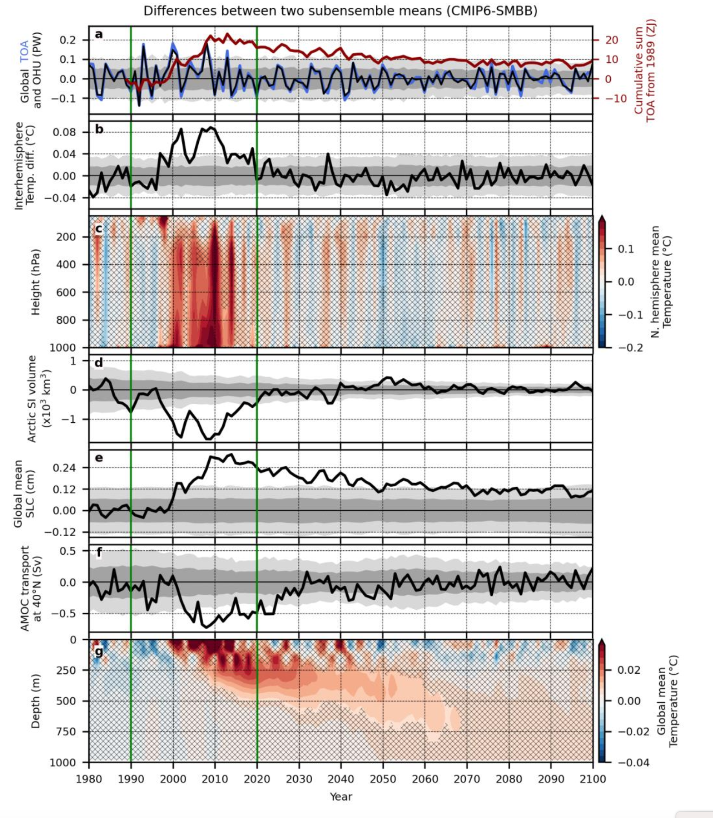
Persistent ocean anomalies as a response to northern hemisphere heating induced by biomass burning variability
Yamaguchi, R., Kim, J. E., Rodgers, K. B., Stein, K., Timmermann, A., Lee Sun-Seon Lee, L.Huang, M. F. Stuecker, J. T. Fasullo, G. Danabasoglu, C. Deser, J.-F. Lamarque, N. Rosenbloom, N. & Edwards, J. (2023). Persistent ocean anomalies as a response to Northern Hemisphere heating induced by biomass burning variability. J. Clim., doi: 10.1175/JCLI-D-23-0090.1.
OBJECTIVE
The CMIP6 prescribed biomass emissions have been shown to have an unintended climate response in CESM2. Here the associated response in the ocean is examined and found to persist well into the 21st Century, complicating assessments of climate change for users of the ensemble.
Responses to CMIP Biomass. Differences in subensemble means (CMIP6 minus SMBB) for (a) globally integrated top of atmosphere radiation imbalance (TOA, blue line) and ocean heat uptake (OHU i.e., net ocean surface heat flux, black line), (b) interhemispheric difference in column-mean atmospheric temperature (NH minus SH), (c) NH mean atmospheric temperature profiles, (d) Arctic sea ice (SI) volume, (e) global mean steric sea level change (SLC, estimated from sea water density changes), (f) AMOC maximum transport at 40°N
APPROACH
To subensembles of the CESM2 Large Ensemble, one with CMIP6 prescribed biomass emissions and one with a smoothed version of the emissions, are compared to assess the climate response to biomass burning. A range of fields are assessed including top of atmosphere radiation, sea level, ocean heat content, the Atlantic Meridional Overturning Circulation (AMOC) and ocean temperature.
IMPACT
Biomass burning aerosol (BBA) emissions in the Coupled Model Intercomparison Project Phase 6 (CMIP6) historical forcing fields have enhanced temporal variability during the years 1997–2014, when they are estimated from satellite. The variability drives elevated warming relative to the pre-satellite period that is stored in the ocean, impacts sea ice and ocean currents in the Pacific and Atlantic (AMOC) Ocean, and lasts into the late 21st Century, complicating assessments of climate change.

Slide 2
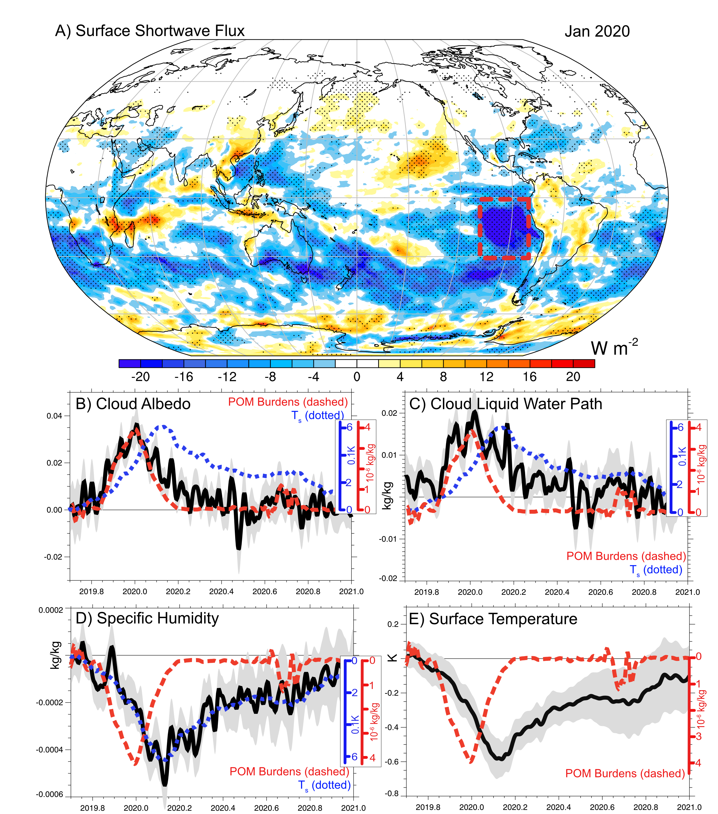
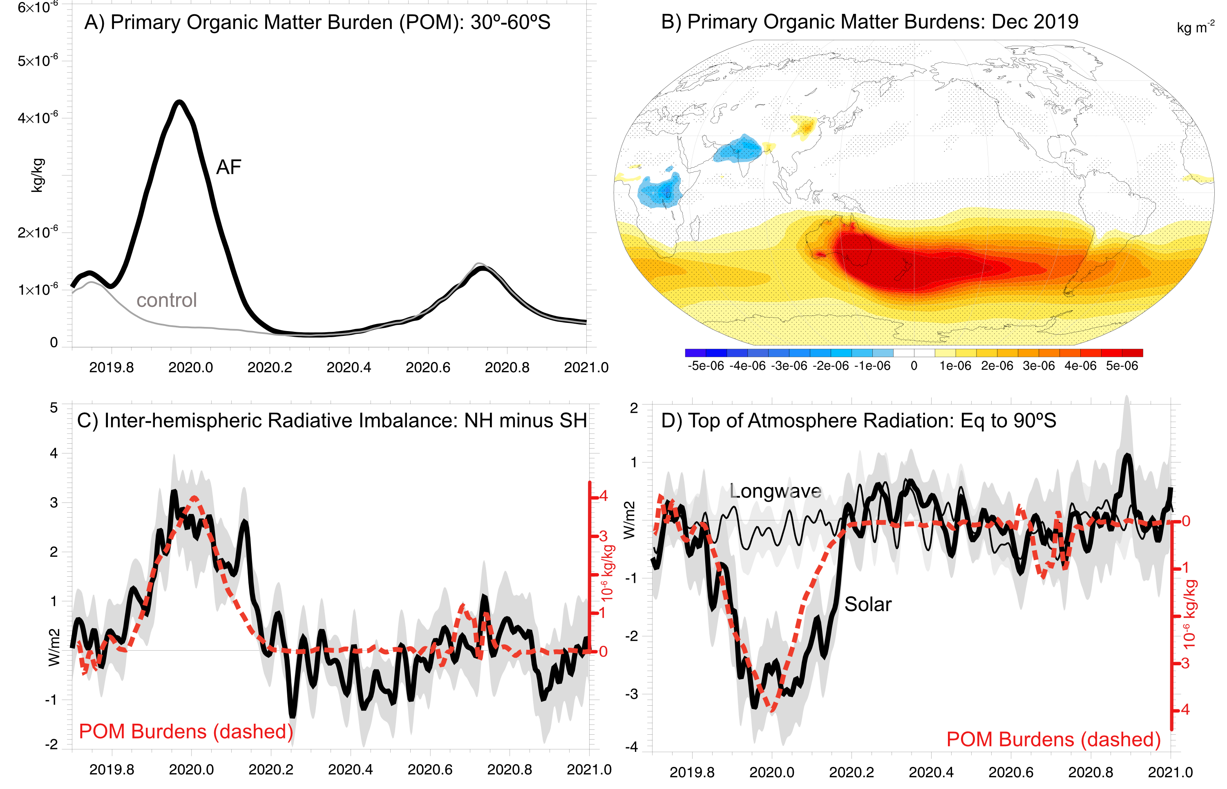
Large-Scale Responses
Eastern Pacific Responses

Slide 3
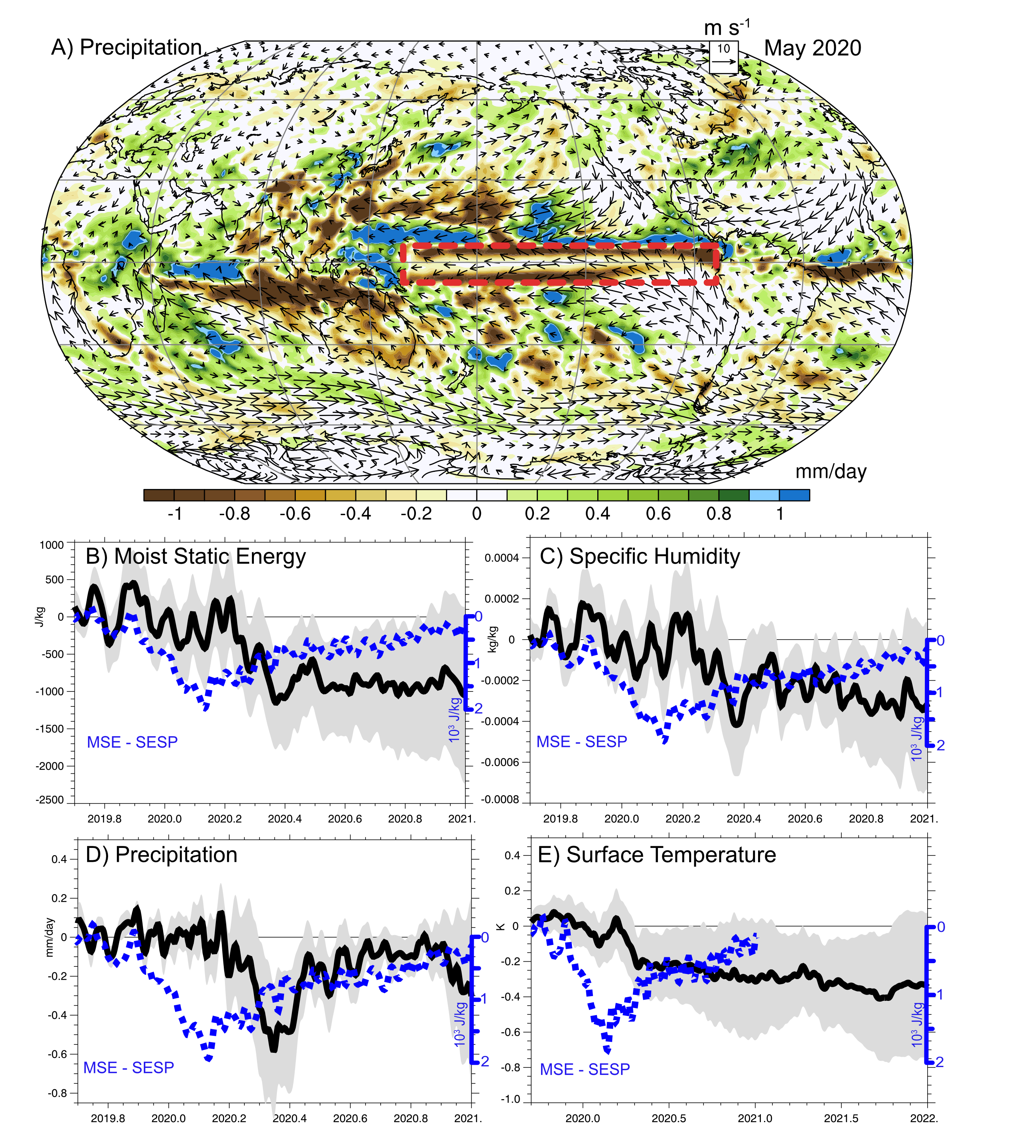
Equatorial Pacific Responses

