Slide 1
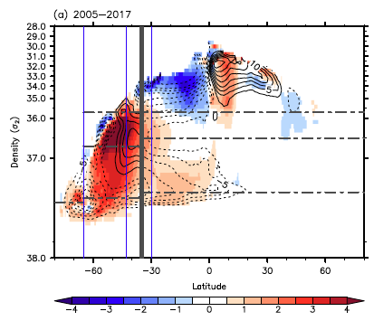
Human-induced changes in the global meridional overturning circulation are emerging from the Southern Ocean
S.-K. Lee, R. Lumpkin, F. Gomez, S. Yeager, H. Lopez, F. Takglis, S. Dong, W. Aguiar, D. Kim, & M. Baringer, 2023: Commun Earth Environ, https://doi.org/10.1038/s43247-023-00727-3
OBJECTIVE
The overturning circulation in the ocean is expected to change in response to anthropogenic forcings, but the lack of direct long-term monitoring makes it challenging to detect human-induced change. A diagnostic modeling approach is used here to demonstrate that Southern Ocean overturning has undergone significant interdecadal change since the mid-20th century.
APPROACH
The CESM1 ocean and sea ice components at 1° resolution are forced with ERA5 reanalysis data and relaxed to decadally averaged World Ocean Atlas 2018 climatology between 1955 to 2017 to obtain decadal snapshots of global meridional overturning circulation (GMOC) evolution consistent with in situ observations.
IMPACT
We find that significant changes in GMOC are detectable in the Southern Ocean in response to strengthened SH westerlies caused by ozone depletion and increasing atmospheric CO₂. There is evidence that a large-scale readjustment of the GMOC is underway in the South Atlantic and Indo-Pacific Oceans since the mid-2000s in response to Southern Ocean changes.
GMOC volume transport streamfunction (contours) and its change relative to 1955-1974 (colors) in the Southern Ocean (south of 35°S) and the Indo-Pacific Ocean (north of 35°S).

