Slide 1
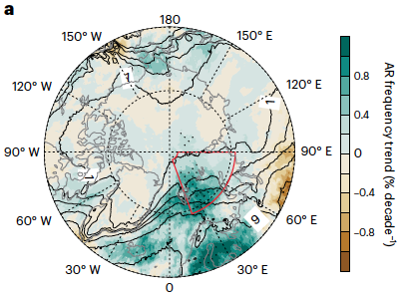
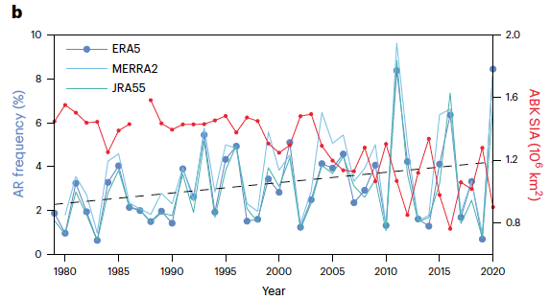
More Frequent Atmospheric Rivers Slow the Seasonal Recovery of Arctic Sea Ice
Objective
Examine the link between increasing atmospheric rivers (ARs) reaching the Arctic and the Arctic sea ice decline in winter during the recent decades and determine the relative roles of anthropogenic forcing and natural variability in the observed AR changes.
Approach
Use data derived from satellite remote sensing and atmospheric reanalysis datasets to build a quantitative linkage between Arctic AR occurrences and the sea ice growth anomaly in the Barents-Kara Seas and the neighboring central Arctic (ABK) in winter.
Use a series of large ensemble experiments, including simulations of historical human forcing and simulations that further include part of the observed climate natural variability, to determine the drivers of Arctic AR changes.
Impact
In recent decades, the European Arctic has been affected by more frequent ARs. The moisture carried by these ARs induces a strong melting effect on thin, fragile sea ice recovering from the summer melt.
By preventing sea ice from growing to the fullest extent allowed by freezing surface temperatures, the increase in ARs reaching the Arctic accounts for ~34% of the total sea ice coverage decline from 1979-2021.
Modeling experiments suggest that both anthropogenic forcing and natural variability are responsible for the AR changes in the Arctic in the recent decades.
As ARs are accompanied by heavy precipitation and strong wind, more frequent ARs may also increase ecosystem fragility and human exposure to natural hazards as the international ocean freight and fishing industries are expected to grow over the coming decades.
(a) AR frequency trends from the ERA5 reanalysis. (b) Area-averaged AR frequency time series in the ABK area (highlighted by the red outline in a) from three reanalysis datasets. The dashed grey line is the linear trend of the ensemble mean of the three datasets. The red line is the time series of the area sum sea-ice area (SIA) in the ABK.
Zhang, P., G. Chen, M. Ting, L.R. Leung, B. Guan, and L. Li. “More Frequent Atmospheric Rivers Slow the Seasonal Recovery of Arctic Sea Ice,” Nature Clim. Change, 13, 266–273 (2023). [DOI: 10.1038/s41558-023-01599-3]

