Slide 1
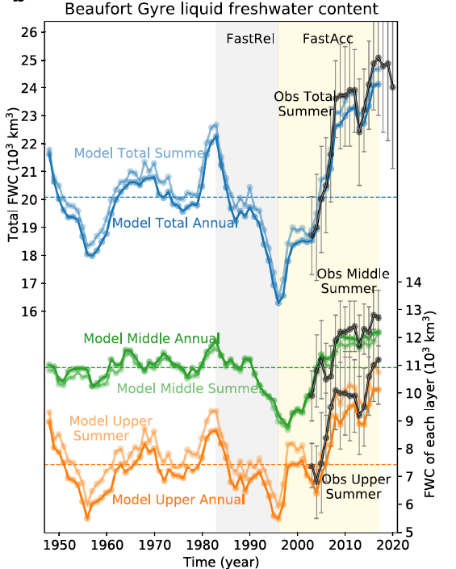
The Beaufort Gyre: Mean State and Response to Decadal Forcing
Objective
We study the processes responsible for exchanging relatively fresh water between the Beaufort Gyre and its surroundings
Research
We simulate the Beaufort Gyre in an ocean/sea ice configuration of E3SM-HiLAT
We study the volume budgets of different layers in the Beaufort Gyre
We find that Ekman transport driven by winds and ocean/sea ice coupling is a key process for the freshwater budget of the Beaufort Gyre.
Annual mean BG liquid freshwater content. Blue, orange, and green indicate the total, upper layer (S ≤ 30.4), and middle layer (30.4 < S ≤ 33.6). Climatological mean values over 1948–2017 are indicated by dashed horizontal lines.
Impact
The Beaufort Gyre has accumulated unprecedented amounts of freshwater in recent decades.
When released, it could impact ocean circulation at lower latitudes.
Understanding the processes through which the gyre accumulates and releases freshwater is important for our ability to anticipate the future release of the excess freshwater.
Zhang, J., Cheng, W., Steele, M., & Weijer, W. (2023). Asymmetrically Stratified Beaufort Gyre: Mean State and Response to Decadal Forcing. Geophysical Research Letters, 50(1), e2022GL100457.

