Slide 1
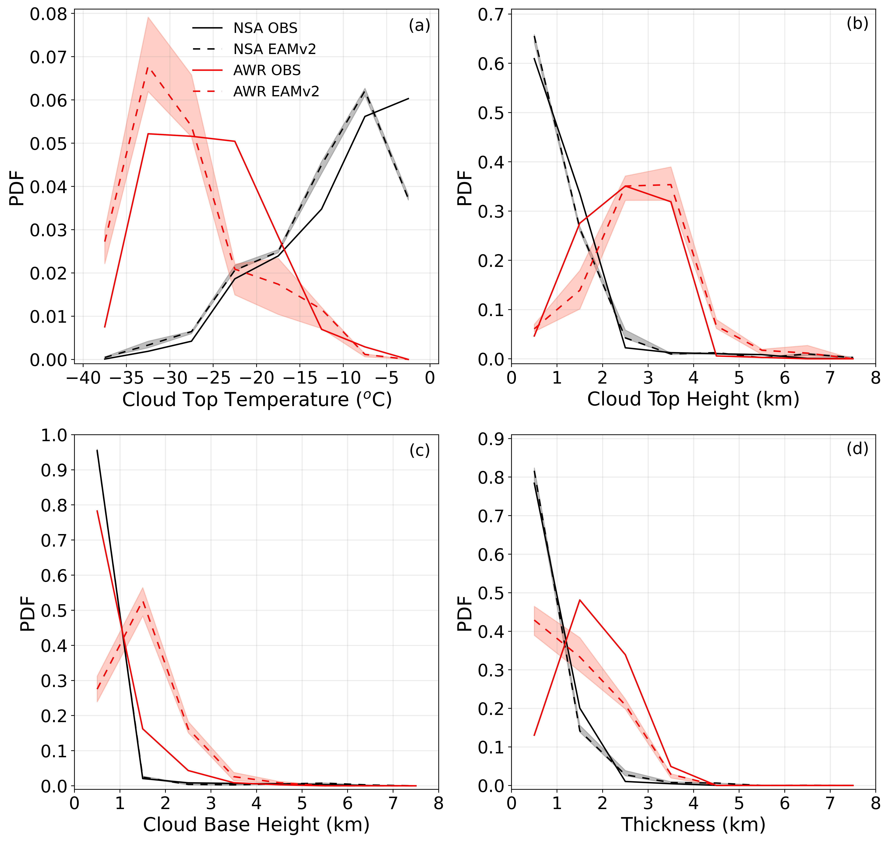
Evaluation of Arctic and Antarctic Mixed-Phase Cloud Properties in E3SMv2 using ARM Observations
Objective
Evaluate the simulation of stratiform mixed-phase cloud properties in the second version of Energy Exascale Earth System Model (E3SMv2) using ground-based remote sensing retrievals from the Atmospheric Radiation and Measurement (ARM) program at the North Slope of Alaska (NSA, Arctic) and McMurdo (AWR, Antarctic) sites.
Approach
Constrain the horizontal wind and temperature to ERA-Interim reanalysis data using the nudging approach in E3SMv2 simulation.
A novel sampling method is applied on simulated clouds to consistently define stratiform mixed-phase clouds as in the ARM retrievals. Then a collocation approach is used for a direct and consistent comparison between the model and observations.
Impact
The cloud morphology of E3SMv2 simulated stratiform mixed-phase clouds is comparable to the ARM retrievals at the NSA site, while larger biases are found at the AWR.
E3SMv2 well simulates the observed hemispheric differences in mixed-phase cloud morphology between the two high-latitude sites.
E3SMv2 simulated cloud phase is largely biased compared to the ARM retrievals, which shows an opposite hemispheric difference feature in supercooled liquid fraction relative to the observations.
Zhang, M., Xie, S., Liu, X., Zhang, D., Lin, W., Zhang, K., et al. (2023). Evaluating EAMv2 simulated high latitude clouds using ARM measurements in the Northern and Southern Hemispheres. Journal of Geophysical Research: Atmospheres, 128, e2022JD038364. https://doi.org/10.1029/2022JD038364
PDFs of observed and modeled cloud top temperature (a), cloud top height (b), cloud base height (c), and cloud thickness (d) for collocated cloud data between E3SMv2 (dashed line) and ARM retrievals (solid line). Black color represents the NSA site, and the red color represents the AWR site.

