Slide 1
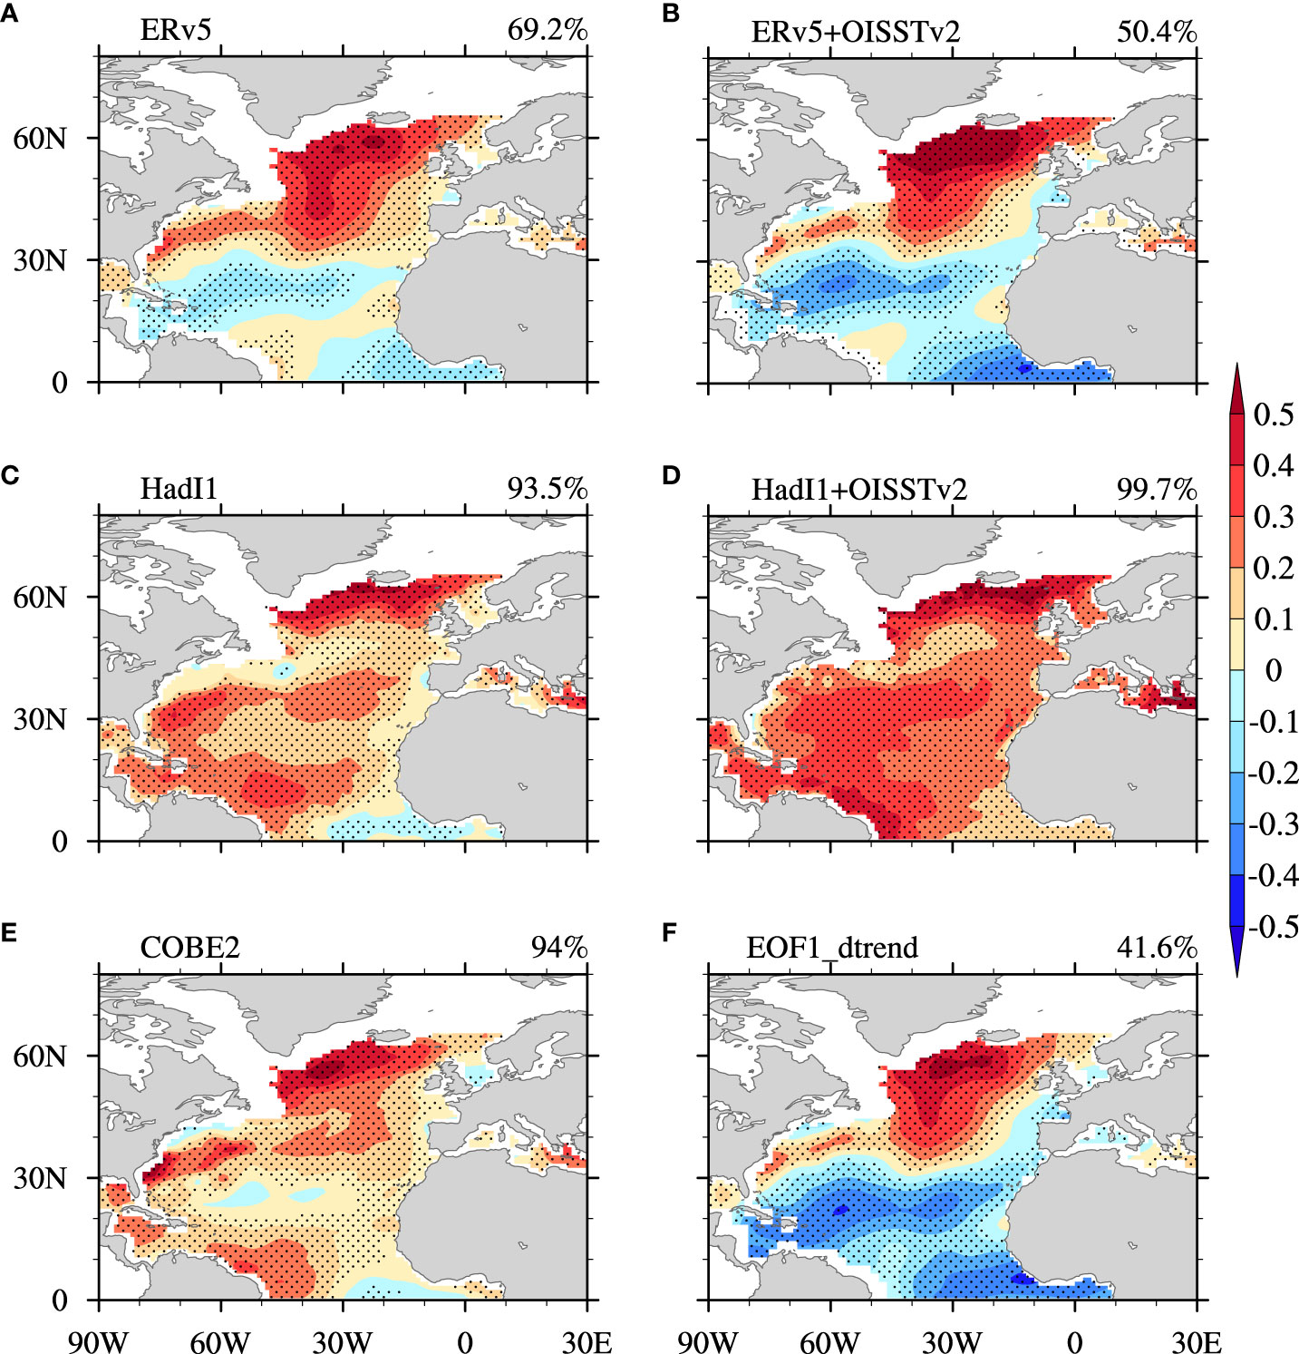
Uncertainty in Atlantic Multidecadal Oscillation derived from different observed datasets and their possible causes
Objective: As a leading mode of sea surface temperature (SST) variability over the North Atlantic in both observations and model simulations, the Atlantic Multidecadal Oscillation (AMO) can have a substantial influence on regional and global climate. By using Low-Frequency Component Analysis, we explore the uncertainties of the resulting AMO indices and the corresponding spatial patterns derived from three observational SST datasets.
Approach: Analyzing three sets of observation-based sea surface temperature (SST) and applied the Low-Frequency Component Analysis to extract the AMO time series and spatial pattern.
Results/Impacts: Uncovering the role of observational SST uncertainty that was resulted from mid-20th century bias adjustment in the observed AMO will help to understand the influence of ocean/atmosphere in shaping the AMO. It is shown that the ocean heat transport convergence seems to drive the tendency of AMO in a coherent AMO pattern (like COBESST2 or HadISST1). In contrast, in the incoherent AMO pattern, the atmosphere may become the driver of the AMO tendency. We suggest that to obtain a more coherent AMO pattern from ERv5 data, it is necessary to preprocess the monthly SST to an annual SST to cancel out the seasonal difference due to the bias correction. And if monthly SST data are employed, a 16-year low-pass filter is recommended in LFCA.
Figure 1. Spatial pattern of the AMO extracted by LFCA from different SST datasets over the period 1900–2019: (A, C, E) ERv5, HadI1, and COBE2, respectively. (B) ERv5 in 1900–1981 and OISSTv2 in 1982–2019. (D) HadI1 in 1900–1981 and OISSTv2 in 1982–2019. (F) Leading mode of LFCA after removing the first leading EOF mode and the principal component (i.e., the inhomogeneous warming trend) over the North Atlantic. The second/third leading low-frequency pattern and component of monthly SSTA in ERv5(COBE2)/HadI1 is the AMO pattern and index, respectively. The AMO CI from each dataset is denoted in the top-right corner of the figure. Dots indicate the value passes the 95% significance level. Unit: °C.
Zhao, B., P. Lin*, A. Hu*, H. Liu*, M. Ding, Z. Yu, Y. Yu, 2022, Uncertainty in Atlantic Multidecadal Oscillation derived from different observed datasets and their possible causes, Frontier in Marine Science, 9, 1007646, doi: 10.3389/fmars.2022.1007646.

