Slide 1
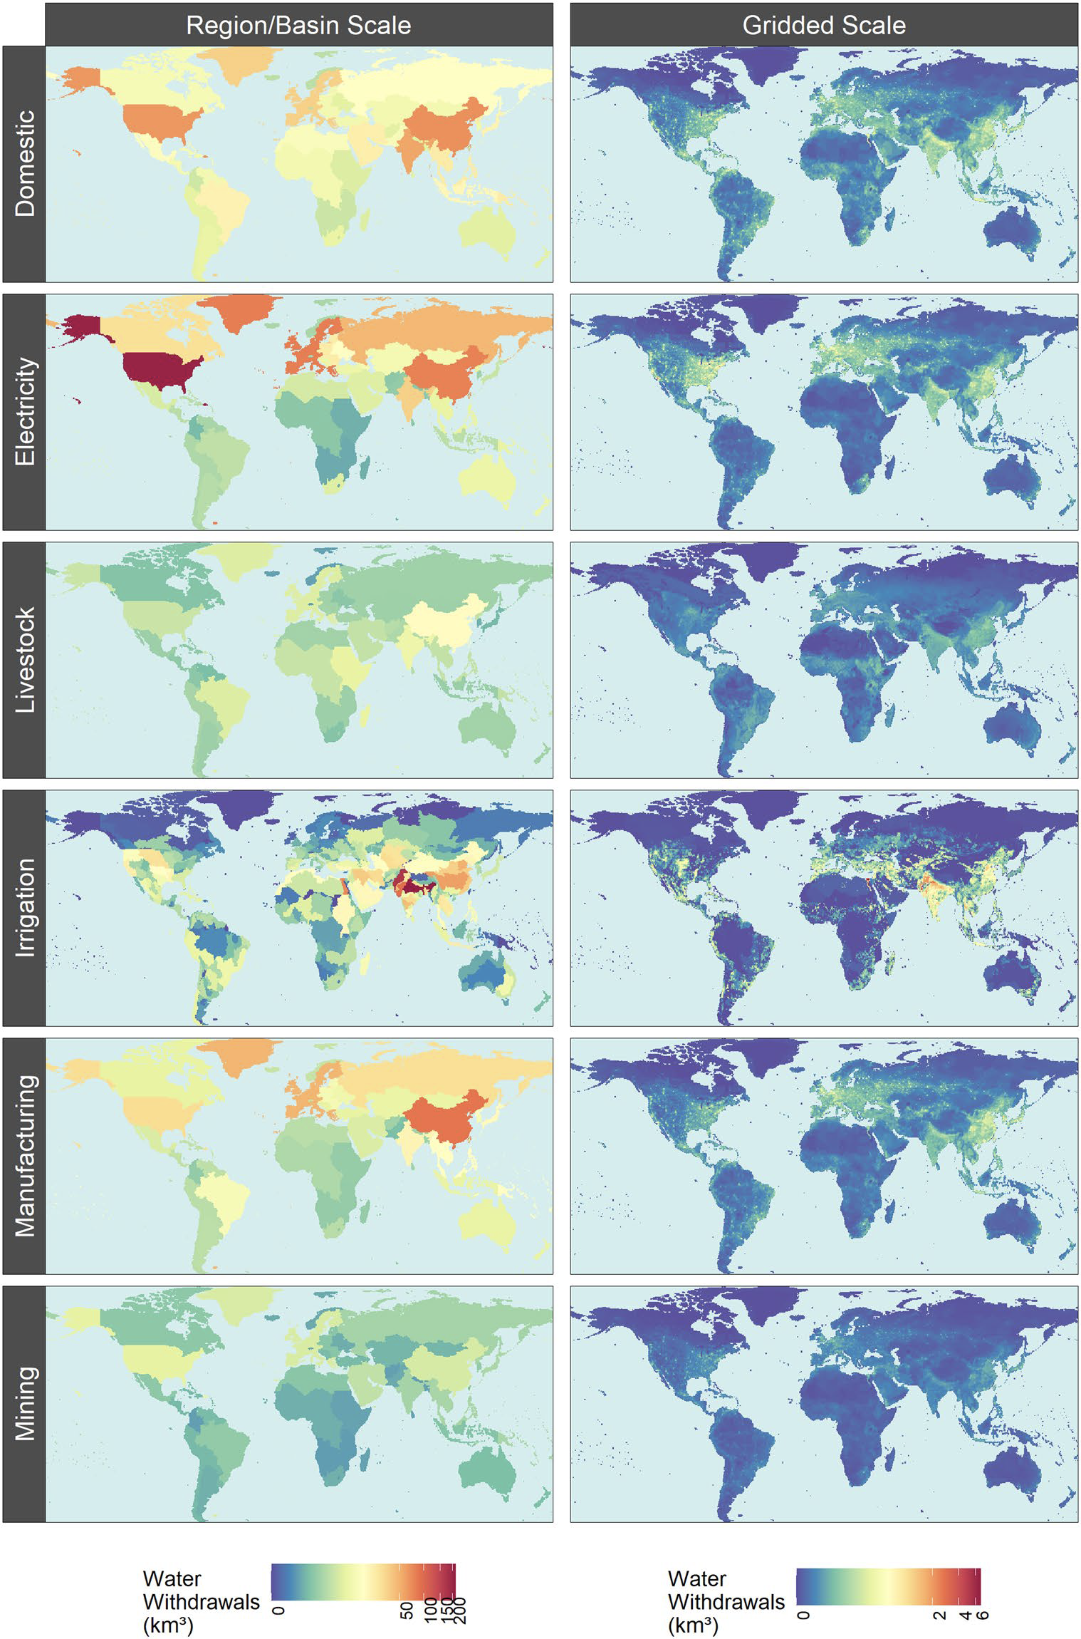
Navigating the Future of Global Water Use: A High-Resolution Analysis
Objective
Generate a global, gridded, monthly sectoral water withdrawal and consumption dataset for 2010–2100 for a range of scenarios to support studies evaluating the implications of human and Earth system change on future global and regional water dynamics.
Approach
Couple the Global Change Analysis Model (GCAM) with a land use spatial downscaling model (Demeter), a global hydrologic framework (Xanthos), and a water withdrawal downscaling model (Tethys) to generate a global gridded monthly sectoral water use dataset.
Use 75 scenarios harmonized with Shared Socioeconomic Pathways and Representative Concentration Pathways to capture a range of futures reflecting diverse global change across the human and Earth systems.
Impact
The dataset quantifies global demand-side pressures on scarce water resources under various future scenarios, highlighting that future water scarcity is primarily driven by human demands rather than climate effects.
The research provides a transparent and open-source dataset with a fine spatiotemporal scale, capturing key drivers of future water scarcity and offering a more detailed understanding of irrigation water use by crop type.
The spatial downscaling of 2010 water withdrawals by sector from GCAM regions and basins to 0.5° × 0.5° grid cells. This helps researchers understand future water usage and scarcity at a finer spatiotemporal scale across diverse socioeconomic and climate scenarios.
Khan, Z., I. Thompson, C.R. Vernon, N.T. Graham, T.B. Wild, and M. Chen. “Global monthly sectoral water use for 2010–2100 at 0.5° resolution across alternative futures.” Sci. Data., 10(201), (2023). DOI: 10.1038/s41597-023-02086-2

