Slide 1
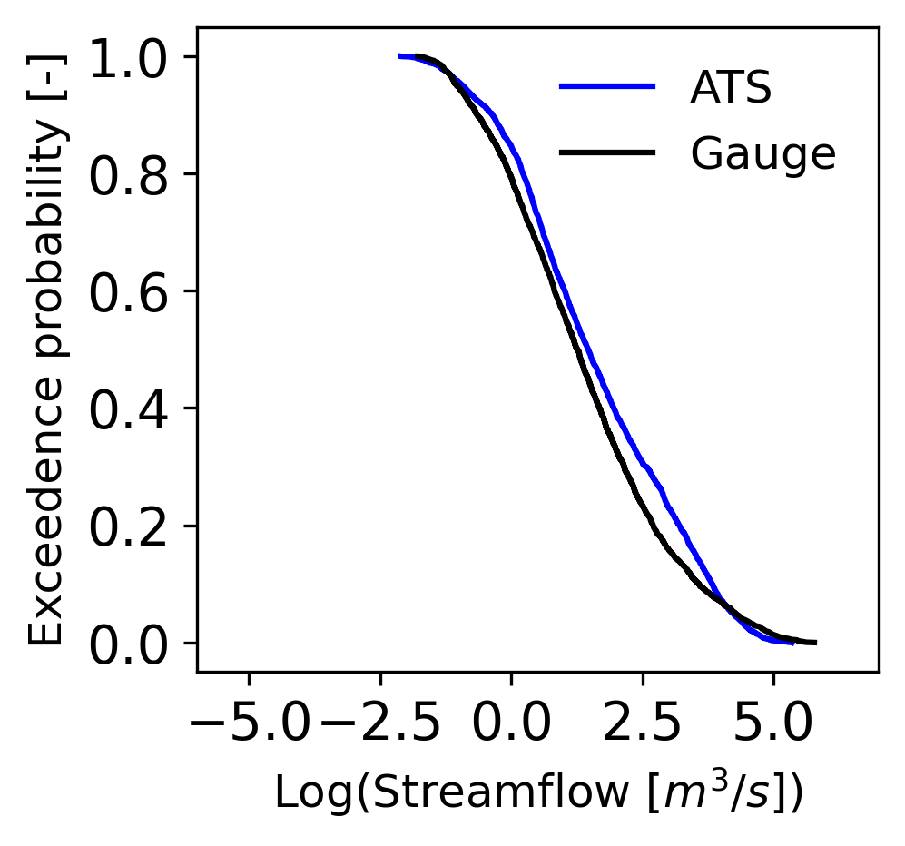
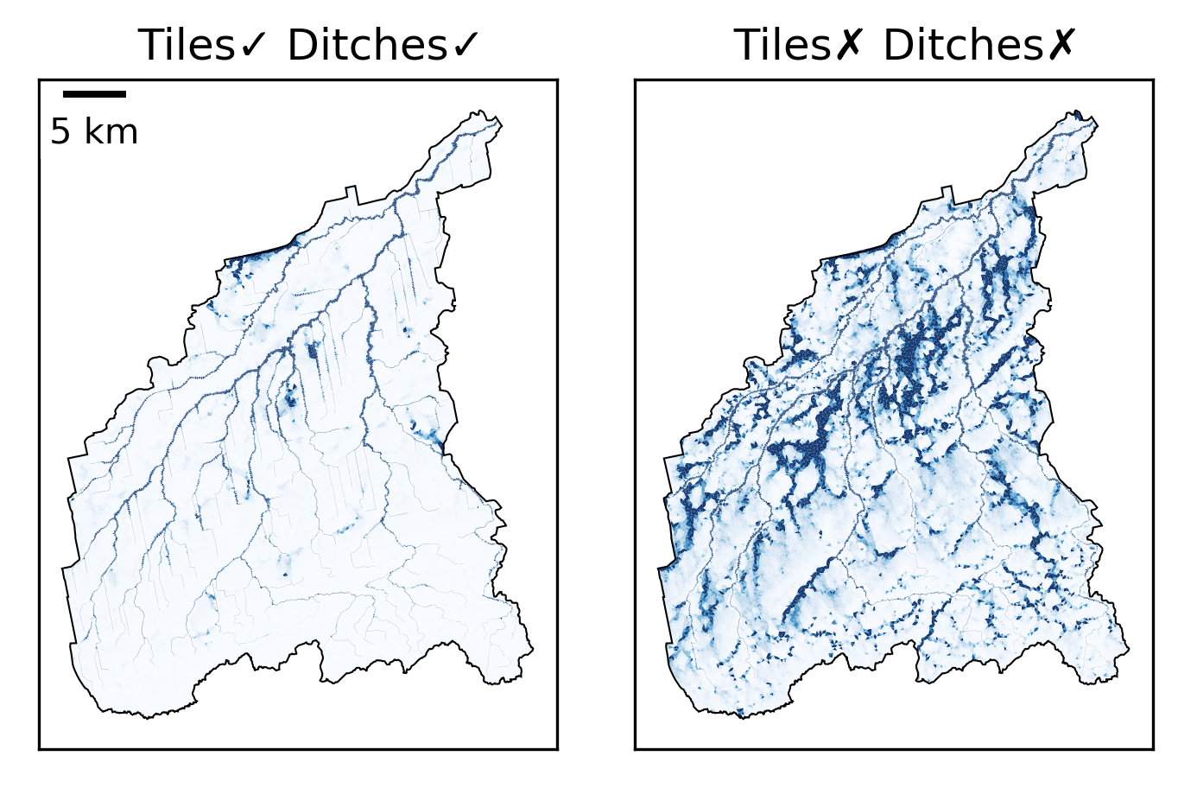
Modeling the Effects of Artificial Drainage on Agriculture-dominated Watersheds using a Fully Distributed Integrated Hydrology Model
Scientific Challenge
Subsurface tile drains and surface ditches have a dominant effect on the hydrology of agricultural watersheds, but those artificial drainage systems are challenging to represent in watershed-scale models.
a
Approach and Findings
﻿We implemented artificial drainage in the DOE-developed ATS hydrology simulator using a combination of explicit mesh refinement for surface ditches and physically based subgrid models for tile drains.
﻿Without site-specific calibration, this model accurately reproduced observed streamflow in the Portage River, OH, Watershed (>1000 km²), significantly outperforming a widely used semi-distributed model calibrated for the site.
b
c
Comparison of ATS-simulated streamflow and stream gauge data from Woodville, OH as (a) time series of streamflow and (b) exceedance probabilities of streamflow. The effect of tiles and ditches is seen in (c), which shows surface ponded depth with and without drainage.
Significance and Impact
New spatially resolved modeling approach for agricultural watersheds with strong physical underpinnings reduces the need for calibration and improves confidence in projections.
High-resolution spatially resolved simulation capacity provides a platform for studying watershed-scale hydrological response and nutrient transport in a changing climate.
Rathore, S. S., Svyatsky, D. S., Coon, E. T., Son, K., & Painter, S. L. (2024). Modeling the effects of artificial drainage on agriculture‐dominated watersheds using a fully distributed integrated hydrology model. Water Resources Research, 60, e2023WR035993. https://doi.org/10.1029/2023WR035993
Department of Energy • Office of Science • Biological and Environmental Research
Notes:
Word highlight text here.

