Slide 1
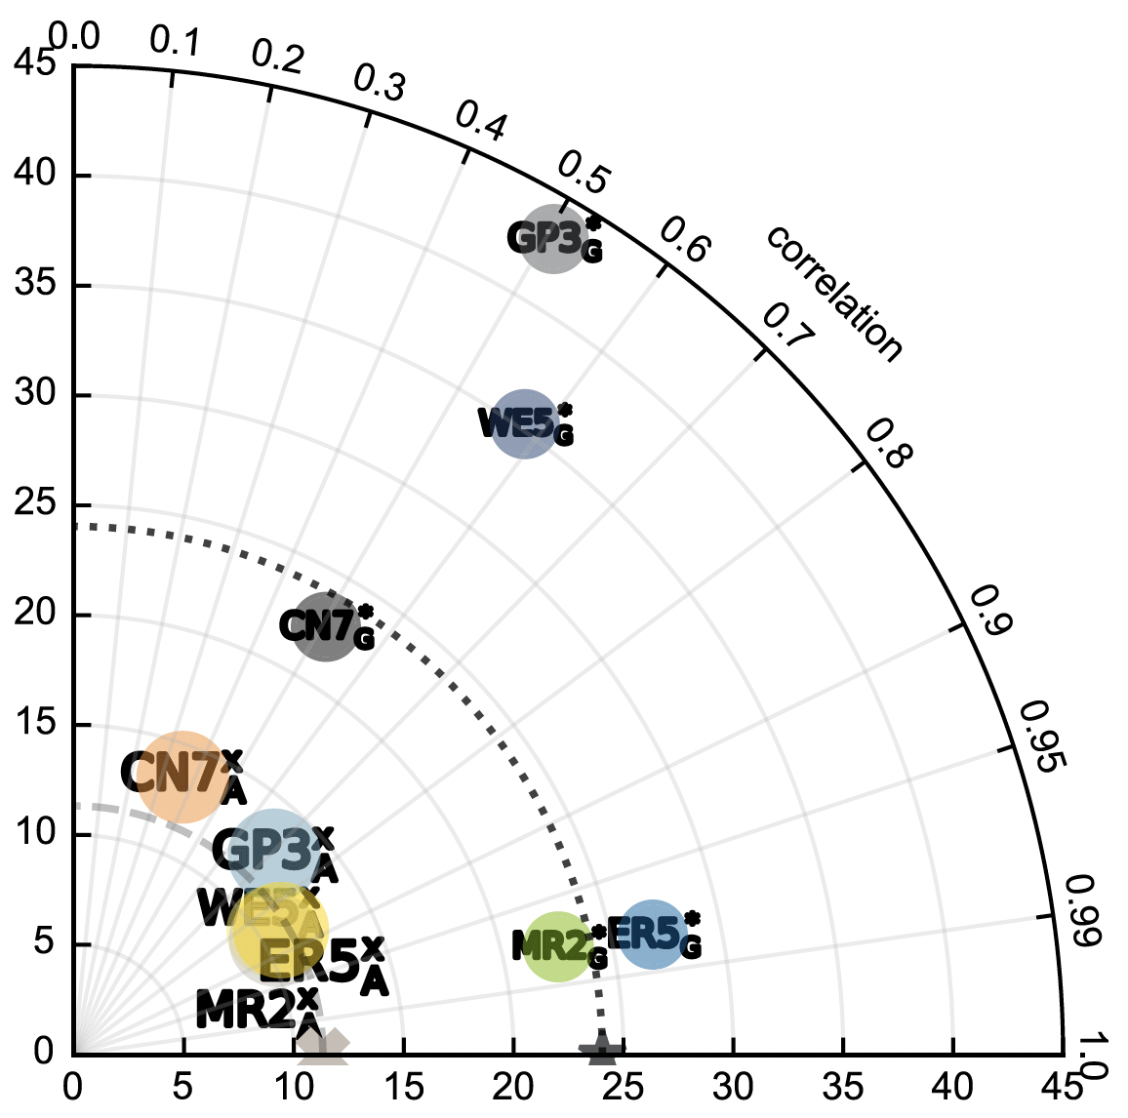
First Use of Shallow Ice Cores to Constrain Precipitation Over Ice Sheets
Scientific Challenge
The plurality of sea-level rise is due to Greenland ice-sheet (GrIS) surface melt, yet estimated ice-sheet snowfall, the source of the melt, varies widely among observational reanalyses. Which is best to use in ESMs?
Approach and Findings
Compare 1980s net accumulation (snowfall minus sublimation) from dry, shallow, ice cores (SUMup database) in Greenland and Antarctica (AIS) to 1980s reanalyses (CRUNCEP7, ERA5, GSWP3, MERRA2, WFDE5)
ERA5, MERRA2 strongly correlate (r²>95%) with GrIS, AIS ice cores
Other reanalyses are unfit for ESM surface mass balance studies
Figure
Significance and Impact
Researchers now know to spin-up snowpack in ESMs with ERA5 or MERRA2 to obtain realistic firn depth and air content required to project ice sheet, ice shelf, and sea-level rise responses to global warming
We implemented and now use ERA5 (instead of CRUNCEP7) in E3SM for more robust surface mass balance and sea-level rise studies.
Taylor diagram shows ERA5 (ER5), MERRA2 (MR2) agree best with GrIS, AIS SUMup data (dashed).
Schneider, A., C. S. Zender, N. L. Loeb, and S. F. Price (2023), Use of Shallow Ice Core Measurements to Evaluate and Constrain 1980—1990 Global Reanalyses of Ice Sheet Precipitation Rates, Geophys. Res. Lett., 50(19), e2023GL103943, doi:10.1029/2023GL103943.
Department of Energy • Office of Science • Biological and Environmental Research
Notes:
Word highlight text here.

