Slide 1
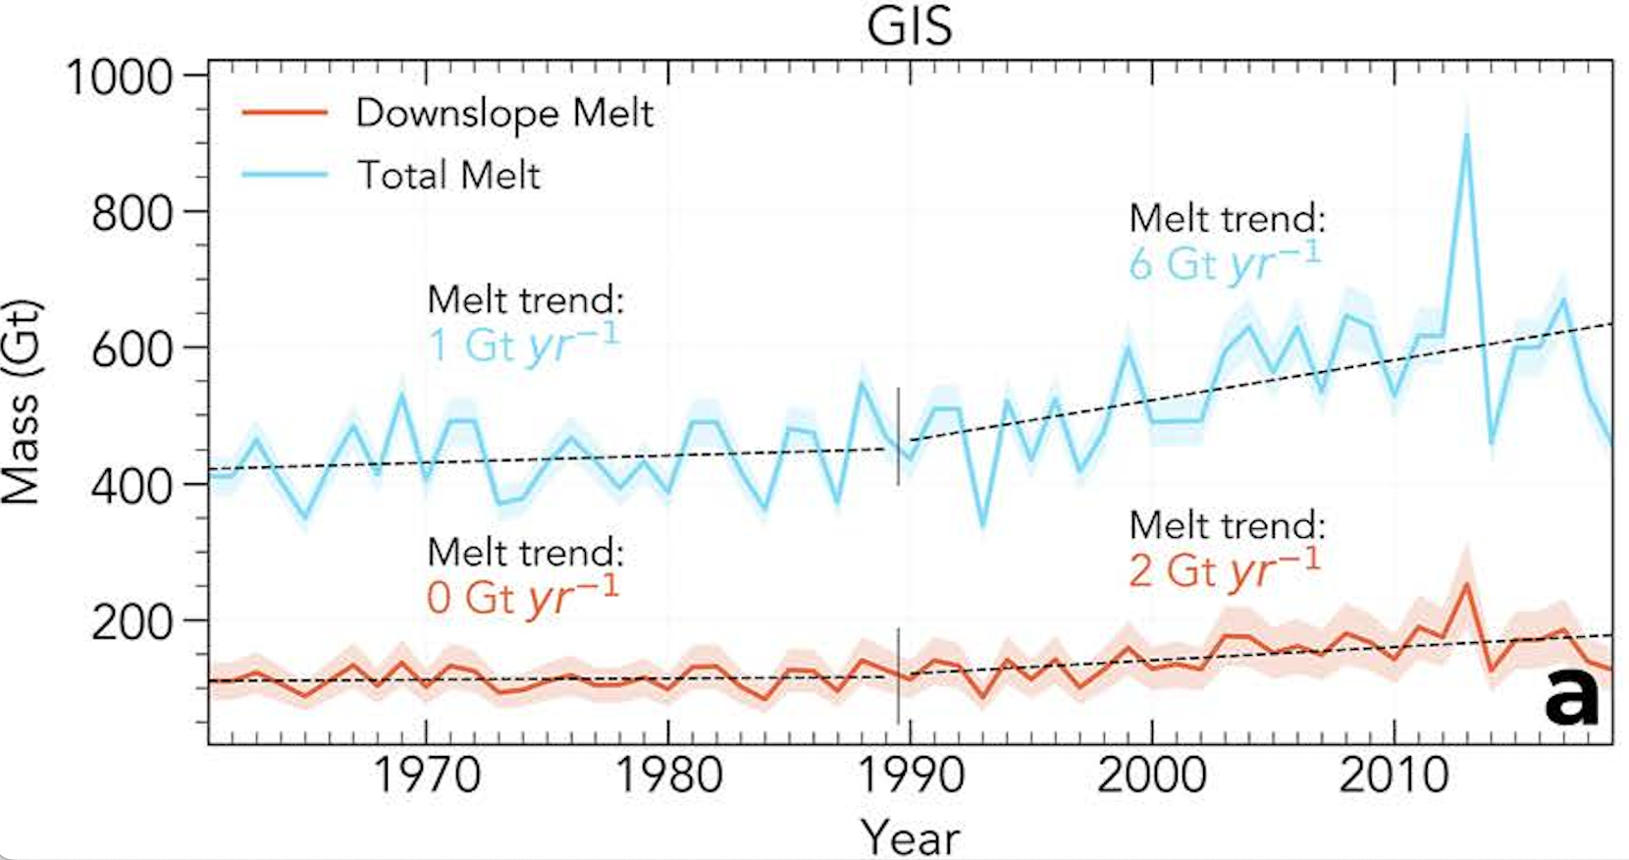
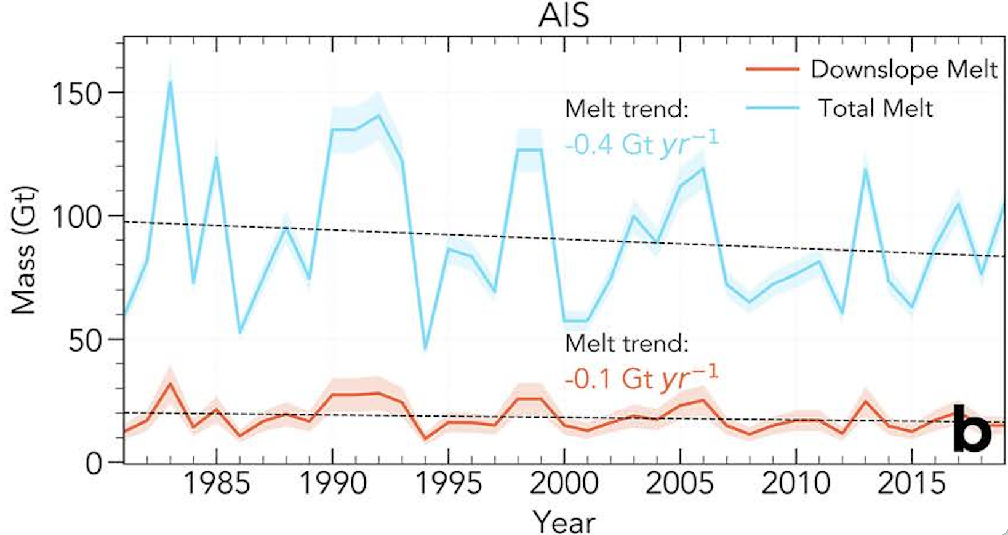
Opposite Wind-driven + Total Surface Melt Trends in Antarctica vs. Greenland
Scientific Challenge
Sea-level rise is currently driven by ice-sheet surface melt, of which a significant component (10-20%) is driven by downslope winds. We must understand how and why these trends have changed in recent decades.
Approach and Findings
Antarctic wind-associated melt has decreased about ~32% since 1999, while total melt has decreased about 15% due to reduced föhn-induced melt on the Antarctic Peninsula, and increased stratospheric ozone.
Wind-associated melt increased about 10% in Greenland, and along with warmer surface temperatures increased total melt about 34%.
Figure
Significance and Impact
Ice sheet surface melt processes that drive sea-level rise are complex, interlinked, and non-intuitive. Replicating our findings is an important challenge for the physical fidelity of Earth System Models such as E3SM.
Melt Trends in (a) Greenland (b) Antarctica
Laffin, M. K., C. S. Zender, J. M. van Wessem, B. Noël, and W. Wang (2023), Wind-associated melt trends and contrasts between the Greenland and Antarctic Ice Sheets, Geophys. Res. Lett., 50(16), e2023GL102828, doi:10.1029/2023GL102828.
Department of Energy • Office of Science • Biological and Environmental Research
Notes:
Word highlight text here.

