Slide 1
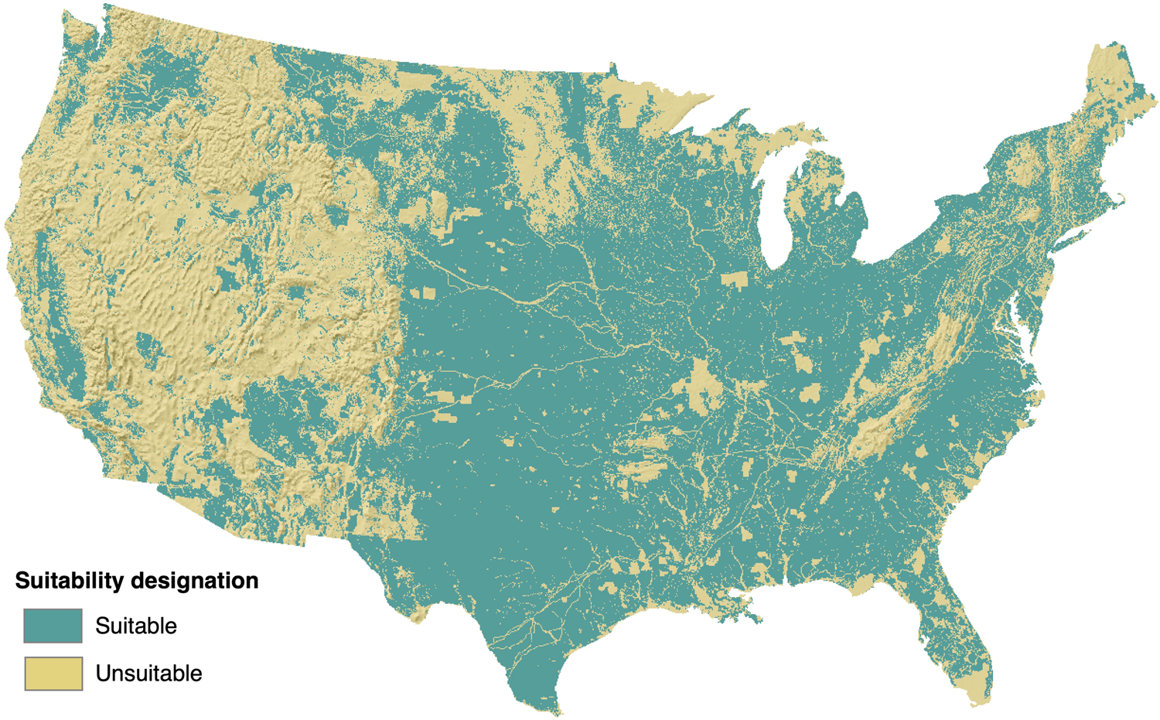
Advancing Energy Infrastructure Expansion Planning with the GRIDCERF Data Package
Objective
Develop the Geospatial Raster Input Data for Capacity Expansion Regional Feasibility (GRIDCERF) data package to evaluate siting suitability for renewable and non-renewable power plants across the United States, considering a range of location- and technology-specific issues that impact power plant siting.
Approach
Compile a comprehensive set of geospatial data across the conterminous U.S. to create land suitability layers tailored to the siting requirements of 56 renewable and non-renewable power plant technology configurations.
Develop a common spatial resolution of 1 km² as a basis for the average footprint of a utility-scale power plant, addressing the larger land footprint of wind and solar in multiples of 1 km² grid cells.
Incorporate both static and dynamic layers in the data package to facilitate modeling of future energy infrastructure under changing conditions, such as population projections and changing environmental conditions.
Impact
Provides high-resolution products to evaluate siting suitability for renewable and non-renewable power plants in the conterminous U.S.
Offers 264 suitability layers for use with 56 power plant technologies in a harmonized format that can be easily ingested by geospatially-enabled modeling software.
Robustly addresses science objectives for infrastructure siting feasibility planning amid climate change, energy transitions, and socioeconomic change.
This figure illustrates the result of combining multiple geospatial data layers (1 km² resolution) to define the siting suitability of thermoelectric power plants. These layers represent siting requirements, such as proximity to water availability, avoiding protected lands, and avoiding areas with high population density.
Vernon, Chris R., Kendall Mongird, Kristian Nelson, and Jennie S. Rice. 2023. “Harmonized geospatial data to support infrastructure siting feasibility planning for energy system transitions.” Scientific Data 10 (786). https://doi.org/10.1038/s41597-023-02694-y

