Slide 1
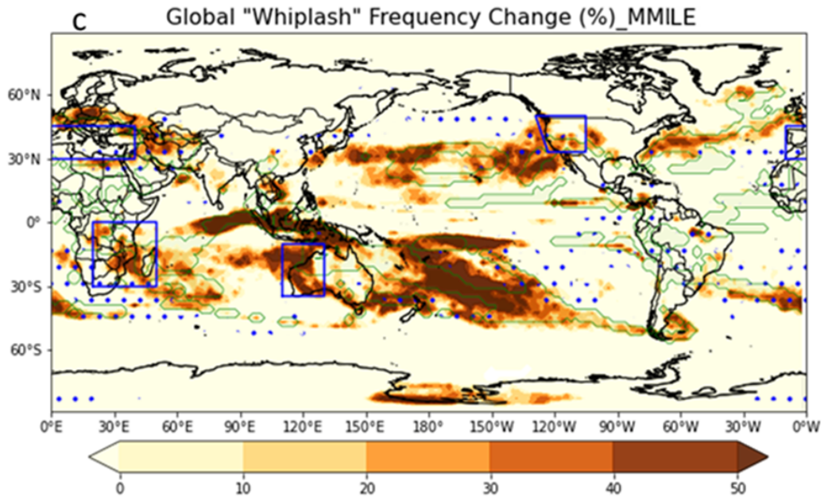
Increasing volatility of precipitation around the globe
Scientific Challenge
Extreme interannual swings between wet and dry years (“whiplash”) have unique impacts on water resources, wildfire, and landslides. They are highly challenging to predict in a climate-change context because they are such a low-frequency event. This requires a robust representation of both their occurrence historically and the future projections therein.
Approach and Findings
We used the Multi-Model Large Ensemble Archive, consisting of five global climate models with ~20 realizations per model. Each realization spans pre-industrial times up to 2100. This dataset allowed us to robustly represent whiplash in the historical climate, as well as its future projections. A handful of regions with mostly Mediterranean climates are projected to experience increases of ~50% whiplash frequency by 2100.
Figure
Significance and Impact
These findings highlight that a handful of key regions, in particular those with Mediterranean climates, are expected to experience increased precipitation volatility through the 21st Century. This means that extremely wet and dry years will become increasingly close together. These results imply that water resources will become increasingly unstable in the given regions, while drought, wildfires, flooding, and landslides are likely to become more common.
Relative future change (2070–2100 minus historical, normalized by historical
values) in ‘whiplash’ year frequency calculated using the Multi-Model Large Ensemble Archive (80 members). The blue dots indicate where 60% of ensemble
members agree on the sign of ‘whiplash’ frequency change. The green patches illustrate regions with positive changes in both wet (⩾80th percentile) and dry year (⩽20th percentile) frequency. The blue boxes indicate four regions with outstanding changes over land.
D. Chen, J. Norris, C. W. Thackeray, and A. Hall, 2022, Environ. Res. Lett., 17, 124011
Department of Energy • Office of Science • Biological and Environmental Research
Notes:
Word highlight text here.

