Slide 1
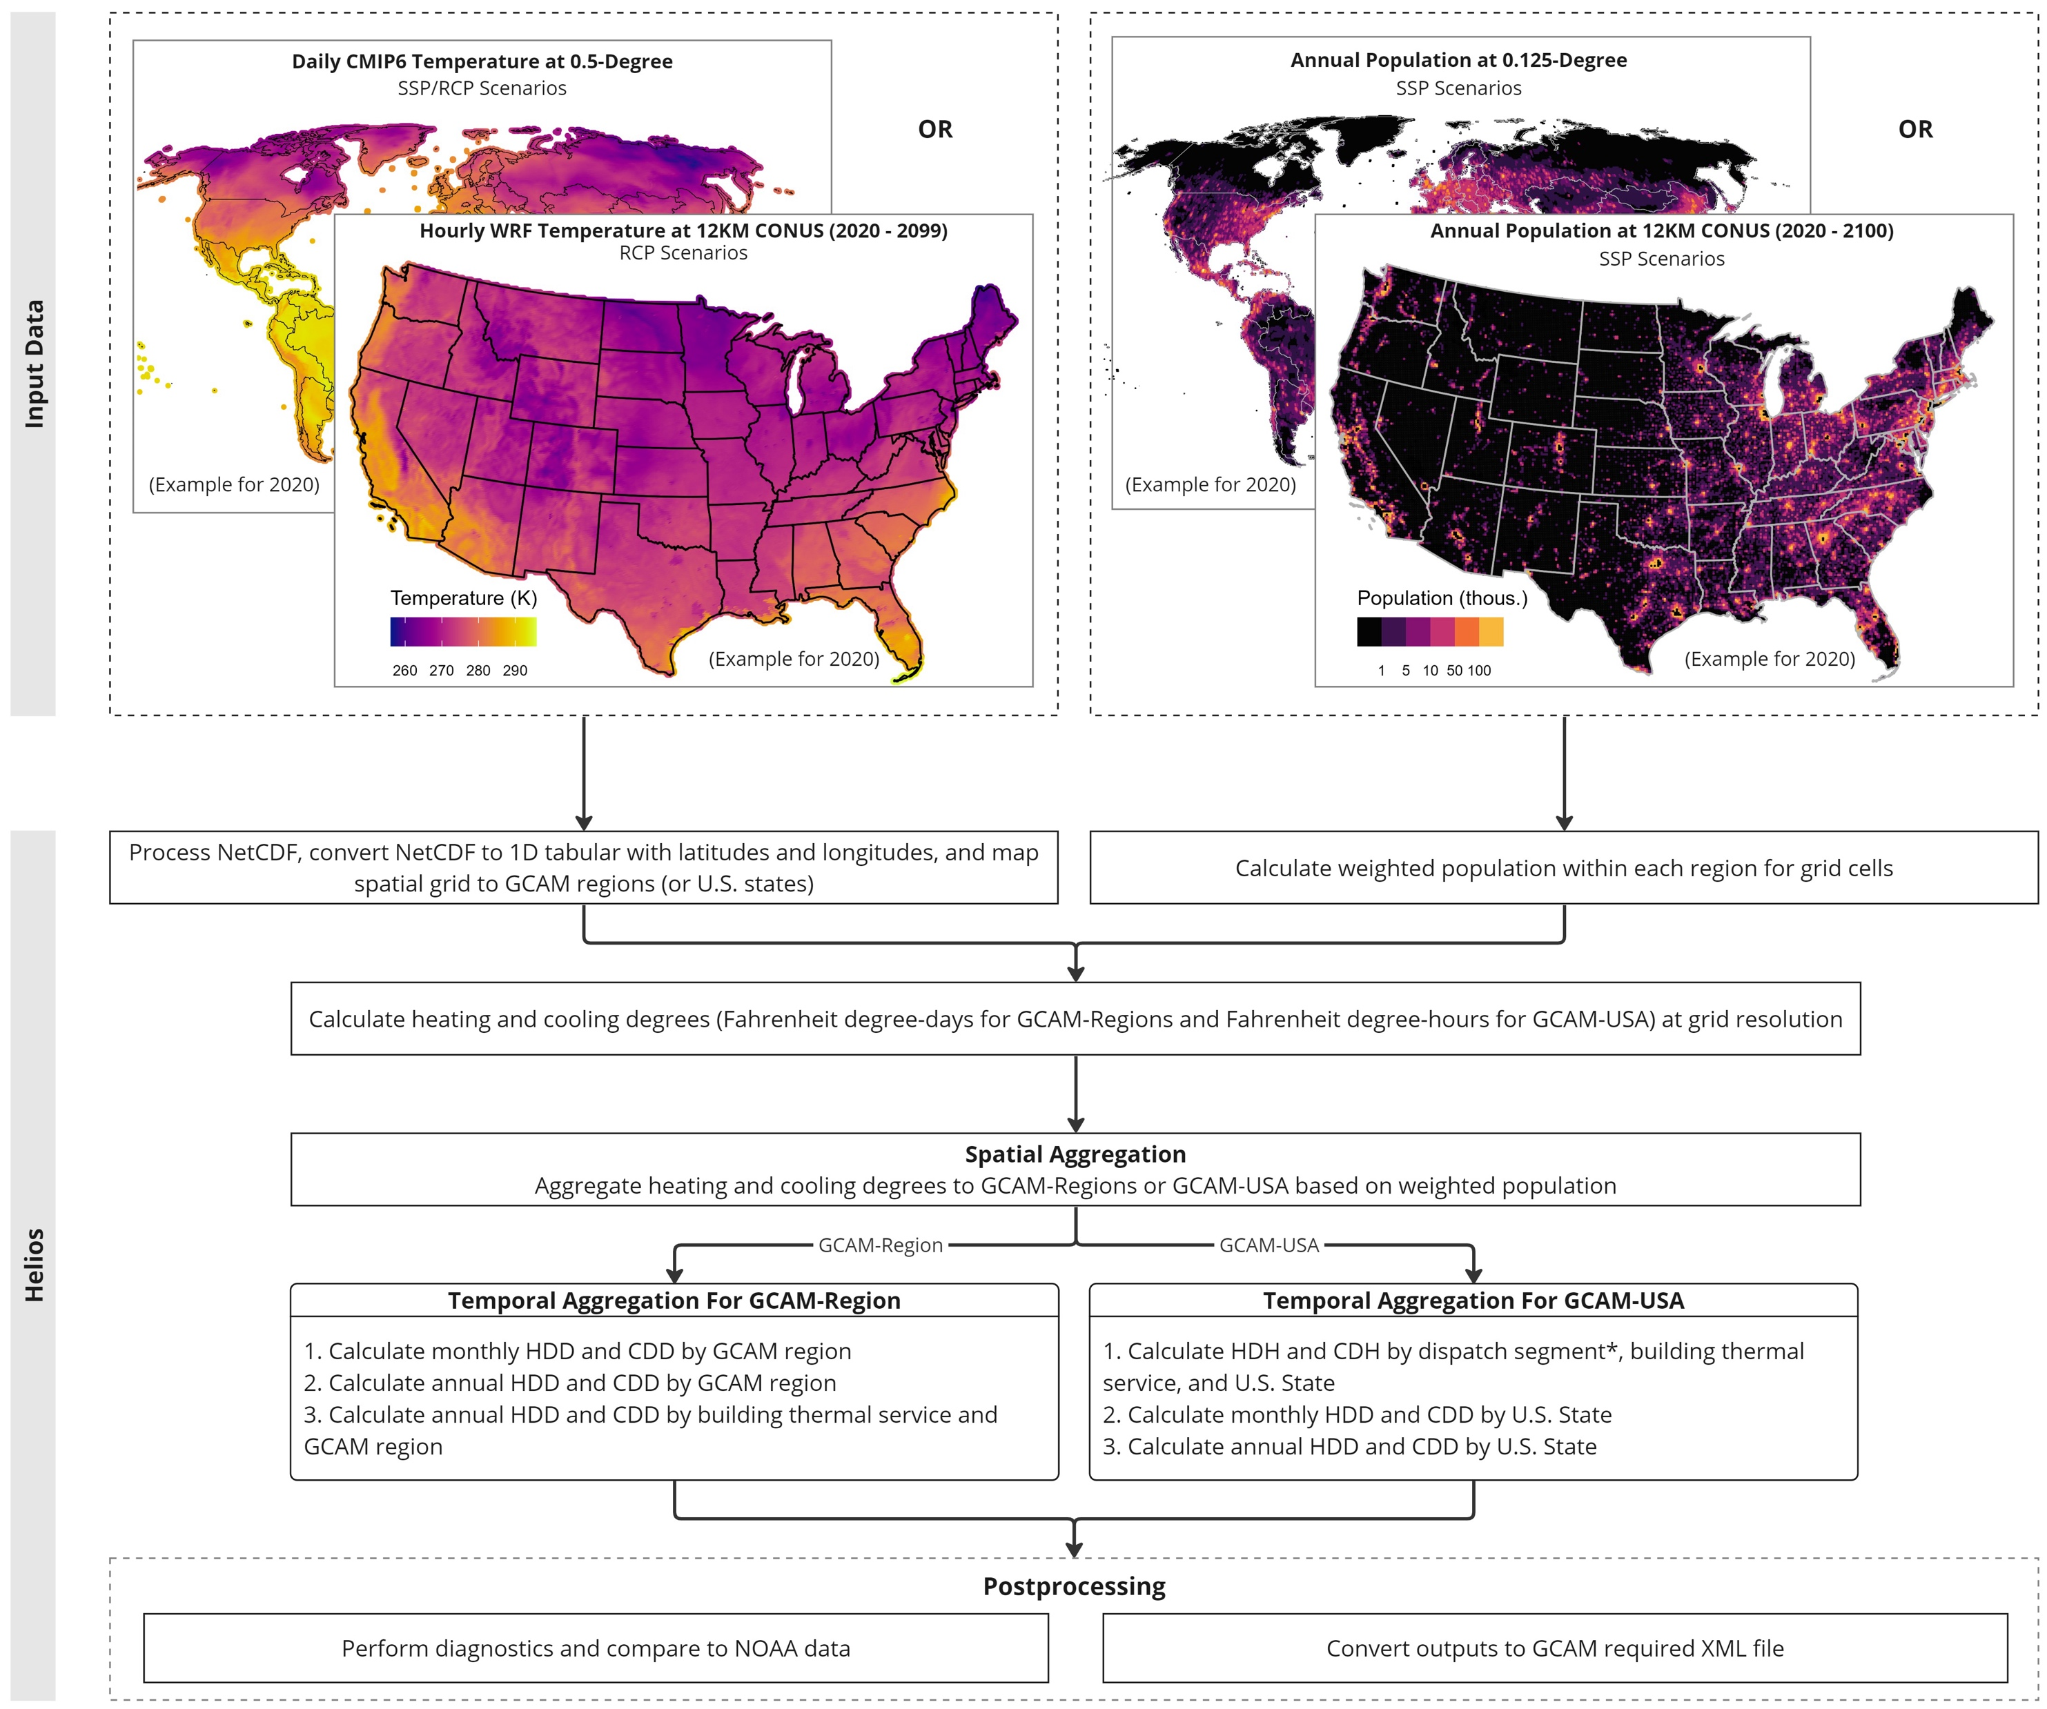
A New Tool to Incorporate Climate Impacts on Building Energy Demand
Objective
Develop the Helios R package to estimate population-weighted heating and cooling degrees, facilitating the integration of high-resolution climate data with the Global Change Analysis Model (GCAM) for improved building energy demand projections.
Approach
Implement a four-step workflow in the Helios R package that processes raw climate data, calculates population-weighted heating and cooling degrees, performs visual diagnostics, and outputs results in user-defined formats for integration with the GCAM.
Incorporate hourly or daily temperature data to calculate population-weighted heating and cooling degrees at various temporal and spatial scales.
Impact
Helios is an R package that enables the modeling of climate impacts on energy demand at multiple spatiotemporal scales for GCAM.
The package reveals significant sub-annual and regional variations in electricity demand and peak loads.
Helios streamlines the workflow from raw climate data processing to outputting results in formats compatible with GCAM, facilitating global and regional energy infrastructure planning.
This figure is an example of the Helios workflow using two types of input datasets (e.g., global data from CMIP6 and CONUS data from WRF). This demonstration showcases Helios’ capability to generate heating and cooling degrees by GCAM region or U.S. States, among other spatiotemporal scales.
Zhao, M., Z. Khan, K. Dorheim, and C. Vernon. "helios: An R package to process heating and cooling degrees for GCAM." Journal of Open Source Software 9, no. PNNL-SA-188047 (2024). DOI: 10.21105/joss.06033

