Slide 1
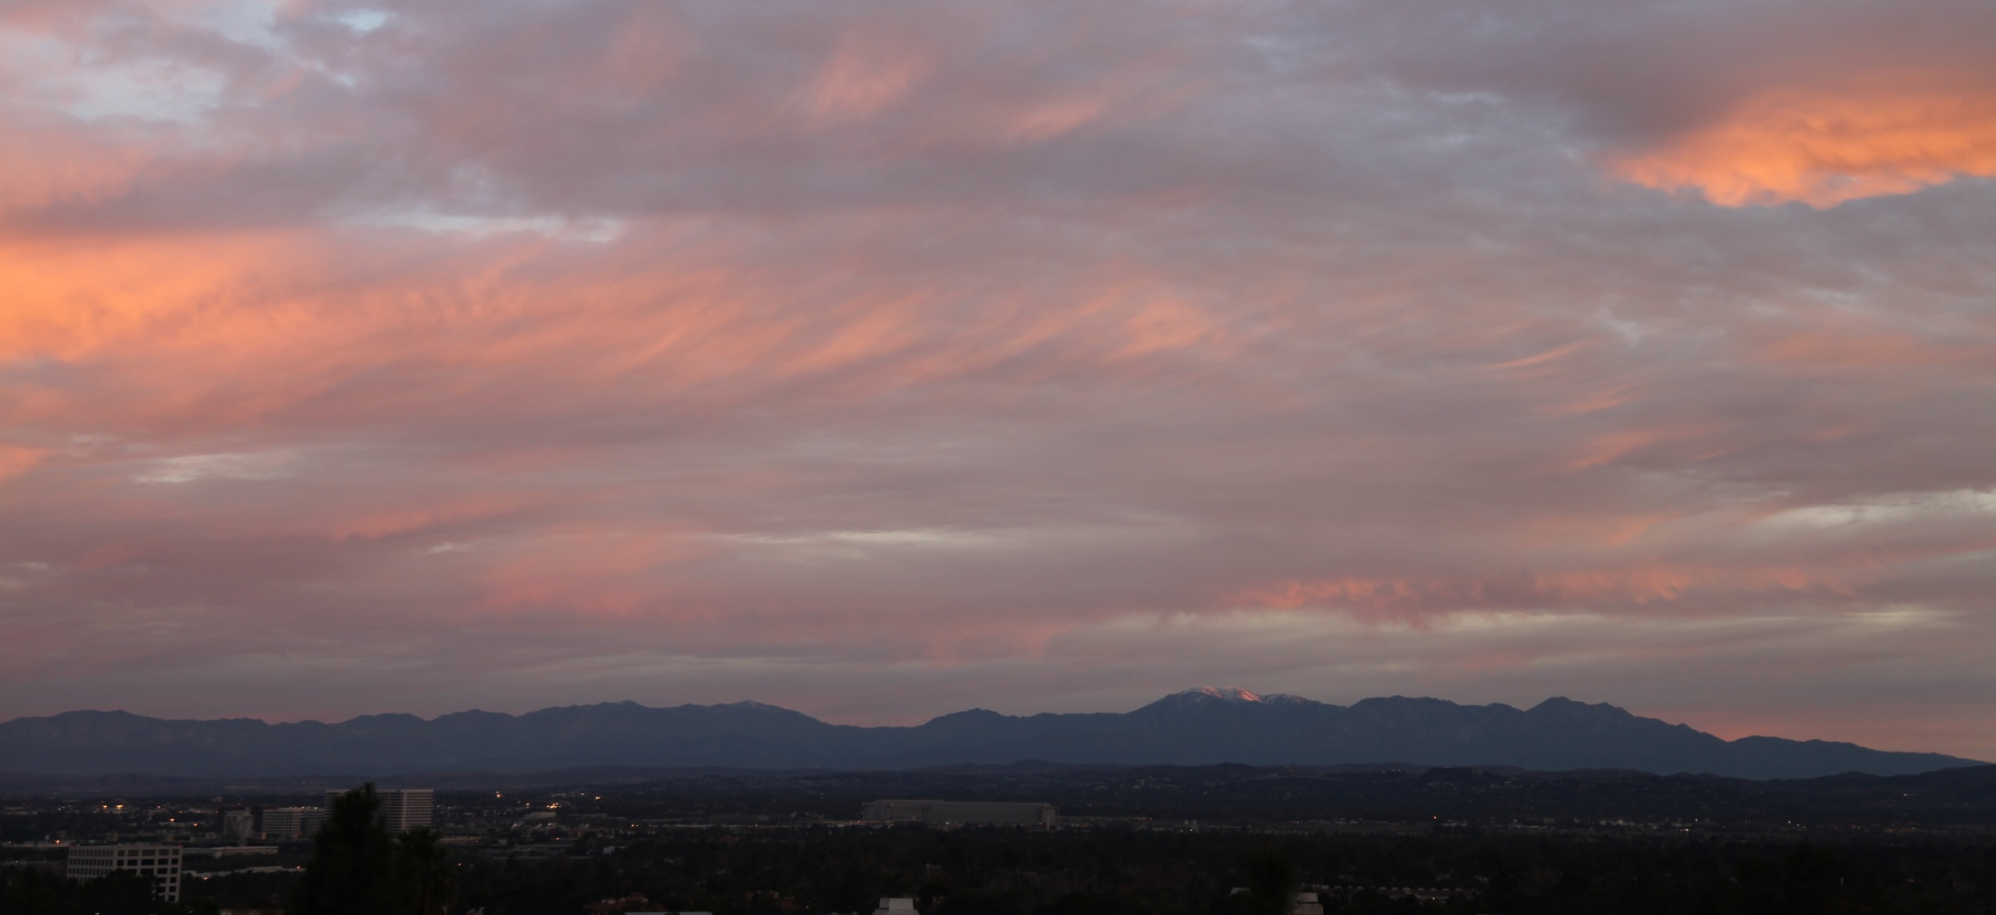
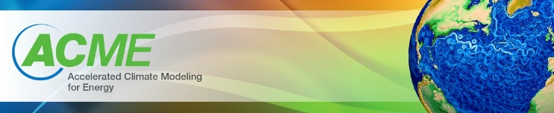

UCI 4 Jan 2010 0754h
An examination of systematic biases in ACME solar heating rates – comparing RRTMG and multi-stream Solar-J
Michael Prather, Juno Hsu, Alex Veidenbaum, Alex Nicolau, Philip Cameron-Smith*
UC Irvine & LLNL*
ACME PI Meeting, 7-9 June 2016

Slide 2
Why Solar-J?
Photolysis Rates (J-values)
Photochemistry is essential for simulation of non-CO₂ greenhouse gases and many aerosols.
Most important anthropogenic climate-active aerosols are secondary and generated by photochemistry (NO₃⁻, SO₄⁼, NH₄⁺, SOA).
For climate feedbacks, photolysis rates must respond to changing clouds, aerosols, ozone, ground-cover/canopy, and land-use.
Solar-J (Fast-J) is one of the reference modes for J-values
O₃ + hv => O₂ + O(¹D)
O(¹D) + H₂O => 2 OH
OH + X => ….

Slide 3
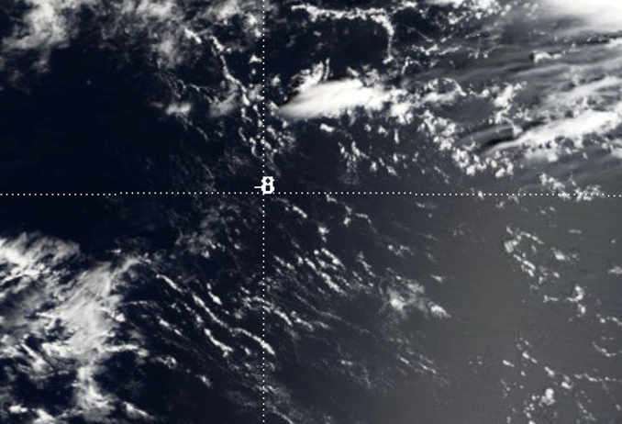
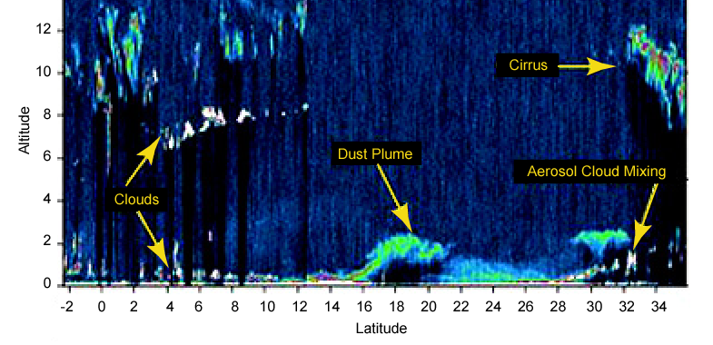
Why Solar-J?
Photolysis Rates (J-values)
Cloud Fields
Solar-J (Cloud-J) integrates over correlated overlapping cloud layers using quadrature column atmospheres (QCAs).
QCAs are a far more efficient way to get average J-values and heating rates than random Monte Carlo sampling (MCICA).
3 QCA calls = ±3% error; 3 MC calls = ±12% error

Slide 4
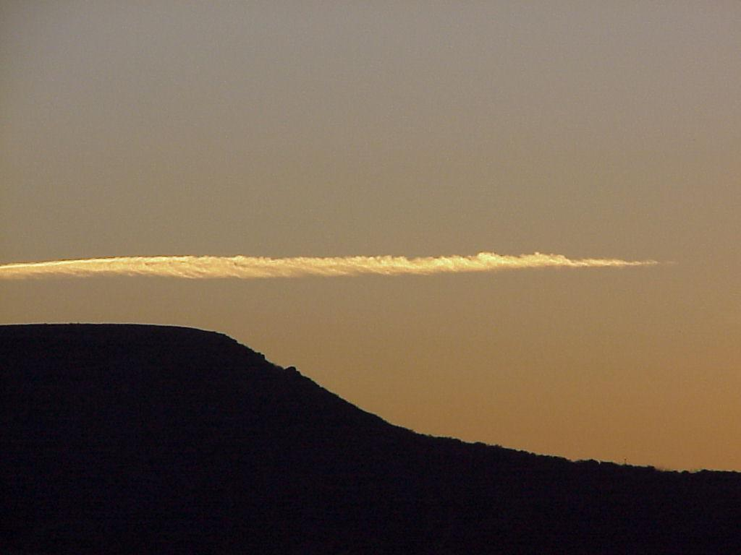
Why Solar-J?
Photolysis Rates (J-values)
Cloud Fields
Multi-Stream RT
Solar-J (Fast-J) is hardwired and optimized for 8-stream, plane-parallel, multi-scattering radiative transfer solutions.
Solar-J can directly use all scattering phase functions and avoid the two-stream approximations (isotropic only, reduced cloud/aerosol optical depths, distorted direct/diffuse PAR, …)
Solar-J makes approximations with 8-streams,
but not parameterizations.
4 up
4 down

Slide 5
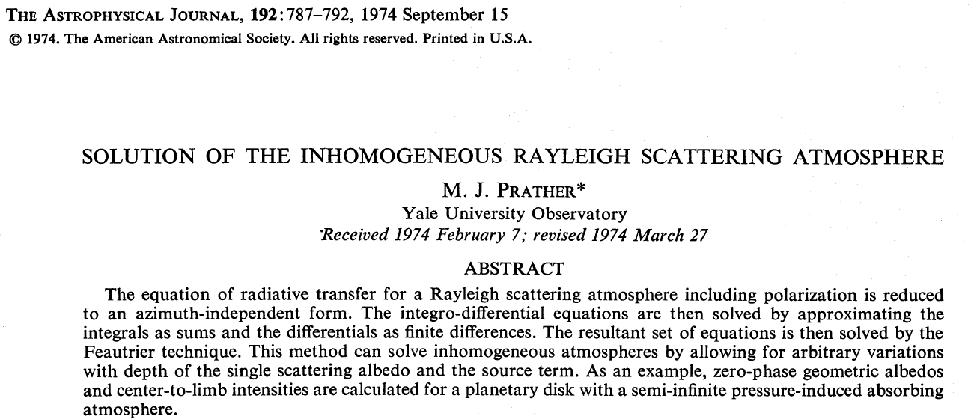
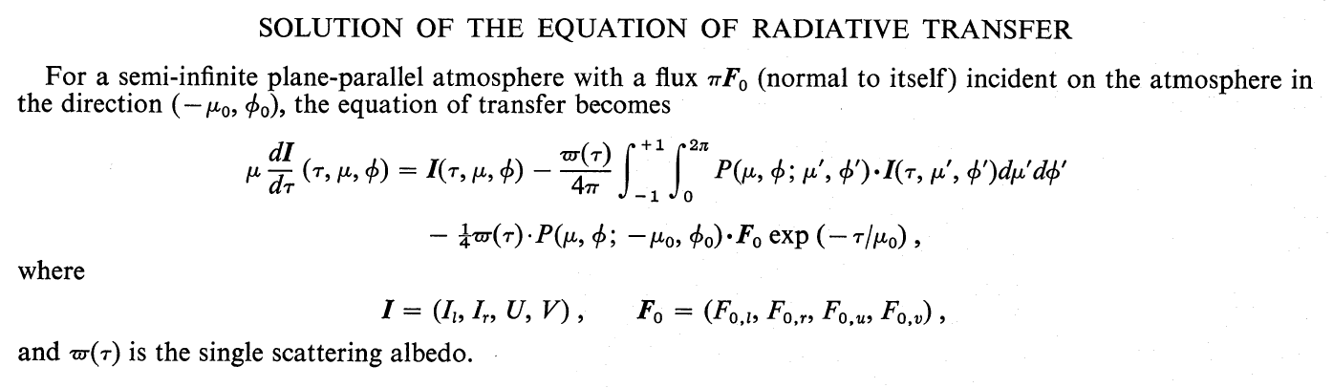
A brief history of Solar-J
began w/ planetary atmospheres
not DOE sponsored

Slide 6
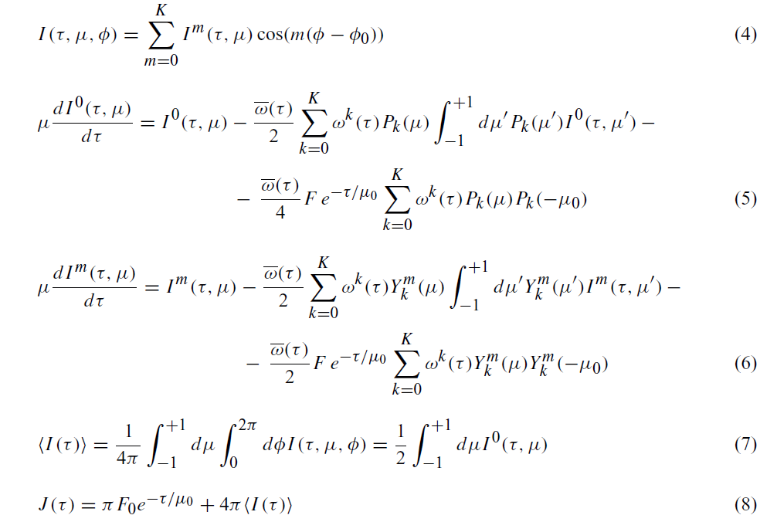
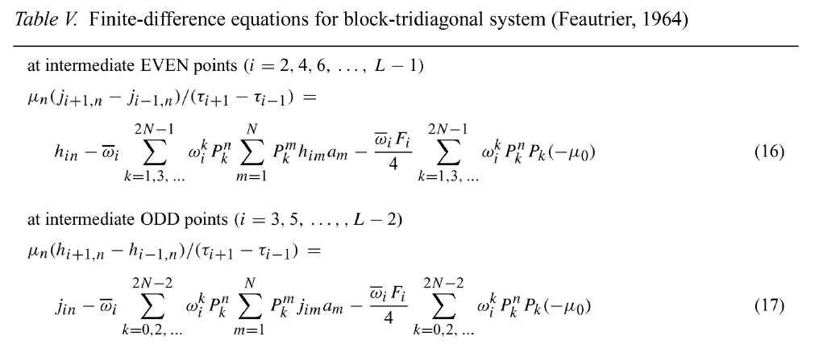
Solar-J:
optimized Feautrier solar atmos. code (pre-DISORT)
2.0. FEAUTRIER SOLUTION OF MULTIPLE SCATTERING
solution split at alternate layers into odd-even scattering:
Feautrier solution with 8 angles solves 4x4 matrices vs. DISORT 8x8 matrices (2³ x cost)

Slide 7
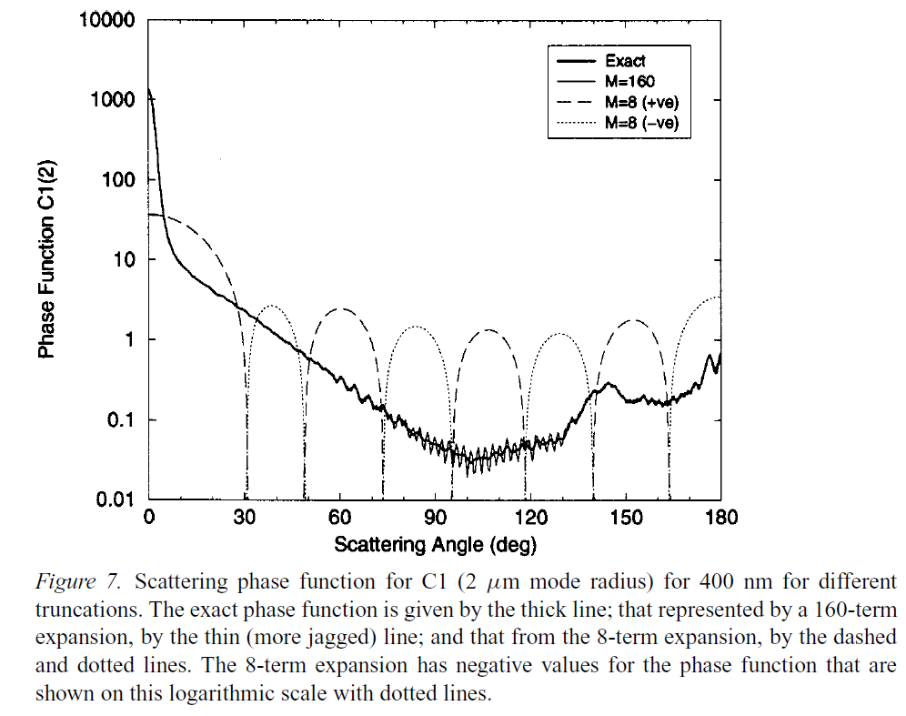
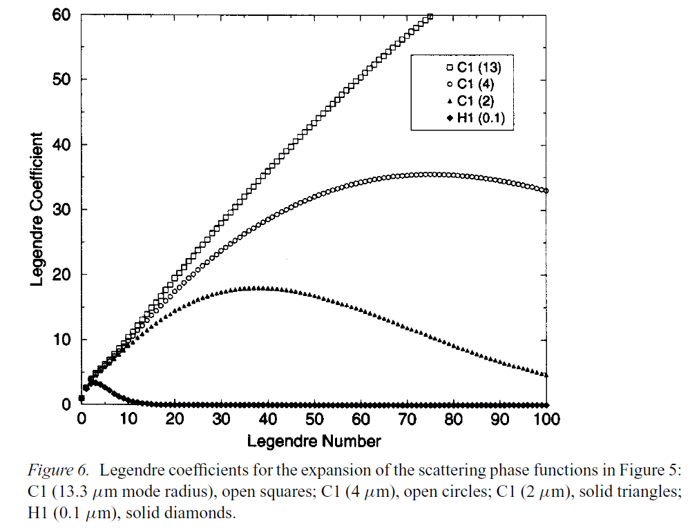
Solar-J:
simple truncation of full phase function
8-stream (4x4 soln)
has neg phase fn

Slide 8
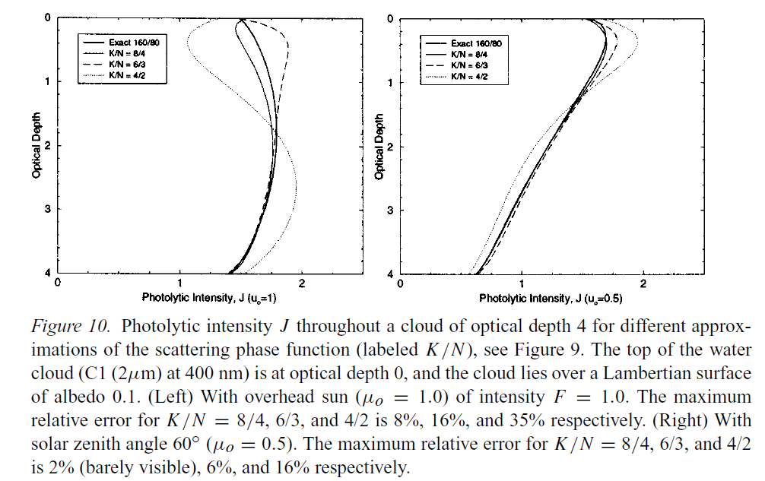
Solar-J:
8-stream tested against fully resolved solution
2.4. OPTIMIZE FOR MIN ERROR OF 8-STREAM VS. 160-STREAM (two solid lines)

Slide 9
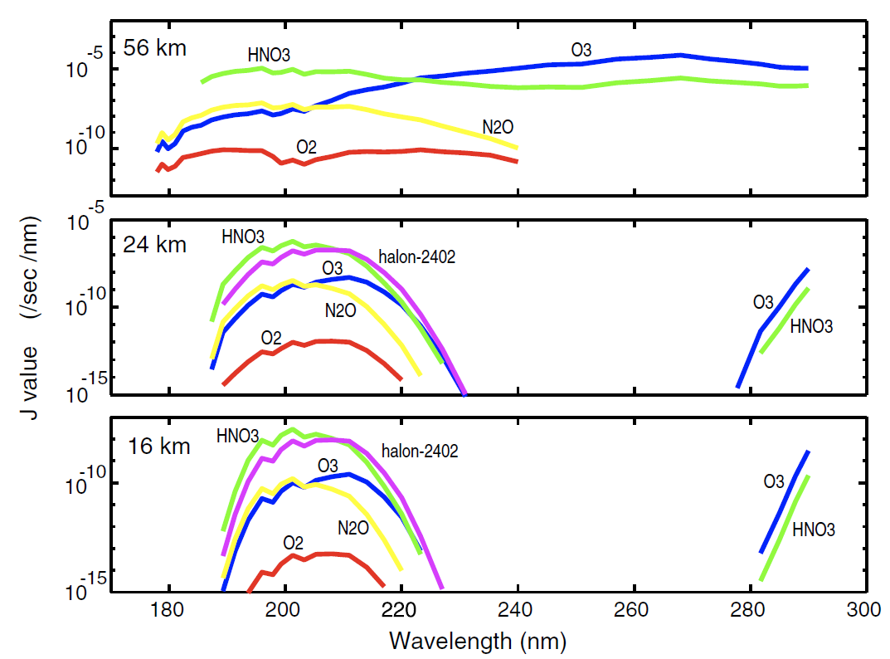
Fast-J: added stratosphere
For λ < 298 nm, need 11 bins to resolve O₃ absorption/heating

Slide 10
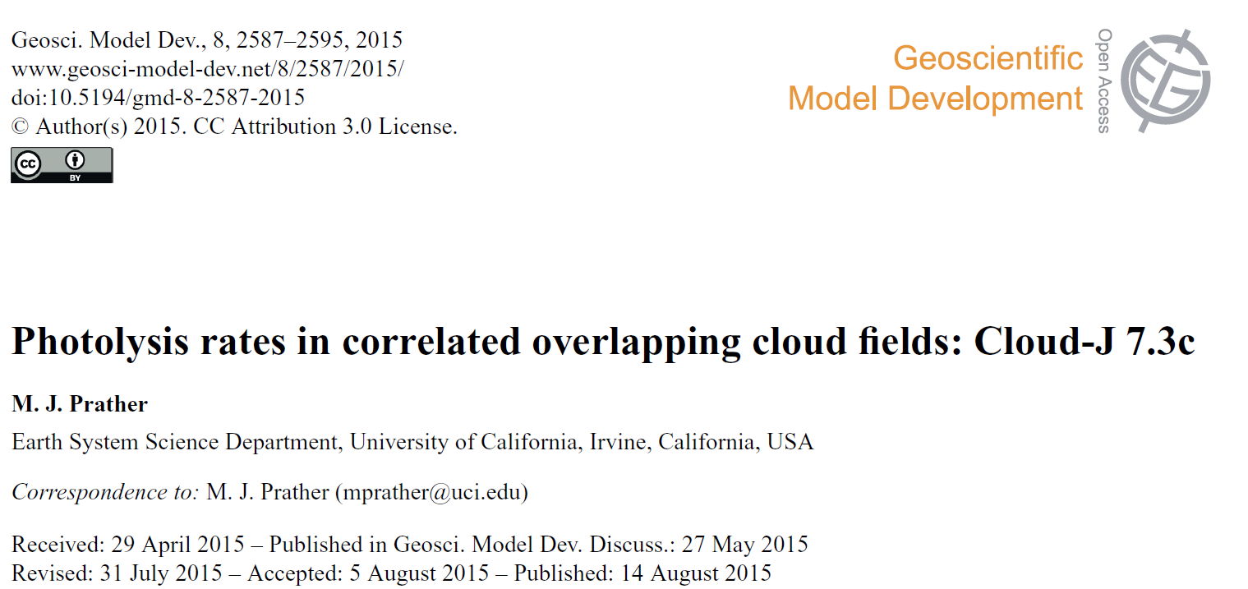
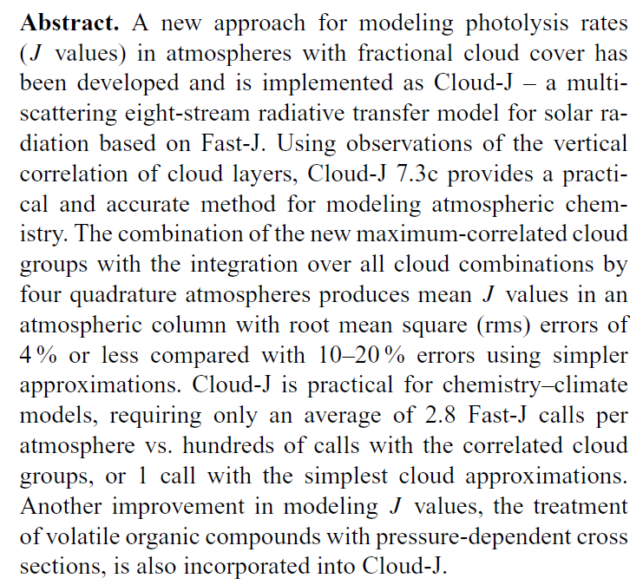
Cloud-J – a major update to implement observed
correlation of overlapping cloud layers*
*DOE sponsored DE-SC0012536

Slide 11
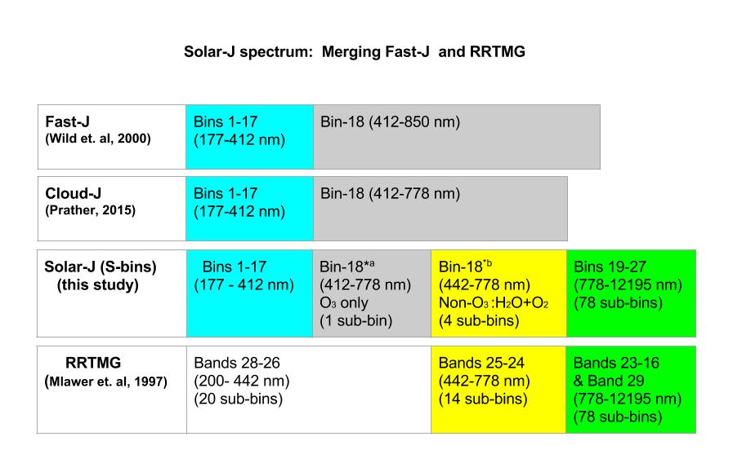
Solar-J – a merging of Cloud-J photolysis
and RRTMG solar heating codes*
18 RT calls 84 RT calls (5x???)
Are there other options for >778 nm speedup?
*DOE sponsored DE-SC0012536

Slide 12
Solar-J –
speedup of Fast-J core RT computation with GPUs*
Fast-J core code ported and optimized for execution on Xeon Phi (60 cores with improved vector capabilities, AVX512) on the Babbage prototype at NERSC.
The ported code can execute Fast-J for 8 air columns concurrently on a single Xeon Phi processor (~1 air column for Solar-J).
With each column executing on 6 cores, we get a 2.5x - 3x speedup compared to the single core version.
Caveats: Significantly slower clock of the current generation Xeon Phi processor compared to the Xeon server processors. The Phase II Cori upgrade will integrate the next generation Xeon Phi processors (improve performance and provided reduced latency to "local" memory). Likely lead to greater speeup in future.
*DOE sponsored DE-SC0012536

Slide 13
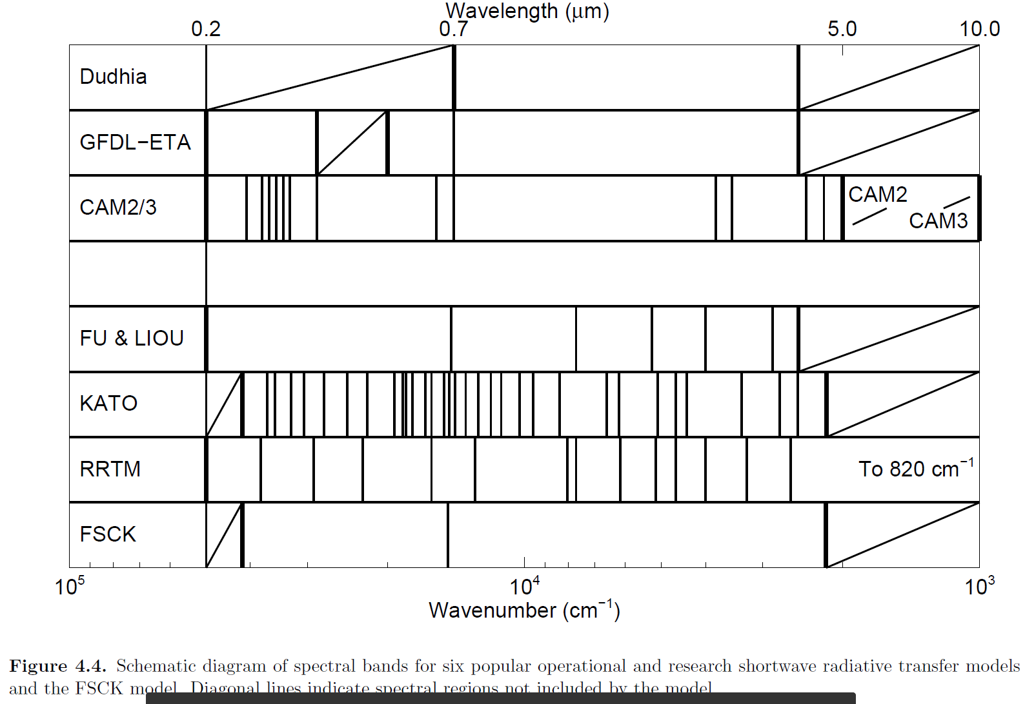
Solar-J –
speedup with alternative 0.7 – 5 µm bands
D. T. Pawlak (2004, Penn State U., dissertation, w/ Harrington)
15 bins?
J. L. Petters (2009, Penn State U., dissertation) - 27 shortwave CKD wavelength intervals match Fu and Liou (1992) above 0.5 μm, includes the CKDv2.4 model for continuum absorption (Mlawer et al., 1999).

Slide 14
Solar-J –
speedup with alternative 0.7 – 5 µm bands
LLNL model
λ range (μm) |  | solar (W/m²) | # k-bins
0.69 | 0.86 | 209.8 | 2
0.86 | 2.27 | 472.7 | 6
2.27 | 3.85 | 46.8 | 7
combined
0.69 | 3.85 | 729.3 | 5
combined band (0.69-3.85 μm) sub-intervals
Fraction | k_{H2O} (cm²/g)
0.79058 | 0.01002
0.06306 | 0.23374
0.08508 | 1.1571
0.04246 | 10.938
0.01882 | 142.19
  Grant, K. E., and A. S. Grossman (1998), Description of a Solar Radiative Transfer Model for Use in LLNL Climate and Atmospheric Chemistry Studies, UCRL-ID(129949), 17 pp.
  Chou, M. D. (1986), Atmospheric Solar Heating Rate in the Water-Vapor Bands, J Clim Appl Meteorol, 25(11), 1532-1542.
  Chou, M. D. (1992), A Solar-Radiation Model for Use in Climate Studies, J Atmos Sci, 49(9), 762-772.

Slide 15
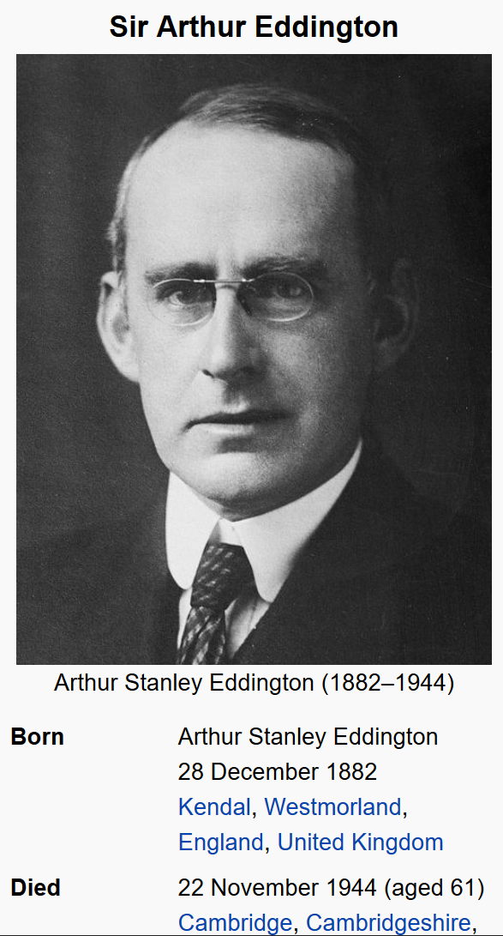
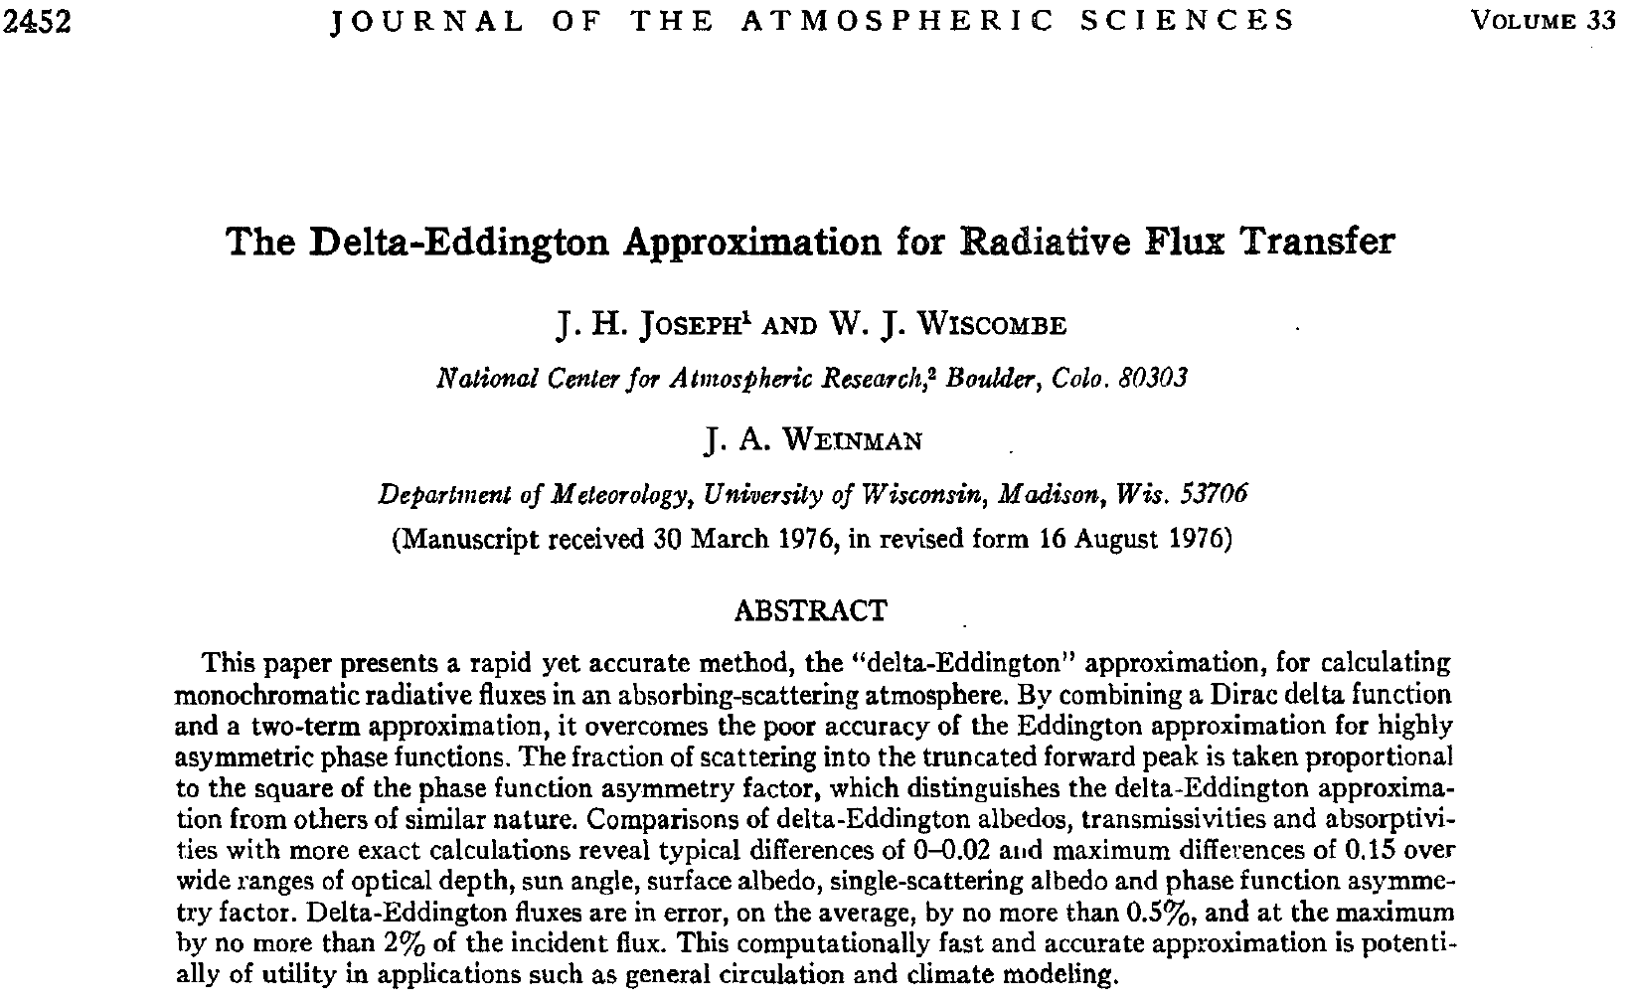
Two-Stream Approximation vs. Multi-Stream RT
δ - Eddington

Slide 16
Two-Stream Approximation vs. Multi-Stream RT
δ - Eddington

Slide 17
Two-Stream Approximation vs. Multi-Stream RT
δ - Eddington

Slide 18

Two-Stream Approximation vs. Multi-Stream RT
δ – Eddington uses Henyey-Greenstein phase fn
H-G has no
backscatter
peak.

Slide 19
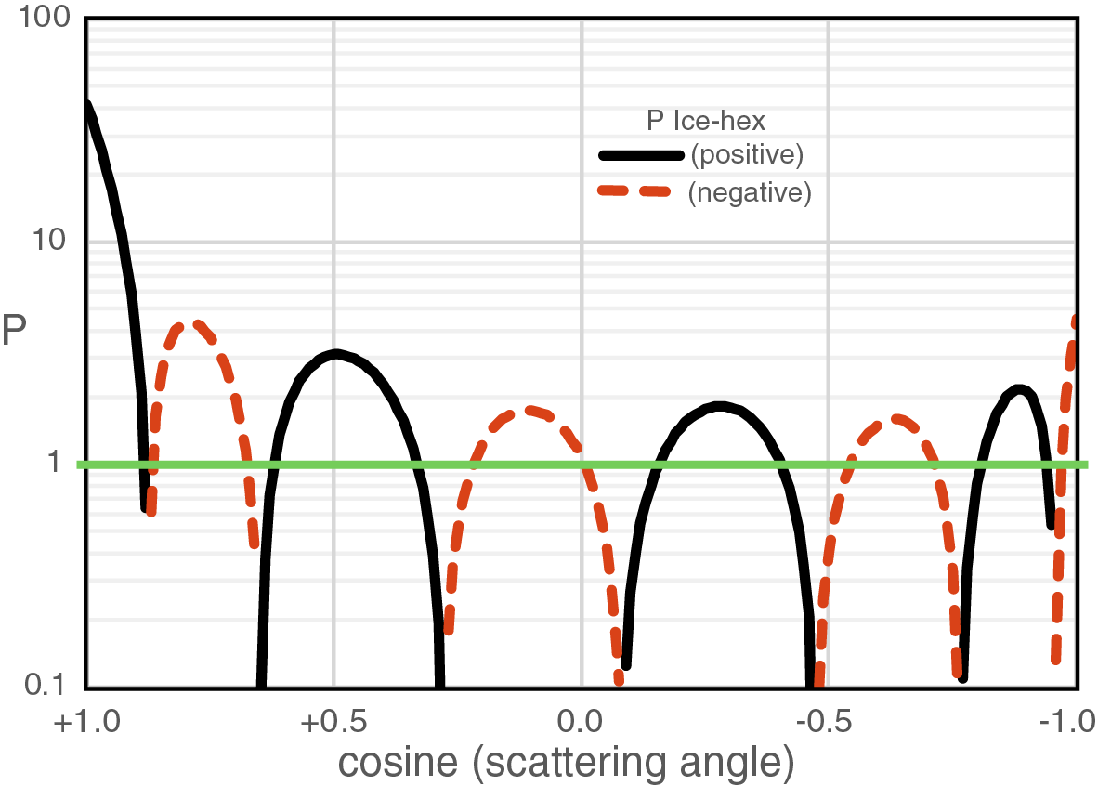
Solar-J vs. RRTMG:
Scattering Phase Fn:
Solar-J uses Mishchenko’s hexagonal ice phase function for cold cirrus
Solar-J
RRTMG

Slide 20
Two-Stream Approximation vs. Multi-Stream RT

Slide 21
Two-Stream Approximation vs. Multi-Stream RT
In the tests with the GCM dataset, the Practical Improved Flux Method …. provided slightly better results than the delta-Eddington approximation …
[but] r.m.s. errors in top-of-the-atmosphere (TOA) and surface were ~ 3 W/m².

Slide 22
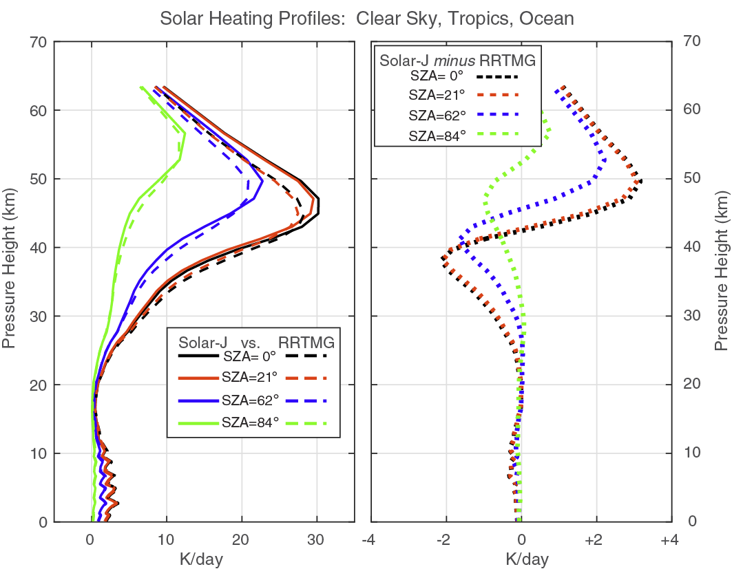
Solar-J vs. RRTMG: Clear Sky differences OK
N.B. Solar-J uses correct
Rayleigh Scattering
phase function (1 + cos²Θ)
strat O₃
crazy wiggles come
from RRTMG bins ??

Slide 23
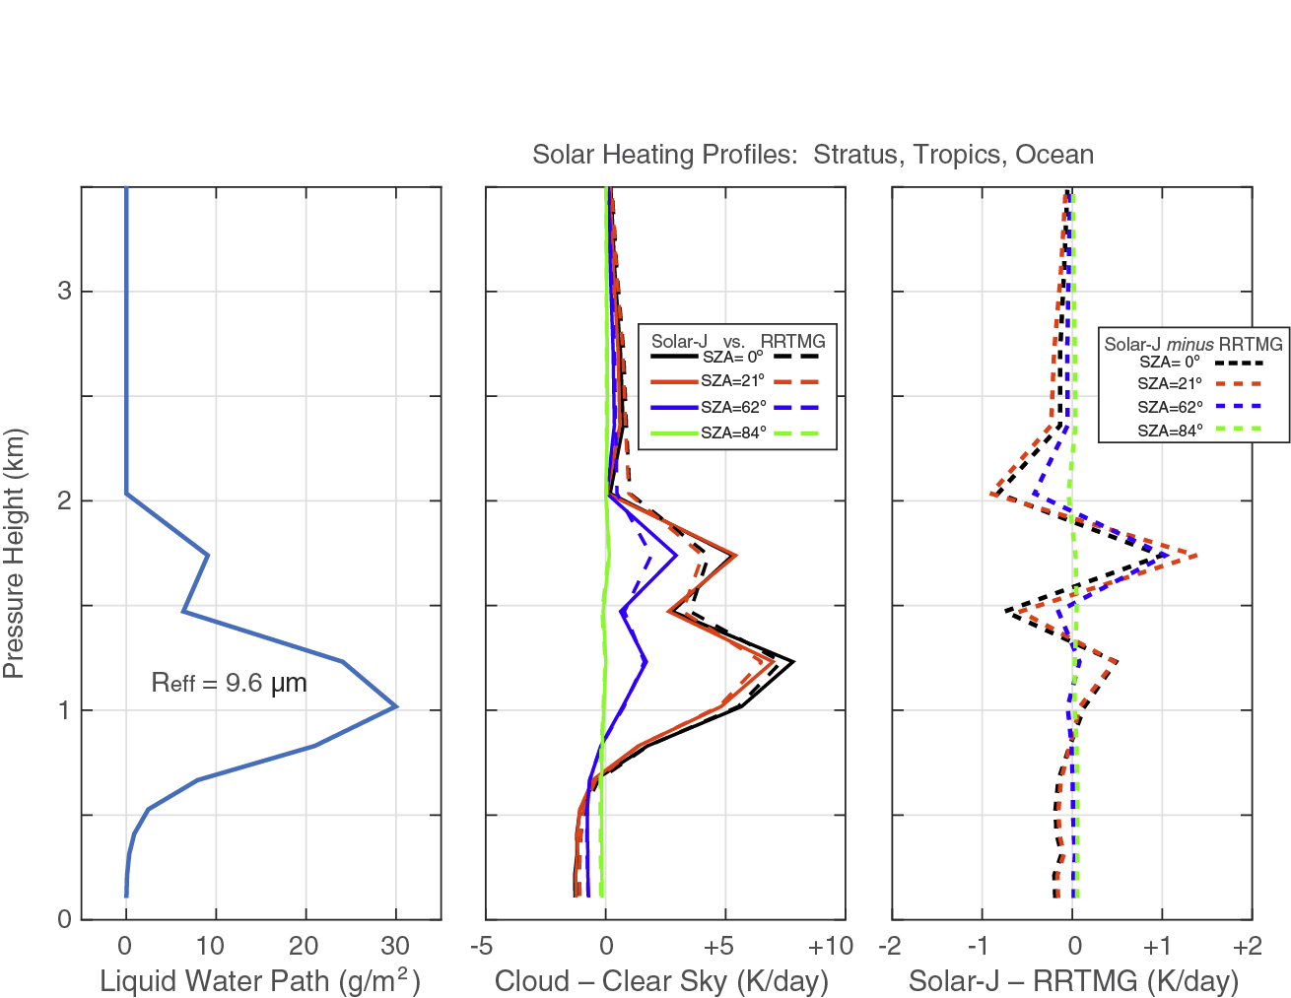
Solar-J vs. RRTMG: tropical marine stratus
Both Solar-J and RRTMG were given the same conditions:
profile of LWP (left) & Reff = 9.6 µm.
Both calculated the same Mie phase function with g = 0.86 and the same total OD before δ-M rescaling:
OD (Solar-J) 16.7
OD (RRTMG–unscaled) 16.7
OD (RRTMG–isotropic) 4.3

Slide 24
Solar-J vs. RRTMG: tropical marine stratus
Solar-J vs RRTMG for a marine stratus
 | SZA = 0 deg |  | SZA = 62 deg
Cloud–ClearSky all W/m² | SolarJ | ΔRRTMG | SolarJ | ΔRRTMG
top-of-atmos | +481 | -26 | +267 | -15
in-cloud | +66 | -1 | +13 | -4
surface | -568 | +22 | -291 | +17
Solar-J and RRTMG agree on In-Cloud heating.
For a wide range of SZA, RRTMG has less reflection by ~20 W/m² and more surface heating by ~20 W/m².
Consistent with errors in 2-stream approx.

Slide 25
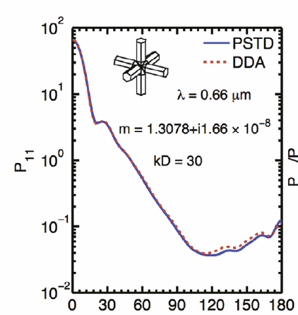
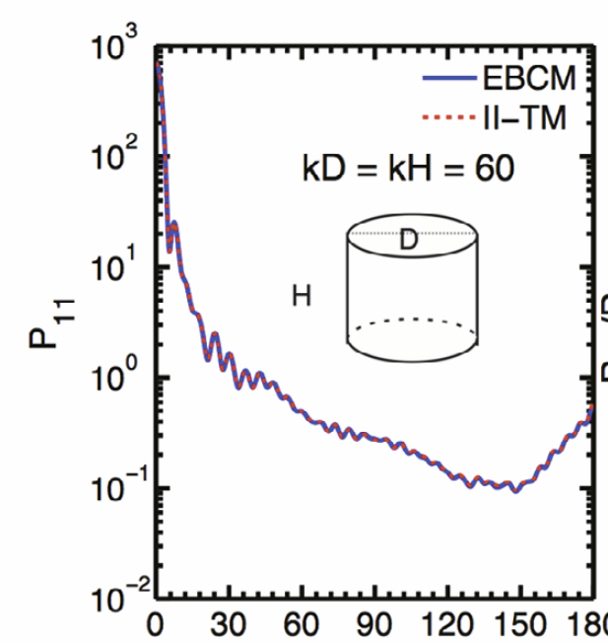
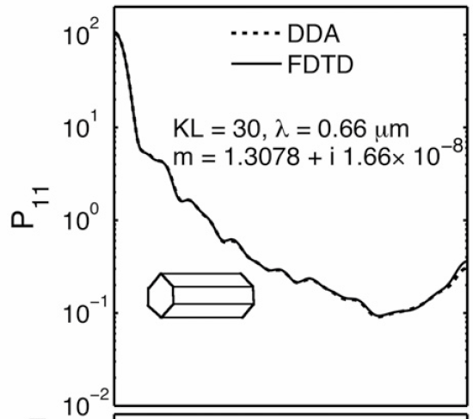
Solar-J vs. RRTMG: tropical cirrus
Cirrus – should not this be easy ?
Well the scattering phase fns are ….
Ping Yang, 2013, 2015

Slide 26
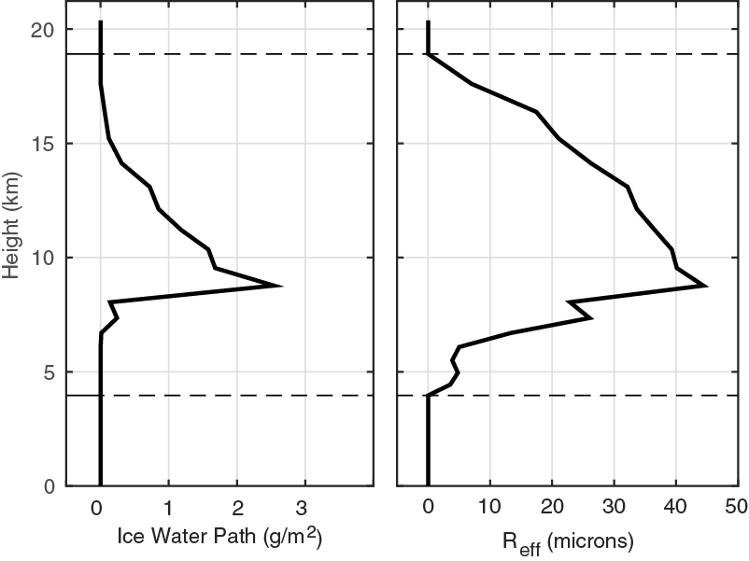
Solar-J vs. RRTMG: tropical cirrus

Slide 27
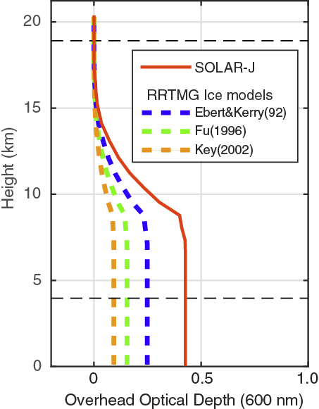
Solar-J vs. RRTMG: tropical cirrus
Note. 3 different Cirrus
approx for RRTMG
Note. reduced OD
for RRTMG
Curry(92)

Slide 28
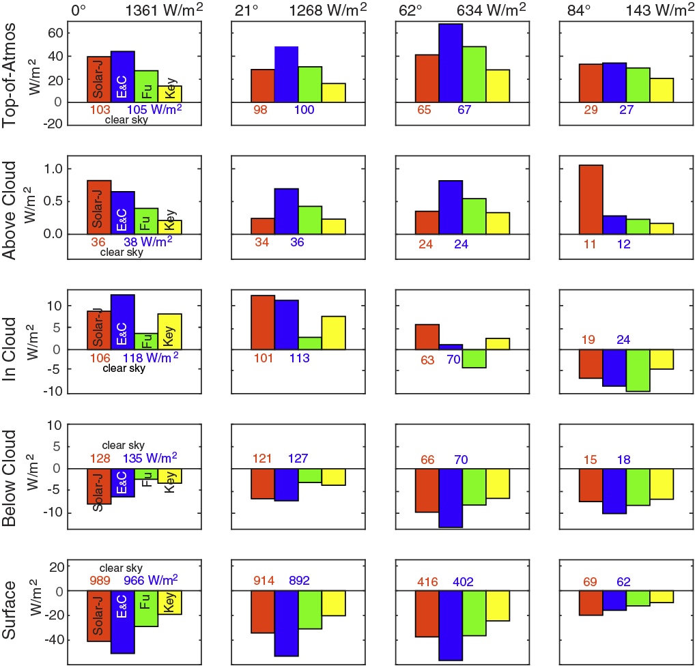
Solar-J vs. RRTMG: tropical cirrus

Slide 29
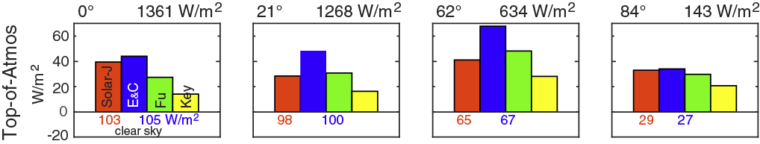
Solar-J vs. RRTMG: tropical cirrus
RRTMG uses 3 options for ice clouds – no clear directions
  Ebert & Curry 1992, largest OD, always overestimate reflection.
  Fu 1996 errors vary with SZA.
  Key 2002 always underestimates total reflection from atmosphere.

Slide 30
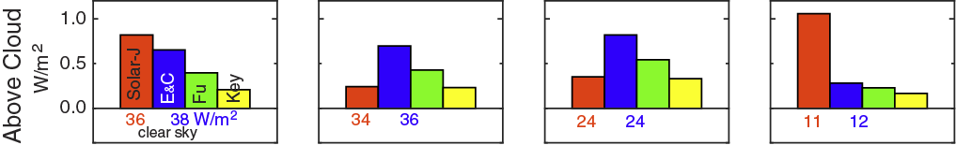
Solar-J vs. RRTMG: tropical cirrus
Above-Cloud heating rates are enhanced due to scattered light being picked up by O₃ in the Chappuis Bands (600 nm).
RRTMG vs. Solar-J is erratic, but all differences are small (<1 W/m²).

Slide 31
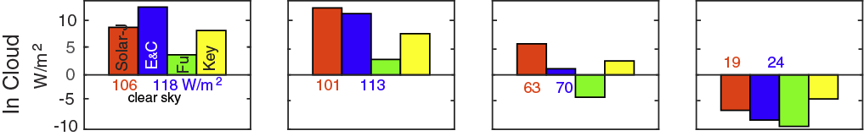
Solar-J vs. RRTMG: tropical cirrus
In-Cloud heating rates are enhanced due mostly to cloud water absorption.
There is still erratic scaling with SZA due to the very different OD.

Slide 32
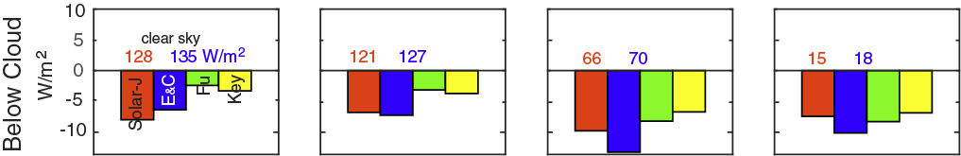
Solar-J vs. RRTMG: tropical cirrus
Below-Cloud cools by 5 to 10 W/m2.
All models agree,
but the magnitude and response to SZA is erratic.

Slide 33
Solar-J vs. RRTMG: tropical cirrus
Surface cooling from cirrus is universal across all models,
but the magnitude is a large fraction of the solar input,
and the differences are a factor of 2 and not obviously systematic.

Slide 34
Solar-J vs. RRTMG: timings
Caveat – done on single cpu, maybe not relevant to ACME. Redo of stratus deck 1,000 times:
Cloud-J (only 18 visible bands, J-values) 2.2 sec
Solar-J (18 C-J bins plus 84 RRTMG bins) 7.9 sec
RRTMG (called alone) 7.6 sec ???

Slide 35
Now that we can match RRTMG, it is time to look at
optimization and other solar heating approximations.
It is not worth trying to optimize the performance for
80 RT calls when we may chose a scheme with only 25.
Slight loss in accuracy over wavelengths is made up for
with much better cloud / aerosol heating rates, cost?
MC 3D ray tracing or MC 2-stream or Cloud-Quad 8-stream?
UCI 4 Jan 2010 0754h
An examination of systematic biases in ACME solar heating rates – comparing RRTMG and multi-stream Solar-J
Michael Prather, Juno Hsu, Alex Veidenbaum, Alex Nicolau, Philip Cameron-Smith
funding: DOE DE-SC0012536
ACME PI Meeting, 7-9 June 2016

