Slide 1
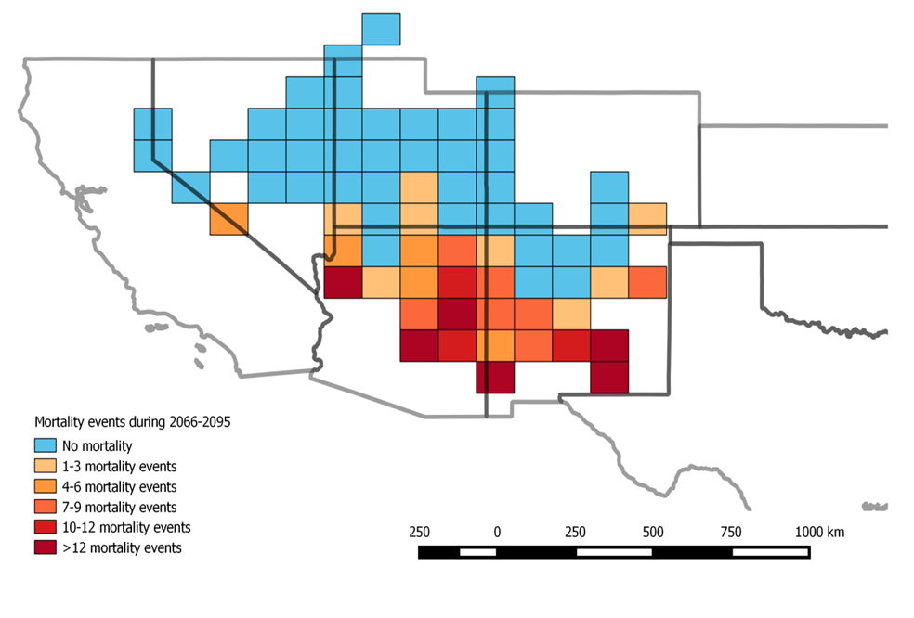
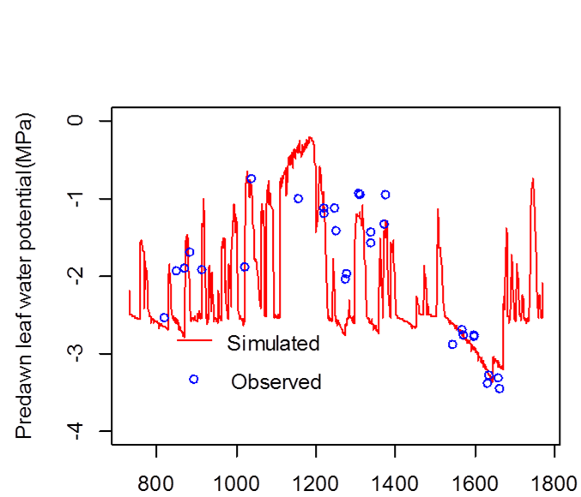
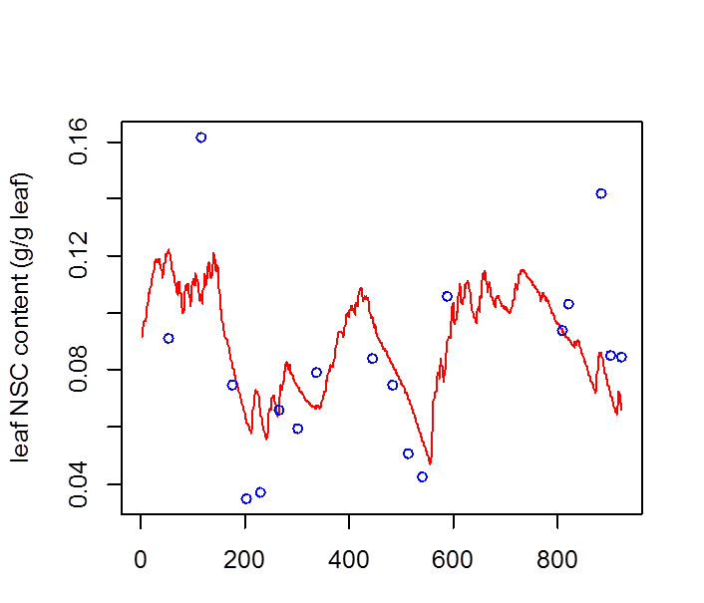
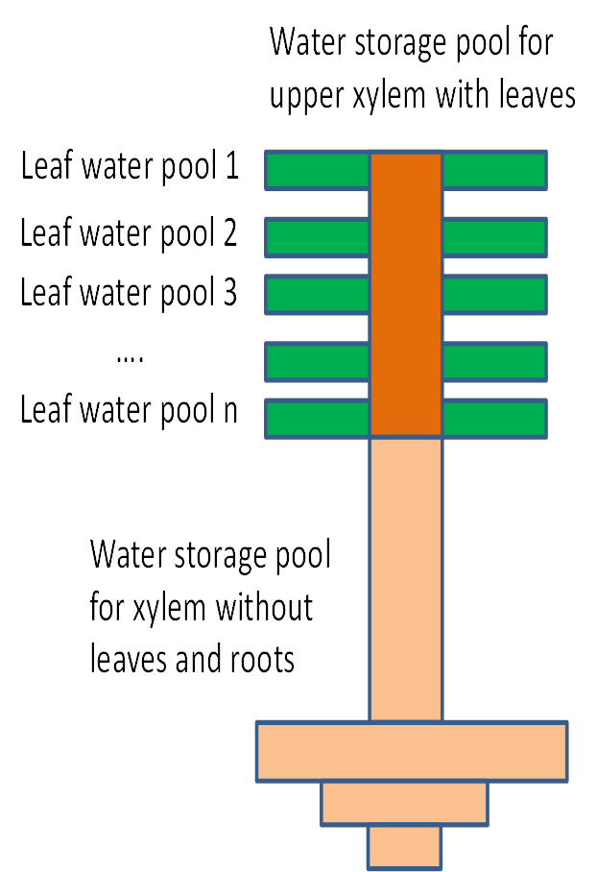
R:
Toward a better prediction of water stress on vegetation dynamics in ALM
Chonggang Xu, Bradley Christoffersen, Daniel Johnson, Wei Liang, Sanna Sevanto, Rosie Fisher, Henry Adams, Nate McDowell
Los Alamos National Laboratory
Predictions of piñon pine mortality events using our hydrodynamic model (McDowell et al 2016. Nature Climate Change).
Objective
We are developing process-based plant hydrodynamic models to predict the impact of water stress on vegetation growth and tree mortality, for a better prediction of terrestrial carbon and water cycles in ACME.
Plant hydrodynamic model and its evaluations at one drought-experimental site in New Mexico
Days from Jan 1st, 2007
Days from Jan 1st, 2007
For additional information, contact:
Chonggang Xu
Los Alamos National Laboratory
505-665-9773
cxu@lanl.gov
climatemodeling.science.energy.gov/acme

