Slide 1
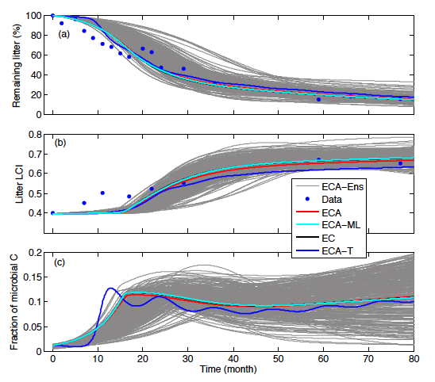
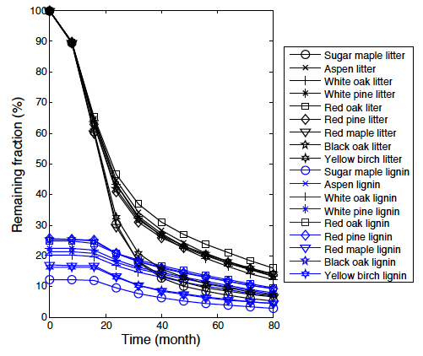
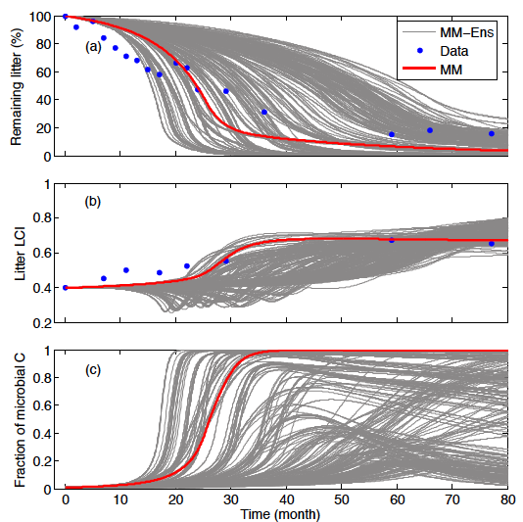
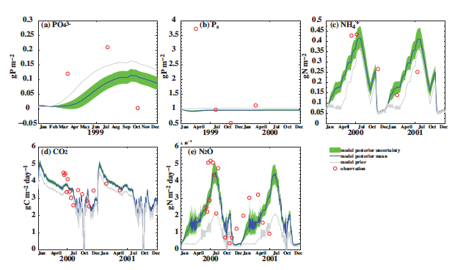
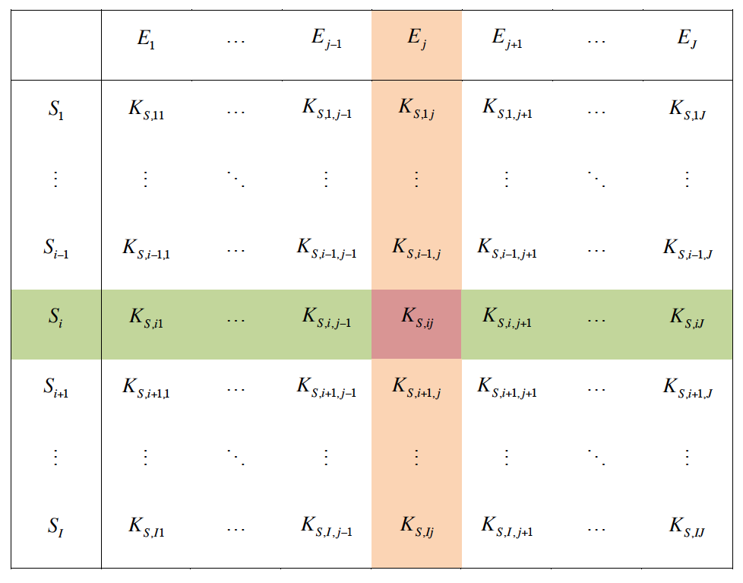
Representing Substrate Competition in Biogeochemical
Networks Using the ECA Kinetics
Jinyun Tang (jinyuntang@lbl.gov), William J. Riley, and Qing Zhu
Introduction and Objective
Results
For biogeochemistry, competition for carbon and nutrients between microbes, plants, and abiotic processes is critical
Substrate competition in existing land biogeochemical models is typically represented linearly, with a few using Michaelis-Menten Kinetics
Theoretically, these approaches are applicable only when substrates are abundant, which is typically not the case in natural ecosystems
Further, even the mechanistically based Michaelis-Menten kinetics are insufficient when more than one substrate is competed for
In a previous study (Tang and Riley, 2013), we showed that under the more general situation where many agents are competing for multiple substrates, the Law of Mass Action (LMA) is appropriate and that Equilibrium Chemistry Approximation kinetics are a good approximation to the LMA
Figure 2: The ECA kinetics predicts litter decomposition dynamics (left and middle plates), whereas MM kinetics failed even after calibration (right plate).
Figure 3. The ECA kinetics successfully predicted the competition for NH₄, NO₃, and PO₄ by microbes and plants. (Zhu et al., 2015)
Approach
Impact
Apply ECA kinetics to litter decomposition and ALM nutrient competition
Figure 4. Probability density of f_{denit} (proportion of terrestrial nitrogen lost to denitrification vs. total nitrogen losses) from CLM4.5 (upper left) and the improved CLM4.5 (upper right). Latitudinal distributions of f_{denit} from improved CLM4.5 and Houlton’s dataset¹. Error bars indicate the longitudal variation of f_{denit} within each latitudal bands (Zhu et al. 2015, submitted Nature Climate Change)
ECA kinetics solve for the product P_{ij} from the following equation
Ongoing work includes using ECA kinetics to formulate more aspects of the biogeochemical modeling in ALM. We expect great improvement for ALM when compared to other land biogeochemical models.
References
Figure 1. Schematic of the ECA kinetics (Tang and Riley, 2013)
Tang and Riley, Biogeosciences, 2013.
Zhu et al., Biogeosciences discuss, 2015.
Zhu and Riley, submitted to Nature Climate Change.
For additional information, contact:
Staff Member
Title
Institution or Organization
(555) 555-1234
staff.member@email.gov
climatemodeling.science.energy.gov/acme

