Slide 1
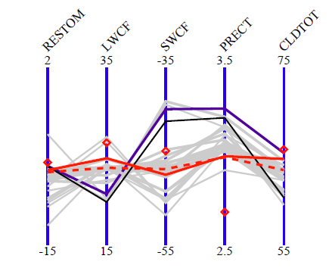
R:
Strategy for Tuning High-Resolution ACME V1 Model
W. Lin¹, S. Xie², P. Ma³, P. Rasch³, Y. Qian³, H. Wan³, S. Klein², C. Golaz², P. Cameron-Smith², Q. Tang²,
H. Wang³, K. Zhang³, S. Burrows³, J. Bacmeister,⁴ R. Neal⁴, C. Hannay⁴, V. Larson⁵, A. Gettelman⁴
1 BNL, 2 LLNL, 3 PNNL, 4 NCAR, 5, UWM
Objective
91
CAPT
AMIP
41
The ACME V1-alpha atmosphere model, while well tuned for 1° resolution, needs to be retuned for 0.25° resolution to reduce large mean biases. The computational burden is heavy. This work describes an effective strategy for tuning high-resolution ACME model through extensive use of the Cloud Associated Parameterization Testbed (CAPT) framework for an iterative CAPT-AMIP approach at each stage of development cycle.
18
Walltime
4
Obs
AC01
AC03
CAPT
CAPTf
AC03T
1350 nodes
4050
Global JJA mean stats from CAPT and AMIP runs. AC01 and AC03 use default. CAPTf and AC03T use same tuning parameters
Illutration of walltime for CAPT (5day) and AMIP (JJA or 15mon) simulations on Titan. One unit is 42 minutes.
Highlight of Results
Large biases in key quantities in high-res. model when using parameters well-tuned for low-res.
A small number of CAPT hindcasts are used to effectively gauge the tuning response at high-res.
Computational cost for a CAPT test is 1/25th or less compared to a typical AMIP test.
Walltime as small as 1/100th with bundling; turnaround even quicker as short large jobs favored on LCs.
CAPT hindcasts reproduced AMIP large biases in quantities closely related to physical parameterizations.
Well-tuned configuration based on CAPT consistently lead to improved AMIP simulations.
So far only need 1-2 AMIP simulations to reach the tuning target for each stage of development.
CAPT framework will be further explored for tuning other aspects of the ACME model.
For additional information, contact:
Wuyin Lin
Atmospheric Scientist
Brookhaven National Laboratory
(631) 344-7249
wlin@bnl.gov
climatemodeling.science.energy.gov/acme

