Slide 1
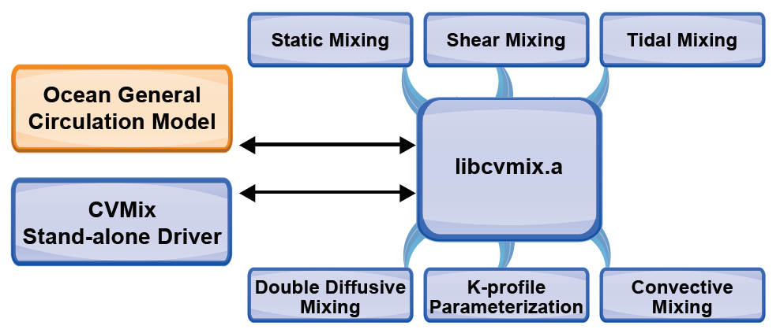
The Community Ocean Vertical Mixing (CVMix) Project
Ocean Surface Collaborative Science
CVMix is a broadly used computational modeling framework to calculate the small-scale transport of heat and gases between the ocean surface and the deeper ocean.
Collaborative Software
Developed by scientists from three modeling centers, CVMix optimizes a diverse set of approaches for vertical ocean mixing into a stand-alone library that can be implemented into other ocean models.
CVMix features a flexible benchmarking interface for both new and existing vertical-mixing models.
To date, CVMix has been integrated with E3SM Model Prediction Across Scales project (MPAS-Ocean); NOAA Geophysical Fluid Dynamics Laboratory’s Modular Ocean Model (MOM); and NCAR CSM Ocean Model (NCOM). For each, work is completed on interfaces, and all are operational.
CVMix FORTRAN modules are freely distributed using an open source GitHub repository.
Science Impact
CVMix addresses the needs of the various ocean-modeling groups to code, test, tune, and document parameterizations of ocean vertical mixing for numerical ocean simulations.
Get CVMix
Download at https://github.com/CVMix/CVMix-src or http://doi.org/10.5281/zenodo.1000801
Griffies et al. (2015), “Theory and Numerics of the Community
Ocean Vertical Mixing (CVMix) Project.” GitHub documentation Page: https://github.com/CVMix/CVMix-description/blob/master/cvmix.pdf

