Slide 1
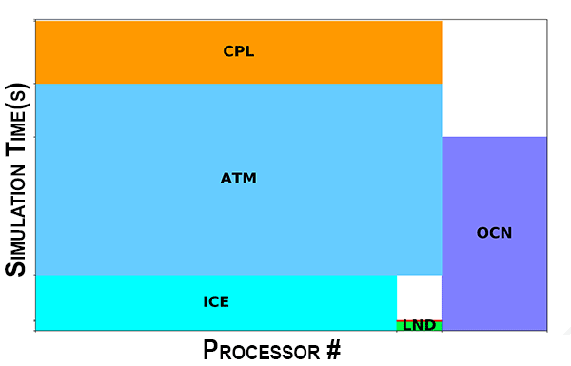
Performance Analytics for Computational Experiments (PACE)
Science
PACE (Performance Analytics for Computational Experiments) is a web-enabled framework that summarizes performance data collected from E3SM experiments.
PACE allows model developers to clearly see where processing time is spent, whether at an overview level as in the figure to the right, or at a much more detailed level where scientists can see how long certain code blocks took to run or compare one region of the model to another.
Example of a PACE “experiment details view” that shows the mapping of parallel processes to model components along with simulation time spent.
Science Impact
Access PACE
PACE Portal – https://pace.ornl.gov/
Reference Page –
https://e3sm.org/resources/tools/diagnostic-tools/pace
Videos –
Web Portal Features: https://youtu.be/0U-uu-5hn2Y
How to Upload Data: https://youtu.be/Vd3q3mJPQFs
PACE enables tracking performance benchmarks and simulation campaigns of interest
Facilitates performance research on load balancing and process layouts
Identifies bottlenecks for targeted optimization to improve model efficiency and throughput

