Slide 1
The ACME Single Column Model
Peter Bogenschutz and Peter Caldwell
Lawrence Livermore National Laboratory, Livermore, CA
Wuyin Lin
Brookhaven National Laboratory, Upton, NY
ACME All Hands Meeting, June 2017, Potomac, MD
This work is funded by the ACME Software Modernization CMDV Project
This work was performed under the auspices of the U.S. Department of Energy by LLNL under contract DE-AC52-07NA27344. LLNL IM: LLNL-PRES-732196

Slide 2
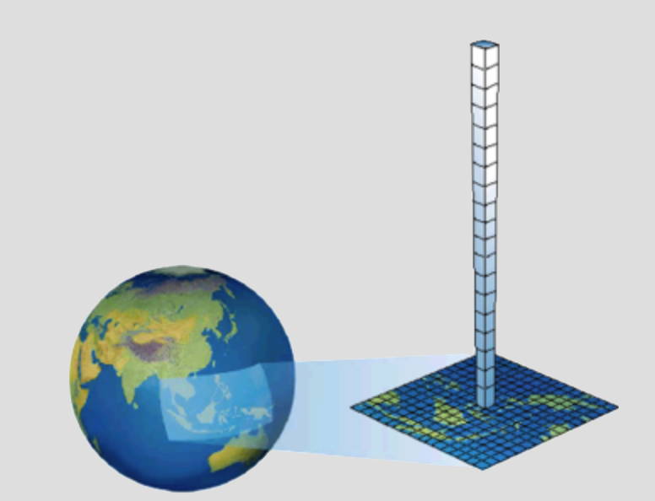
Single column model (SCM)
The SCM is a mode of the ACME model where a single column of the atmosphere is run in isolation with prescribed atmospheric dynamics. Land fluxes can be prescribed or the land model can be run in this configuration
The SCM is a very important tool for development of model parameterizations and can also be useful for model assessment and tuning
It allows developers to easily test a wide variety of model changes
Large number of SCM/GCSS cases exist that span a wide range of climate regimes

Slide 3
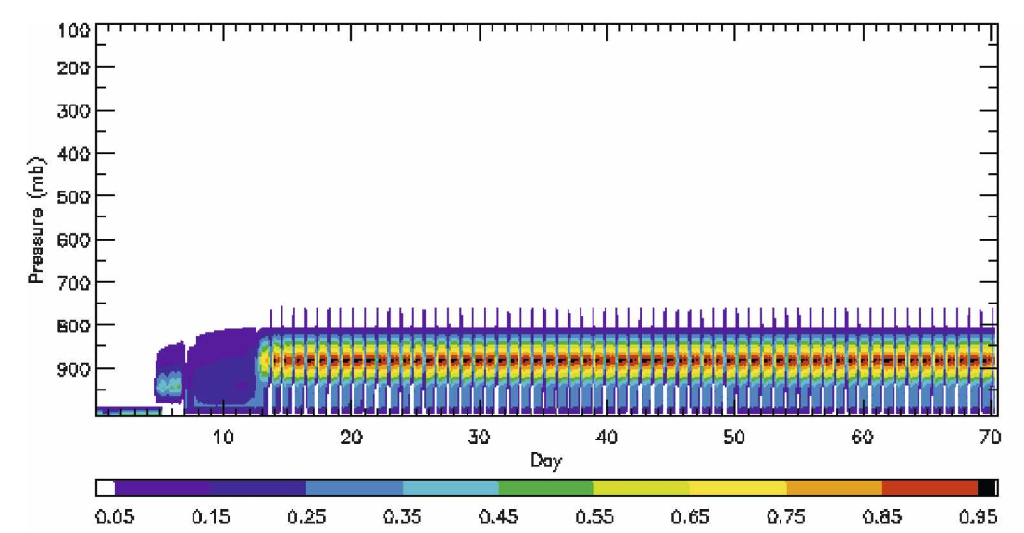
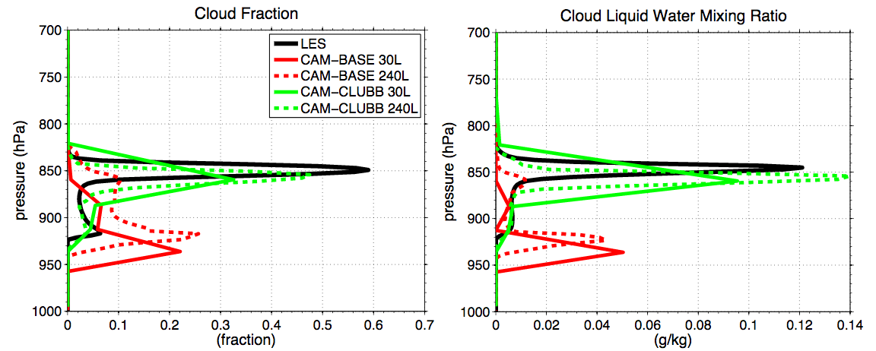
Examples of SCM usefulness
Simulated cloud amount
Zhang and Bretherton (2008)
Zhang and Bretheron (2008) used the SCM to show that cloud feedbacks in CAM3 were controlled by unphysical oscillations caused by interactions between convection and resolved-scale processes
Bogenschutz et al. (2012) used SCM to perform vertical resolution sensitivity tests with CAM with a new parameterization (CLUBB)

Slide 4
SCM Woes
Though a useful tool, the SCM has received minimal support. Often times, this results in a broken version of the model, which can be time consuming to sort out.
Scripts to run the SCM are often passed from user-to-user. Can result in improper case setups and unscientific solutions.
With the upgrade to a modal aerosol model, aerosols by default are initialized to zero. This can significantly effect the SCM solution.
Lack of ”idealizations” required for apples-to-apples comparison with select large eddy simulation (LES) intercomparison studies.
The ACME SCM runs with a dynamical core (Eulerian) which is not the same as the full model (Spectral Element)

Slide 5
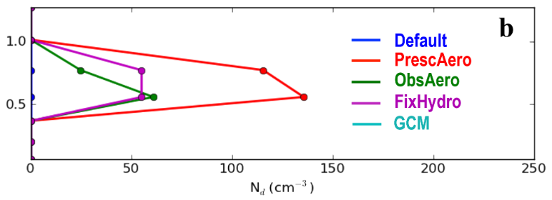
ACME SCM Aerosol specification
ACME SCM initializes all aerosol mass mixing ratios to zero
This results in unrealistically low aerosol concentrations until surface emissions loft sufficient aerosol (process can take several days)
Most GCSS boundary layer cloud cases are hours in length
In addition, with ACMEv1 shallow convective clouds are tied to the MG microphysics
SOLUTION: We implemented the modifications presented in Lebassi-Habtezion and Caldwell (2014)
Nd from DYCOMS-RF02 (drizzling marine stratocumulus)
From Lebassi-Habtezion and Caldwell (2014)

Slide 6
ACME SCM Aerosol specification OPTIONS
Aerosol specification may be accomplished via one of three methods as documented in BLP2014:
Fix cloud-droplet (Nd) and ice crystal (Ni) number concentration
Prescribed aerosols
Prescribes mass mixing ratios of aerosol species based on climatologies
Derived from a long prognostic-aerosol run
Observed mixing ratios
Apply the observed mixing ratios and size distributions to the aerosols (where available)
IT IS IMPORTANT to run with one of these three options (ACME SCM scripts will make you pick one… and will have a default value for supported cases).
When in doubt, run with prescribed aerosols.

Slide 7
ACME SCM Idealizations
Idealizations have been (or will be) implemented to allow the user to run with GCSS specifications for some cases
Turn off shortwave or longwave radiation
Turn off microphysics computation (not yet on master)
All idealizations controlled by namelist flags
Idealizations will be added as they are needed and options will be set to the appropriate default in the run script for that particular case
Support will be added for Lagrangian type cases (i.e. CGILS)

Slide 8
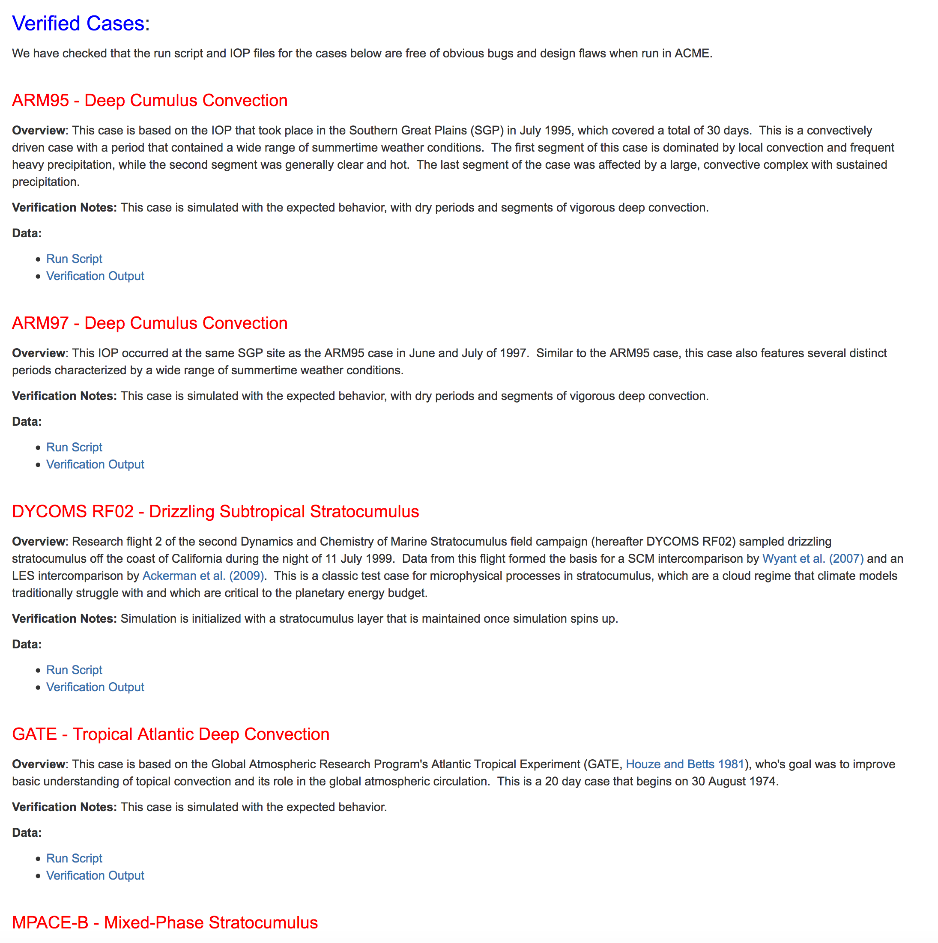
SCM Case library
Confluence How-To page documents the SCM cases library, in addition to obtaining relevant scripts
https://acme-climate.atlassian.net/wiki/display/Docs/ACME+Single-Column+Model+Case+Library
VERIFIED CASES: ARM95, ARM97, DYCOMS2-RF02, MPACE-B, RICO, TOGA-COARE, TWP-ICE, GATE
UNVERIFIED CASES: ARM-GCSS, ATEX, BOMEX, DYCOMS2-RF01, SPARTICUS, RACORO
COMING SOON: MC3E, MAGIC, CGILS
Want a case not listed? Want to contribute a case? Let us know!
Verified Case = We have checked that the run script and IOP files for the cases below are free of obvious bugs and design flaws when run in ACME.

Slide 9
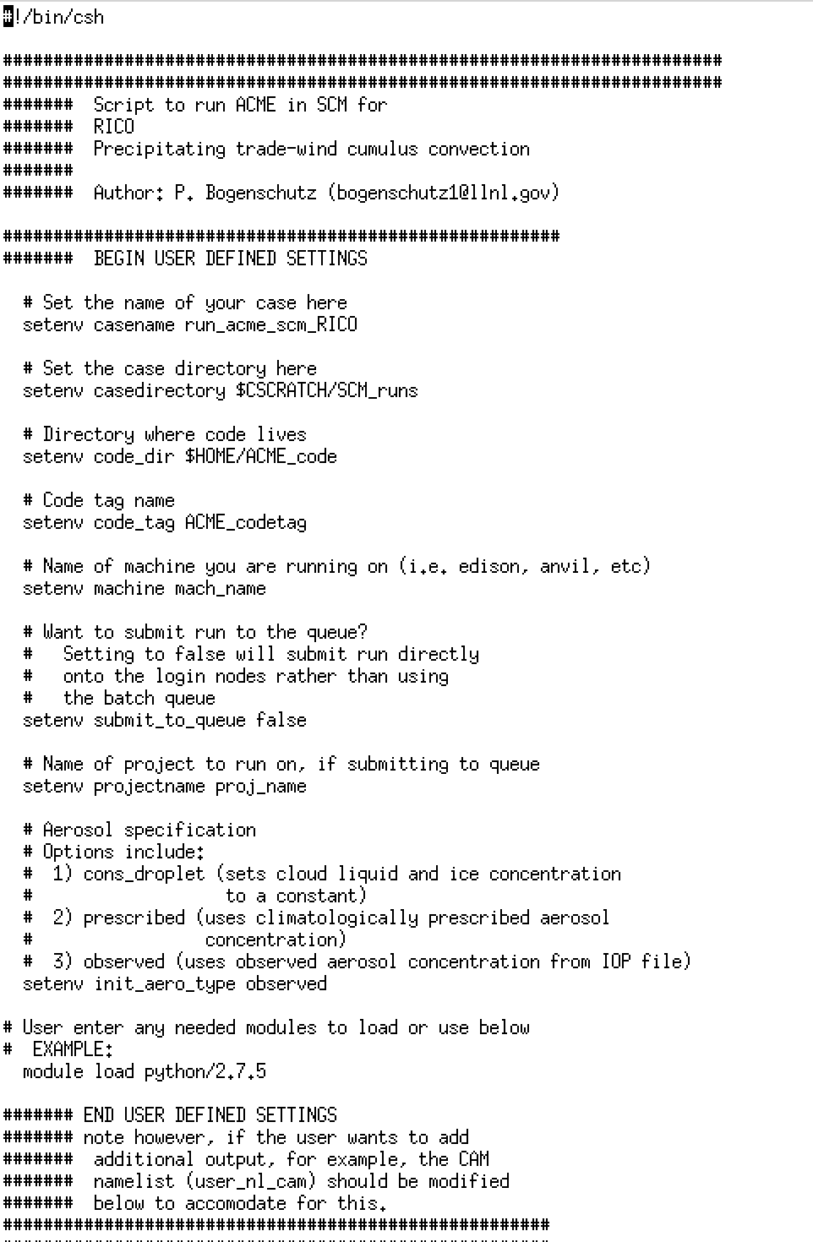
I want to run ACMe scm! What do I do?
Check out ACME master (must be master post May 11, 2017)
Visit the ACME Case Library Page (confluence, under How-To articles) to grab a script for a case you would like to run
Edit the “User Defined Settings” and run!
Scripts have been tested on Edison, Anvil, and Livermore Computing but should work on any ACME supported machine
A companion “How-to” page exists for running/compiling the SCM (though the scripts are the best resource)

Slide 10
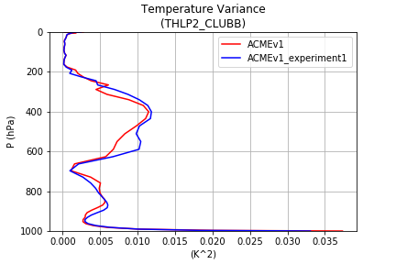
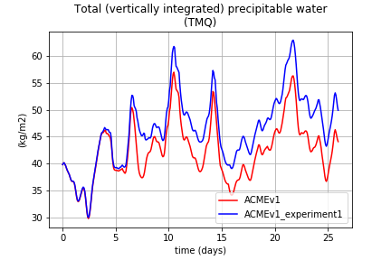
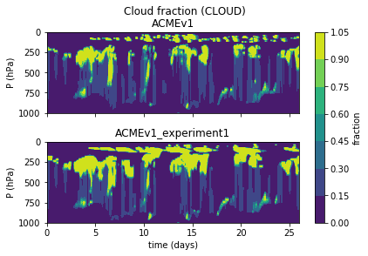
ACME SCM Diagnostics Package
(coming soon)
Profiles
Written in Python
Generates hundreds of plots in seconds for any number of simulations
Support for LES and Observational comparison coming soon
Timeseries

Slide 11
Where are we going?
Slab-ocean SCM capability
Functionality for Lagrangian cases (i.e. MAGIC, CGILS)
Hardened ACME SCM diagnostics
Dependence of SCM on Eulerian dynamical core removed via either:
Setting up the SCM to work with the SE dy-core
Runing the GCM with 6 identical columns and prescribed dynamics
Ability to extract boundary conditions from a GCM run and use it to exactly reproduce the behavior of a single column in SCM mode (a.k.a. “global-IOPs”)
Answer the science question “Does ACME SCM provide a proxy of the full model? Why or why not?”

