Slide 1




HiLAT/RASM Arctic-Focused Science
Notes:
Notes from DOE Budget
Page 136 Evolution of RGCM → RGMA
Core research in model intercomparison and diagnostics will continue. Research will continue to explore how modes of variability affect spatial and temporal patterns of weather and extreme events, including the roles of atmospheric rivers and droughts. The incorporation of uncertainty and performance benchmarks will increasingly become part of research efforts
Higher resolution models, including the new E3SM v1 model to be released in FY 2018, will allow a new level of scientific study involving high resolution process interactions and interdependencies. Models focus on new science on sea ice variability and biogeochemistry coupling with atmospheric and dynamical forcing. Research is eliminated for integrated modeling of impacts, adaptation, and vulnerability as well as for coupled climate-human system interdependencies of the energy-water nexus.

Slide 2
High-Latitude Application and Testing of Global and Regional Climate Models
HiLAT SFA
DOE Science Focus Area (SFA) under RGCM (begun June 2015)
Joint between LANL and PNNL
Renewal proposal due in March 2018, Jointly with RASM
PNNL
Phil Rasch (co-PI)
Susannah Burrows
Hailong Wang
Ben Kravitz
Hansi Singh** (PD)
LANL
Wilbert Weijer (PI)
Matthew Hecht
Milena Veneziani
Joseph Schoonover (PD)
Jiaxu Zhang (PD)
Elizabeth Hunke
Jorge Urrego-Blanco (PD)
Scott Elliott
Nicole Jeffery
Shanlin Wang
Jeremy Fyke
Nathan Urban
Darin Comeau (PD)
Joel Rowland
Anastasia Piliouras (PD)
Funded Collaborators
Gokhan Danabasoglu (NCAR)
Who Kim (NCAR)
Georgina Gibson (UAF)
Unfunded Collaborators
Wei Cheng (UW)
Bill Lipscomb (NCAR)
Catrin Mills* (PD)
Jinho Yoon* (GIST)
C. Zender (UCI)
S. Smith (PNNL, NASA)
*formerly at PNNL
*supported as a PNNL Pauling
Fellow
Capabilities
Atmosphere
Ocean
Sea Ice
Marine Biogeochemistry
Land Ice
UQ
Terrestrial Hydrology

Slide 3
RGCM High Latitude Science Themes (Grand Challenges)
Roles of regional processes and feedbacks on the high-latitude Earth System (variability and trends)
  interactions btw cryosphere, ocean, land and atmosphere
  Terrestrial and Marine Ecosystems
  Component responses to environmental change
Coupling between Low and High Latitudes
  High latitude changes impact mid-latitude weather
  MOC impacts on the Earth system (e.g. shifts in ITCZ)
  Mid / Low latitude transports influencing High Latitudes
How do interactions between Land-Ice, Ocean, and Atm affect SLR?
How does high latitude environment change affect Carbon and Methane budgets in the ES?

Slide 4
Themes for next phase of HiLAT (physics emphasis)
What are the mechanisms responsible for thermodynamic and water changes in high latitude? What are connections with Arctic Sea Ice change? What are the consequences to the rest of the planet?
Objective
changing Arctic features (warming events and sea ice loss) may drive changes in extreme weather at lower latitudes
Sudden Stratospheric Warmings (SSW, ) warm at high altitudes
Rapid Tropospheric Warmings (RTW) warm at lower altitudes
Changes in the frequency of occurrence of Arctic warming events
Wang, S-Y Simon, Y-H Lin, M-Y Lee, J-H Yoon, JDD Meyer, and PJ Rasch. “Accelerated Increase in the Arctic Tropospheric Warming Events Surpassing Stratospheric Warming Events during Winter.” Geophysical Research Letters 44(8), (April 28, 2017): 2017GL073012. DOI: 10.1002/2017GL073012

Slide 5
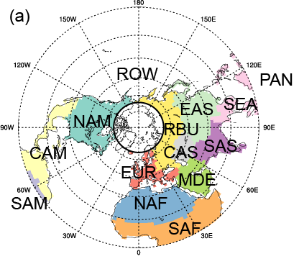
Arctic water cycle and control mechanisms (aerosols)
Aerosol source regions/sectors
Water source regions
H. Wang, and/or J. Fyke
and HiLAT team
Attribution of linear trend in zonal mean water vapor mixing ratio (1980-2015)
Total
ARO
ARL
aerosol/water tagging, with nudging to reanalysis winds
Role of Arctic clouds in teleconnections
Water sources driving surface mass balance
LND
SNP
NAO
Notes:
Talking points:
Developed a new aerosol tagging by source regions, species (BC, POM, sulfate/sulfur), and/or emission sectors to study aerosols and their impact in the Arctic
Apply the water source tagging to study poleward moisture transport and impact on precipitation and AIS/GrIS surface mass balance
Give an example of a recent focus on source attribution of Arctic water vapor trend

Slide 6
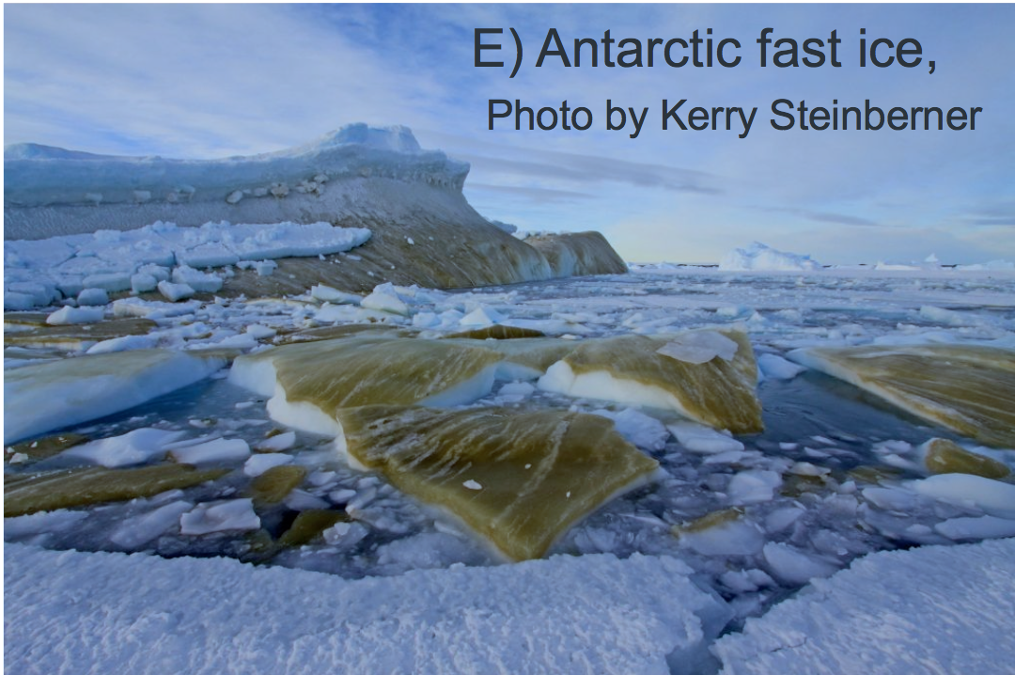
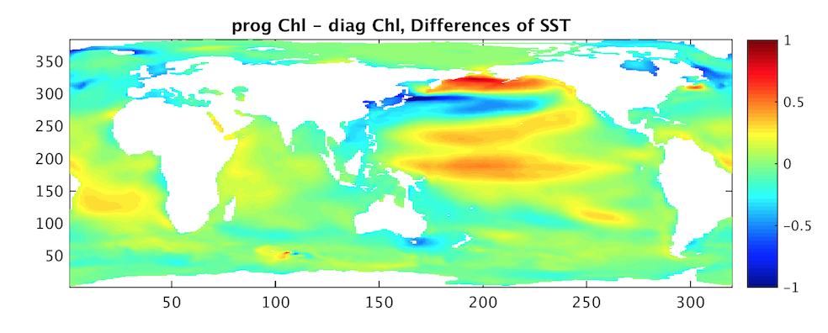
Themes for next phase of HiLAT (BGC emphasis)
How do ocean constituents affect the Earth System? What implications does this have for high latitude climate dynamics?
Temperature change associated with
prognostic treatment of ocean color in long simulations (Wang et al)

Slide 7
DOE’s Introductory paragraph describing RGCM
(not a word has been modified)
The goal of the RGCM program is to advance the predictive understanding of Earth’s climate by focusing on scientific analysis of the dominant sets of governing processes that describe climate change on regional scales; evaluating robust methods to obtain higher spatial resolution for projections of climate and earth system change; and diagnosing model systems that are cause for uncertainty in regional climate projections.
The program goal is accomplished through sensitivity studies and applications of regional and global earth system models that focus on various aspects of the climate system, including but not limited to, the understanding of feedbacks within the climate system, detection and attribution studies, developing capabilities for decadal predictability, and uncertainty characterization.
RGCM investments are also dedicated to development of metrics for model validation, that in turn may be used to inform the model development strategies of Earth System Modeling (ESM), and to inform the process research priorities of the Terrestrial Ecosystem Sciences (TES) and the Atmospheric Systems Research (ASR) programs. RGCM also coordinates with the Integrated Assessment Research (IAR) program on understanding individual and select coupled systems, such as water resources, critical for the energy mission.

Slide 8
DOE’s Introductory paragraph describing RGCM
(not a word has been modified)
The goal of the RGCM program is to advance the predictive understanding of Earth’s climate by focusing on scientific analysis of the dominant sets of governing processes that describe climate change on regional scales; evaluating robust methods to obtain higher spatial resolution for projections of climate and earth system change; and diagnosing model systems that are cause for uncertainty in regional climate projections.
The program goal is accomplished through sensitivity studies and applications of regional and global earth system models that focus on various aspects of the climate system, including but not limited to, the understanding of feedbacks within the climate system, detection and attribution studies, developing capabilities for decadal predictability, and uncertainty characterization.
RGCM investments are also dedicated to development of metrics for model validation, that in turn may be used to inform the model development strategies of Earth System Modeling (ESM), and to inform the process research priorities of the Terrestrial Ecosystem Sciences (TES) and the Atmospheric Systems Research (ASR) programs. RGCM also coordinates with the Integrated Assessment Research (IAR) program on understanding individual and select coupled systems, such as water resources, critical for the energy mission.

Slide 9
Paths Forward (Phil’s vision)
Roles of ESM/ACME & RGCM/HiLAT/RASM
HiLAT
  Better understanding of the Earth system
  Developing and Using analysis tools, observations, diagnostics
    Diagnosis
      How does the ES work?
      strengths and weaknesses of models
    Identifying opportunities for improvement
      what happens if process X is changed to remedy a deficiency?
      What happens if missing process Y is added?
ACME
  Better understanding of the Earth system
  Developing and designing an Earth System Modeling Environment for today and tomorrow
    Anticipating and meeting needs for next generation science and computational opportunities in Earth System Science

Slide 10
Opportunities for collaboration
HiLAT expects to use ACME V1 for some science.
  Some activities will require high resolution
  It makes sense to use a regionally refined configuration
If HiLAT has access to prototypes of V2 it could
  Identify deficiencies relevant to high latitude ES features
  Identify tuning changes that might address some deficiencies
  Identify opportunities for improvement (e.g. a missing process, or alternative formulation for a process)
  These insights might be useful for ACME V3

