Slide 1
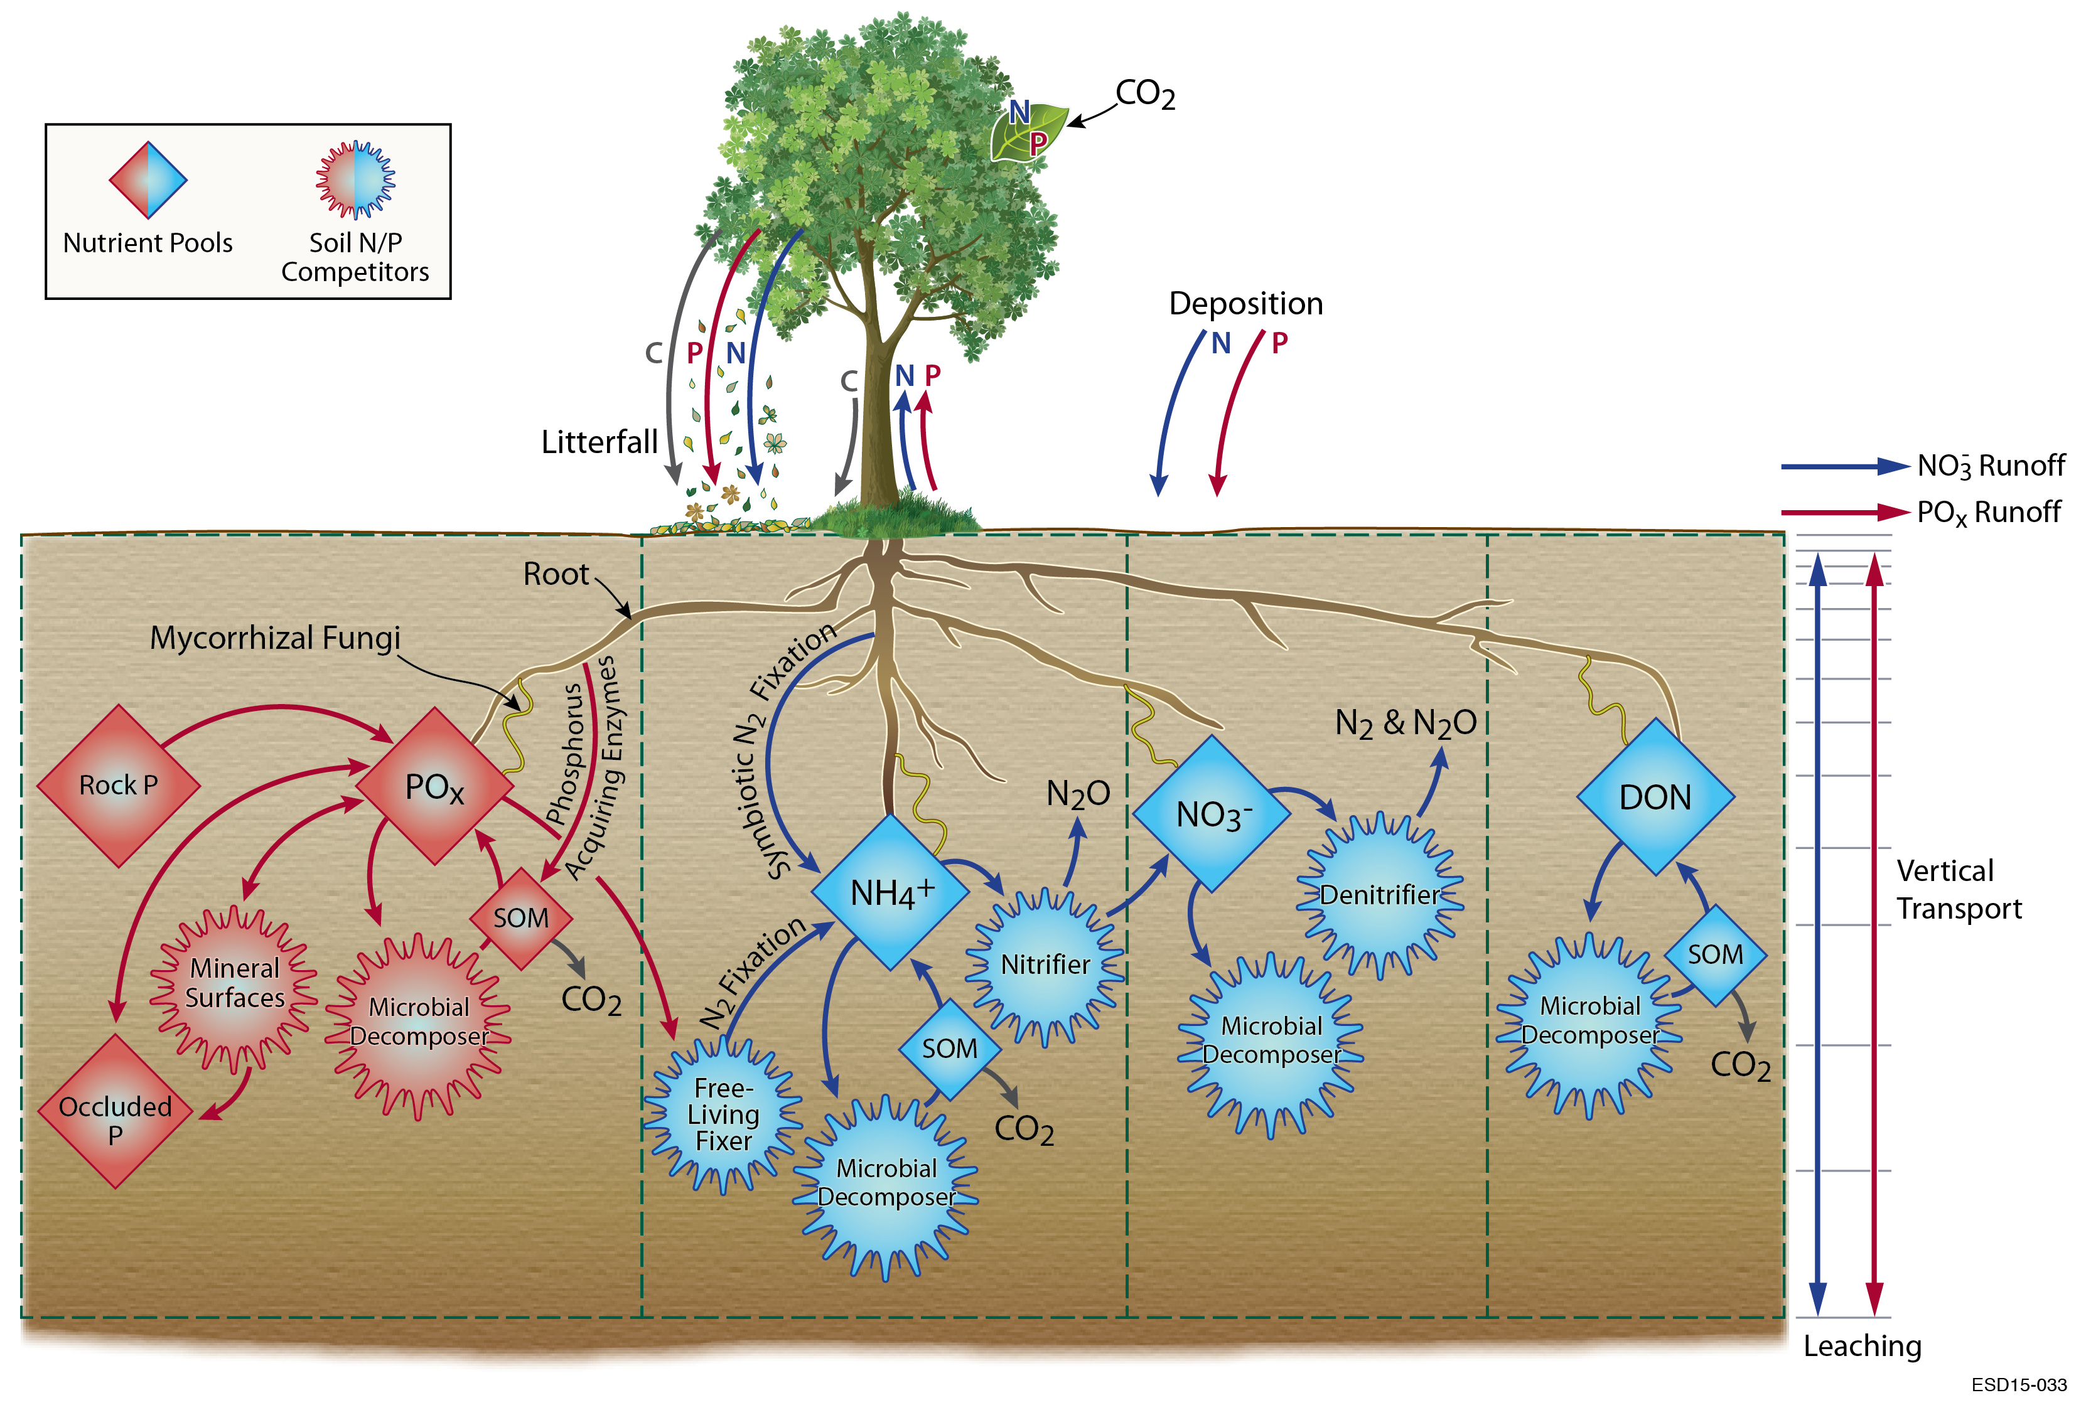
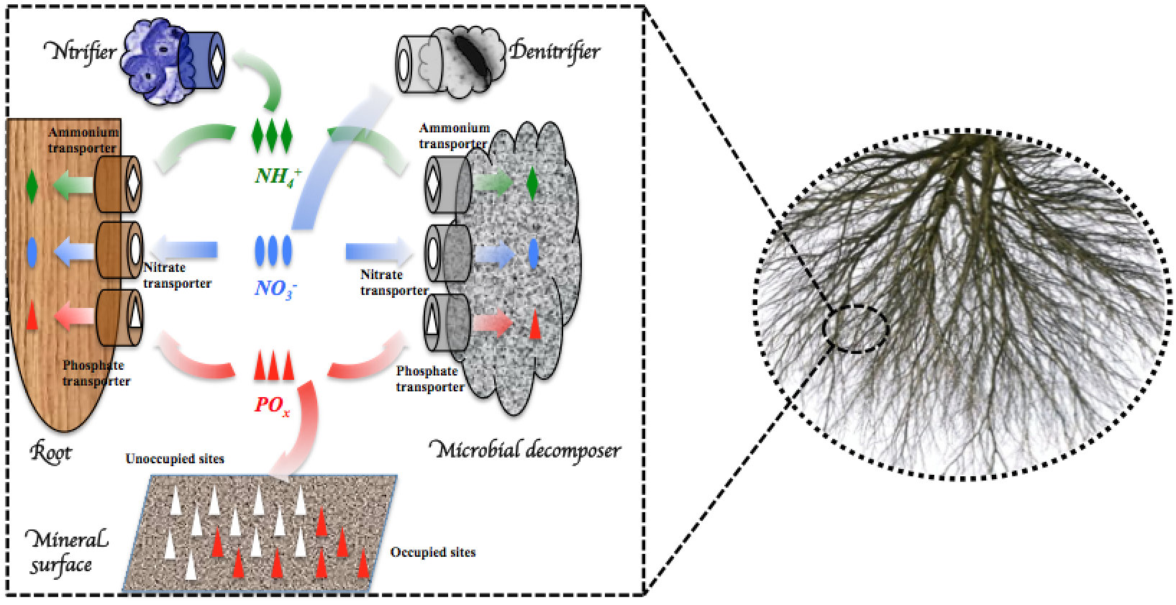
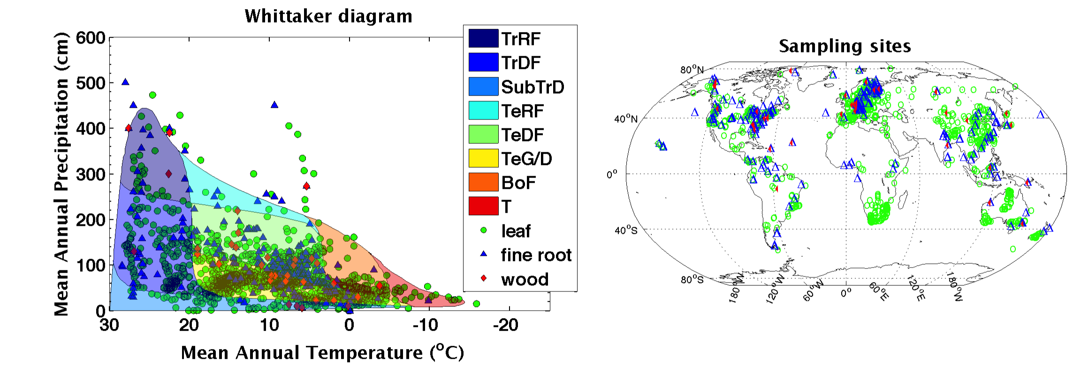
Development and testing of
ALMv1-ECA-CNP
Qing Zhu, William Riley, Jinyun Tang
Abstract
Overview of ALMv1-ECA-CNP
We describe here model development and benchmarking for one of the two land model versions integrated in ALMv1 that will participate in the BGC Inter-comparison: ALMv1-ECA-CNP. ALMv1-ECA-CNP is unique in several ways that strongly affect the model's estimates of terrestrial C budgets: (1) plants have a flexible CNP stoichiometry; (2) plant allocation and storage are dynamic and respond to nutrient, water, and light stresses; (3) a multi-element co-limitation concept replaces Liebig's law of the minimum for nutrient controls on photosynthesis; (4) multiple substrate & nutrient competition is based on the Equilibrium Chemistry Approximation (ECA); and (5) BeTR vertically-resolved multi-phase reactive transport solver is used for numerically robust solutions. This poster describes the model assumptions, implementation, benchmarking, and predictions of global C, N, and P dynamics.
In addition to new competition module and plant stoichiometry, other new components including (1) N/P limitation on photosynthesis rate is directly modeled as non-linear scaling relationship between leaf level N/P concentration and vcmax, supported by big dataset; (2) we used a dynamic allocation scheme that consider the stress coming form N, water, light
Approach
Impact
We adopted Equilibrium Chemistry Approximation (ECA) approach to model belowground complex nutrient competition (Zhu et al., 2017).
Global benchmarking using ILAMB (The International Land Model Benchmarking Project).
(a)
(b)
We synthesized plant C:N:P stoichiometry for ALM (Zhu in prep)
(c)
Global benchmark of GPP from 1982-2008. ALMv0 (blue lines) overestimate GPP for high latitude evergreen needle leaf trees and tropical evergreen broadleaf trees. Those bias was significantly reduced in our new version.
Significant bias reduction for LAI in the v1 (blue bars) compared with v0 (red bars).
1 m depth soil carbon benchmark, we compared various different earth system land models (from CMIP5) we well as ALMv1-ECA-CNP against Harmonized World Soil Database.
For additional information, contact:
Qing Zhu
Research Scientist
Lawrence Berkeley National Laboratory
qzhu@lbl.gov
climatemodeling.science.energy.gov/acme

