Slide 1
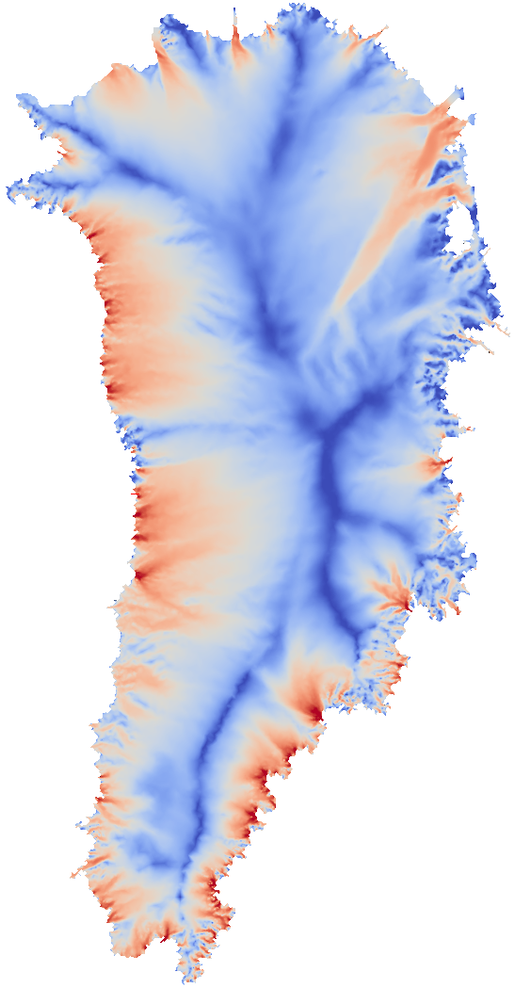
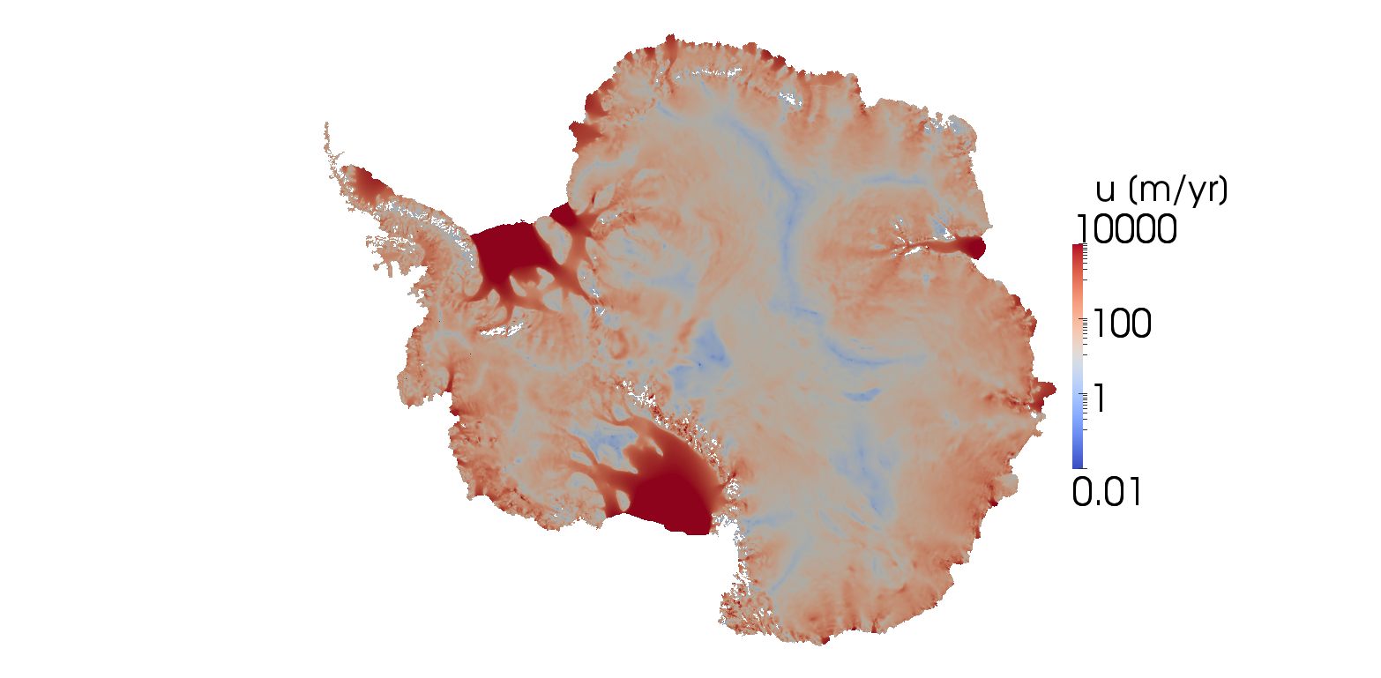
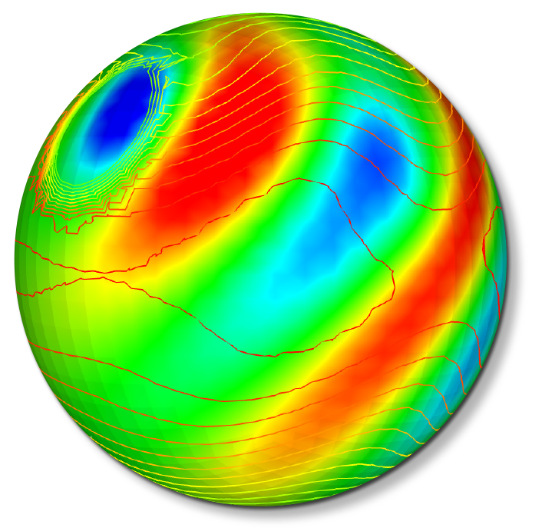
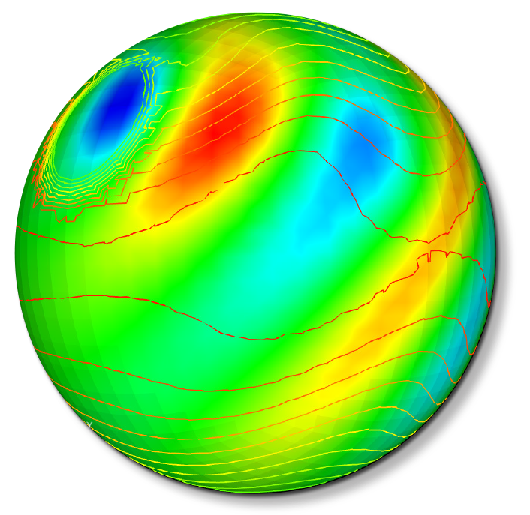
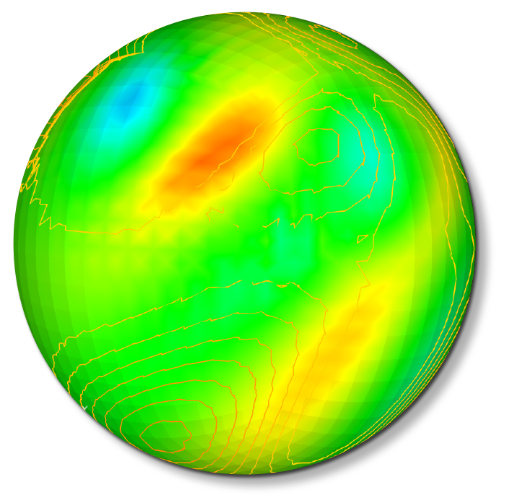
“CMDV Software”
ACME-SM: A Global Climate Model Software Modernization Surge
PI / Computational Lead: Andy Salinger (SNL)
Deputy PI / Climate Lead: Peter Caldwell (LLNL)
Site PIs: Hui Wan (PNNL), Rob Jacob (ANL), Salil Mahajan (ORNL)

Slide 2
CMDV Software: “ACME-SM: A Global Climate Model Software Modernization Surge”
  Goal: To improve the state of ACME software to accelerate scientific discovery
Proposal themes:
  To move DOE climate modeling towards decision support
  To improve agility for ongoing architecture disruption
  To fully leverage DOE computational science expertise
Project Constraints:
3 years: tasks should be complete, minimal mortgage
  More risky then ACME, less then SciDAC
  One-time opportunity
Proposal Challenge: Independent tasks, but not a laundry list
2

Slide 3
“ACME-SM: A Global Climate Model
Software Modernization Surge”
Proposal themes:
  To move DOE climate modeling towards decision support
  To improve agility for ongoing architecture disruption
  To leverage DOE computational science expertise
Selected tasks (associated theme #):
Build System Upgrade (2,3)
Unit Testing (1,2,3)
Climate Reproducibility tests: regression for chaotic systems (2)
Verification: Focus on Atm Physics (1)
Develop Single Column Model (1,2)
Concurrent Atm physics and dynamics (2)
Next-Gen Coupler: time stepping and interpolation (3)
Migration of HOMME to C++/Trilinos/Kokkos (3,2)
Software Engineering Education (3)

Slide 4
Task 01: CMake-based Build System
Brent Perschbacher, Andy Salinger
Goal:
Improve flexibility of ACME build system by migrating it to Cmake
  Make C++ a first-class ACME citizen
Move towards better run-time (rather than compile-time) configurability to improve testing efficiency
  Target developers in addition to scientists with ACME infrastructure

Slide 5
Task 02: Sub-Component Functionality Unit Testing
Anshu Dubey, Andreas Wilke
Goal: Develop a robust capability for testing isolated pieces of ACME code, for efficient test coverage and ability to do targeted performance optimizations
Plan:
Develop and document a unit-testing framework
Build unit tests for ACME code along with developers
Check for and report test coverage
Conduct tutorials and hackathons to encourage use

Slide 6
Task 03: Climate Reproducibility Tests:
Develop Tests for Climate Impact of non-Bit-for-Bit Code Changes
Peter Caldwell, Hui Wan, Salil Mahajan, Joe Kennedy, Kate Evans, Balwinder Singh, Phil Rasch
Goal: Provide ACME with tests to check whether answer-changing modifications affect model climate
  Allow CS experts to verify changes without engaging climate scientists
Plan:
We will test 3 methods:
  Applying multivariate methods to 1 yr simulations (Mahajan)
  Single-step perturbation growth test (Singh)
  Timestep sensitivity for 5 min simulations (Wan)
We will design a common framework/test cases for these methods (Kennedy)

Slide 7
Task 04: Verification
Hui Wan, Bill Spotz, Dick Easter, Vince Larson, Peter Caldwell, Postdoc?
Goal: Assemble verification evidence for ACME, starting with Atmosphere physics parameterizations.
  Nudge the culture towards the expectation of generating verification evidence before validation/tuning begins
Plan:
Develop tests of numerical implementation
  Correctness and convergence
Create web-based documentation of governing equations, tests, expected test results, and actual outcomes
Initial foci: MG2 microphysics, CLUBB, and MAM aerosol treatment

Slide 8
Task 05: Single-Column Model
Peter Caldwell, Pete Bogenschutz
Goal: Modernize the existing atmospheric single-column model capability in ACME
Plan:
Verify that the existing implementation is scientifically credible and fix bugs as needed
Develop an online library of test cases and evaluation data
Modify the code to be dycore agnostic or at least to work with modern dycore options

Slide 9
Task 06: Parallel-Split Physics+Dynamics
Peter Caldwell, Aaron Donahue
Goal: Create a version of ACME where atmospheric physics and dynamics run concurrently. This will greatly improve time-to-solution by exposing more parallelism
Plan:
Evaluate climate impact of parallel splitting
Deal with conservation errors due to parallel splitting
Put physics and dynamics on separate cores
Evaluate performance impact

Slide 10
Task 07: Modernize Coupler
Rob Jacob, Vijay Mahadevan, Iulian Grindeanu, Jason Sarich
Goal: Upgrade the coupler to avoid performance bottlenecks on next-gen computers and meet upcoming ACME requirements
Plan:
Modify coupler to use MOAB data structures and communication/interpolation algorithms to improve scalability
Make the coupler more flexible in terms of time-stepping methods, variable names, etc
Modify coupler to allow for run-time specification of grids, components, and numerical methods for coupling
Implement hooks for dynamic load balancing
Expand depth of expertise in the Coupler on ACME project

Slide 11
Task 08: Rewrite Spectral Element Atmosphere Dycore in C++, Kokkos
Irina Tezaur, Oksana Guba, Dan Sunderland, Michael Deakin, Luca Bertagna, Andy Salinger, Bill Spotz
Goal: Rewrite SE dycore in C++ using Trilinos/Kokkos libraries for a single performance-portable implementation and to leverage ASCR staff and technologies
Plan:
Surround current code with tests (unit, regression, performance) on multiple platforms (CPU, Phi, GPU)
Transition kernels to use Kokkos programming model for performance portability, with single implementation
Migrate whole code to C++, using Trilinos libraries as appropriate
Tune code, investigate new algorithms, for performance

Slide 12
Task 09: Software Engineering Education Learning
Michael Heroux, Andy Salinger
Goal: Improve productivity of ACME developers in writing correct, maintainable, and performant code
Plan:
Gather info about current status of ACME code development
Develop online and (perhaps) class-based tutorials on topics of interest
  Minimum requirements for ACME developers?
Lead by example: demonstrate best practices within the CMDV-software team

Slide 13
Intra-Project Leverage
Atmosphere physics verification task will be early adopter of unit test framework
Climate reproducibility test harness will be expanded for use for automated verification (both do a series of runs in one test)
Coupler rewrite and SE dycore refactor will rely on build system upgrade
All CMDV Software team members will be early reviewers of Software Engineering Learning content
Many more…
Inter-Project Leverage
CMDV-atms, Climate ECP, LEAP-T
IDEAS, ECP Software, FASTMath, SciDAC-Apps-3,4

