Slide 1
run_acme A script for novices and experts to run ACME
Philip Cameron-Smith, Peter Caldwell, Chris Golaz, Qi Tang
ACME meeting, Fall 2016 (Denver)
LLNL-PRES-708641 Prepared by LLNL under Contract DE-AC52-07NA27344.

Slide 2
The Challenge
Do you wish there was a way:
to remember what you did for a run?
to show others what you did for a run?
to learn from others how to do a run?
to check someone else’s run?
to get workarounds for model bugs?
The solution: scripts

Slide 3
The Solution
Do you wish there was:
an easy way to shift between machines?
an easy way for new people to do a run?
an easy way for experts to achieve what they need?
Do you wish someone else would do this for you?
The solution: the run_acme script

Slide 4
run_acme philosophy
Record all setup and run steps in a single script,
Trivial to share and recreate simulation.
Capture and organize additional provenance,
Well documented options and features,
In the script, so it is easy to find and update.
Easy for novices,
Flexible for experts,
Easy to diff scripts to identify changes.
Uniform terminology and protocols,
Productivity enhancements (automation),
Github code extraction,
Daisy-chain batch-queue submissions.
Language universally available and known.
Capture script improvements in Github,
Only one person has to implement each fix and feature.

Slide 5
Standard options
Compset
Resolution
Machine & allocation
Extract code from Github (master, tag, hash, or branch)
Compile options (basic)
Delete key dirs for fresh setup (with abort countdown)

Slide 6
Standard options
CPU layout (standard or custom)
Simulation length
Submit daisy-chained jobs.

Slide 7
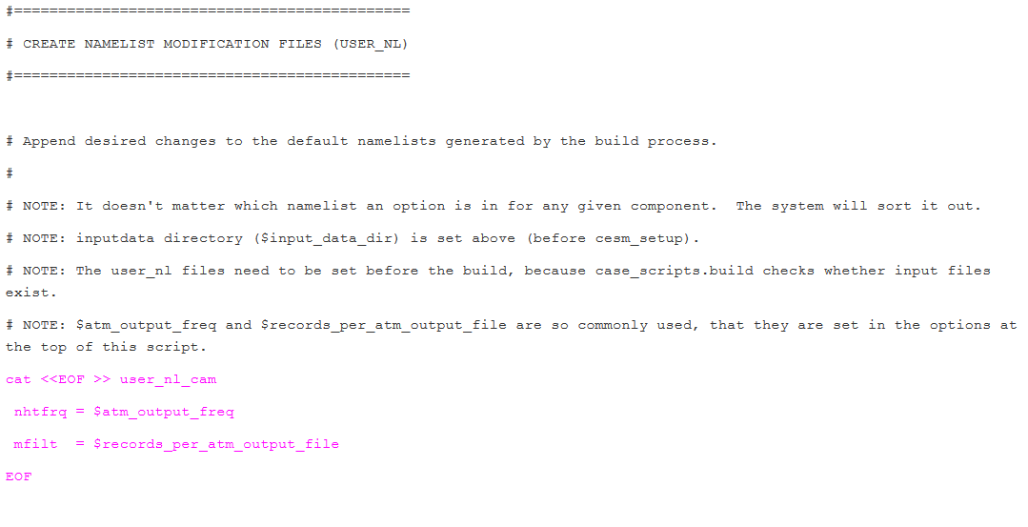
Organized in sections for experts
Organized into sections
Documentation
Namelist changes built-in.

Slide 8
Documenting Coupled Simulations

Slide 9
Documentation & Code
Overview of script:
https://acme-climate.atlassian.net/wiki/display/ATM/The+run_acme+script
Example Script:
https://acme-climate.atlassian.net/wiki/pages/viewpage.action?pageId=46301402
Github location:
https://github.com/ACME-Climate/SimulationScripts/blob/master/serving_as_a_template/recommended/run_acme.template.csh

Slide 10
Summary
One script to rule them all:
Capture Provenance,
Share runs and features,
Good for Novices & Experts,
Already in use by Coupled Group and others.

Slide 11
The End

Slide 12
The Challenge
“create_newcase –compset”
Recreates established case,
Good for code testing,
Must manually workaround ACME and machine bugs,
Difficult to share, so others will fall into the same traps,
Machine dependent.
Compsets have been done before!
New science simulations require changes,
Unwieldy to add a compset for everything.
Incomplete provenance capture,
Time-consuming to pass your run configuration to another user,
Need to document all steps, and some are often forgotten.
Steep learning curve for new users.

