Slide 1
Uncertainty exploration with GCAM
Abigail Snyder, Brian Hutchinson,
Claudia Tebaldi, Jonathan Lamontagne
On behalf of the GCIMS Team
Notes:
Brian's work with Claudia as task lead all sits within Experiment 1, our effort focused on exploratory models and large ens.embles

Slide 2
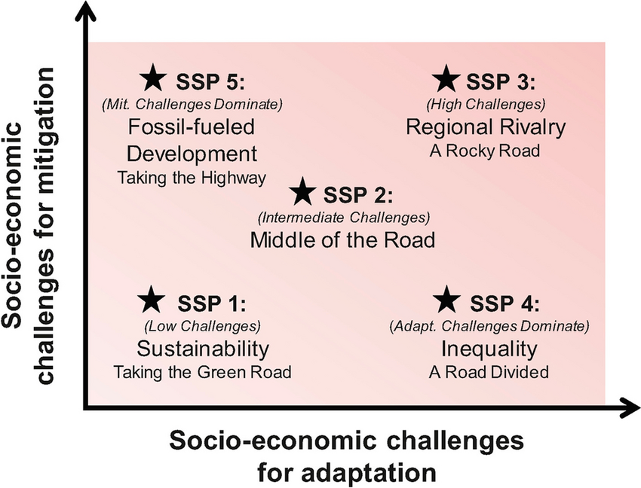
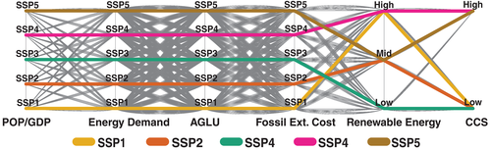
Scenarios have long played a critical role in exploring uncertainty in multisectoral modeling
SSPs: Targeted scenarios based on expert opinion.
Scenario Discovery: Expansive search to identify critical drivers.
GCIMS has pushed the envelope on this style via our collaboration with the Lamontagne Lab at Tufts.
Concern: Expert elicited scenarios may miss critical drivers, but scenario discovery can be inefficient (many factors don’t matter).
Proposal: Deep learning models can emulate GCAM, to help us target our search for interesting outcomes and get there more efficiently.

Slide 3
Scenario Discovery – Lamontagne Lab
scenario box
threshold
Scenario Discovery usually uses ML for classification.
Map Cases of Interest to Key Drivers
Factorial recombination of categorical inputs (Dolan et al 2021 Nature Comm Water Scarcity, Dolan et al 2022 Earth’s Future Land availability, Woodard et al 2023 EF Energy system makeup)
Or sampling continuous inputs in some dimension (Kanyako et al 2023 EF GDP and Population compounding uncertainties, Birnbaum et al 2024 ERL Hydrological uncertainty)
Notes:
Our friends at the Lamontagne Lab have a ton of expertise on the latter style of analysis.
Animation: For a variety of different input features that experts may think are relevant to some question we have, a large ensemble of GCAM runs are performed. These are citations looking at different questions and different sectors.
In any of these studies, we’re defining a question ahead of time and translating that into Cases of Interest (green texts) - they’re usually defined in terms of some kind of high or low thresholding way, and we look at all the scenarios that meet that threshold. So for example, in Flannery Dolan’s 2021 paper, looking at scenarios with low water availability in response to a lot of drivers.
Of those scenarios, that Are our cases of interest, we use classification techniques like CART To break it down to Key drivers (blue text).
And so we learn a lot about the different pathways to similar ‘worlds’ (Cases of interests) in this approach. Because GCAM is a multisectoral model, we learn a lot about tradeoffs between sectors and across regions especially.

Slide 4
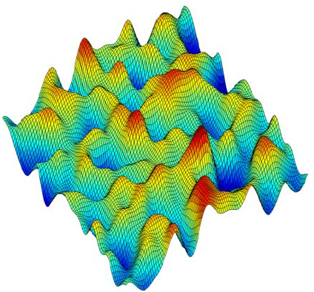
Are we missing outcomes because of our sampling?
_{Outcomes}
A lot of Scenario Discovery has been focused on identifying hi/lo of some metric of interest
How many local optima are there? Are we missing anything?
But what is the rate of change of GCAM’s different outputs with respect to its inputs?
Being able to identify that would give us greater insight to which inputs drive GCAM’s variability
And let us know which inputs are most beneficial to run greater or fewer ensemble members on: Targeted searches and targeted GCAM ensembles
x₂
x₁
Dellago and Bolhuis 2008, illustrative purposes only.
GCAM is much higher dimensional than this
Notes:
So GCAM is really some kind of surface (Colorful blob cartoon) that takes inputs (X1, X2) and turns them into Outcomes. GCAM is high dimensional and nonlinear, but continuous in a lot those dimensions: Deep Neural Network (DNN) emulation of carefully designed GCAM experiments can give us a much more wieldy representation of this surface than running GCAM a bunch of times.
Backup slides 8 and 9 are an example of this. A pilot study that we thought would be neat and we would learn some good stuff from but it has turned out to work better than anticipated and made us very excited for what we can do with this more broadly.
First animation: so a lot of SD discovery has been focused on finding outcomes above Some threshold, so maybe all the red peaks in this blob. And from CART, we can understand what worlds those peaks represent, and maybe there’s only a couple KINDS of red peaks coming out of this – eg those peaks at the lower end of X_2 axis maybe are all pretty similar kinds of worlds.
Second animation: we can also look for different kinds of cases of interest. And we can potentially do a larger search, faster.
BUT we never expect to train a ‘master’ GCAM emulator – even with savings from smarter experiment design, it would probably be too much data. And GCAM is a living model. But for continuing to answer specific scientific questions around uncertainty of outcomes from GCAM, we think this is an exciting avenue forward.

Slide 5
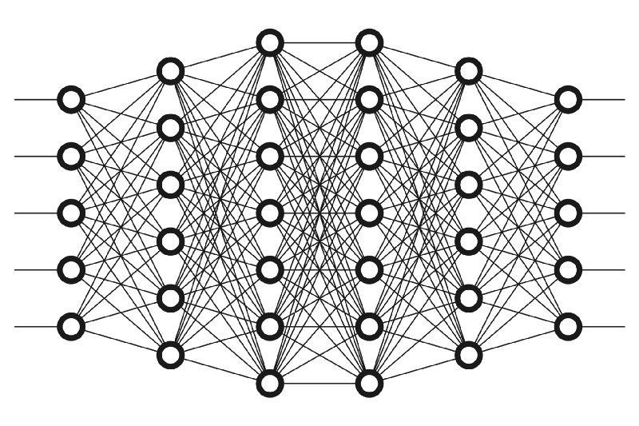
Deep-Learning Aided Scenario Discovery
SSPs: Targeted scenarios based on expert opinion.
DL-SD: Targeted ensemble search to identify critical drivers
Scenario Discovery: Expansive search to identify critical drivers.
Previous approaches are computational book-ends to scenario development.
DL-SD can leverage large-ensembles to provide targeted scenarios, efficiently.
Potentially: Next evolution of our work in scenario discovery
Notes:
Models like GCAM are kind of uniquely well suited to this kind of analysis. Fast enough to run thousands of times for training but slow enough you don’t want to run 100k or a million times. The fact that GCAM is a multisectoral model with simultaneous, integrated solutions for all vectors means we can really explore tradeoffs.
The design of these experiments would be a lot harder if GCAM were a hard-coupled collection of sectoral models. [Franklyn’s compounding GDP and population paper is an easy example of how hard having totally disjoint drivers can be if you aren’t careful].
You don’t need something like this for models like Hector, and you can’t afford to do something like this for E3SM.

Slide 6
Thank you!
This research was supported by the U.S. Department of Energy, Office of Science, as part of research in MultiSector Dynamics, Earth and Environmental System Modeling Program. The Pacific Northwest National Laboratory is operated for DOE by Battelle Memorial Institute under contract DE-AC05-76RL01830. The views and opinions expressed in this paper are those of the authors alone.
And a very special thanks to our Western Washington University team, led by Prof Brian Hutchinson:
Andrew Holmes
Matt Jensen
Sarah Coffland
Hidemi Mitani
Logan Sizemore
Seth Bassetti
Brenn Nieva
Notes:
Brian's work all sits within Experiment 1, our effort focused on exploratory models and large ensembles. A good portion of Experiment 1 is methodology development and pilot testing ideas for further expansion, and that includes Brian's work. His technical updates are interesting on their own merits but Abigail will share some slides at the end to put the work in the context of our greater efforts

Slide 7
Deep-Learning Aided Scenario Discovery
Scenario Discovery usually uses ML for classification.
Proposed workflow utilizes for emulation
… and classification.

Slide 8
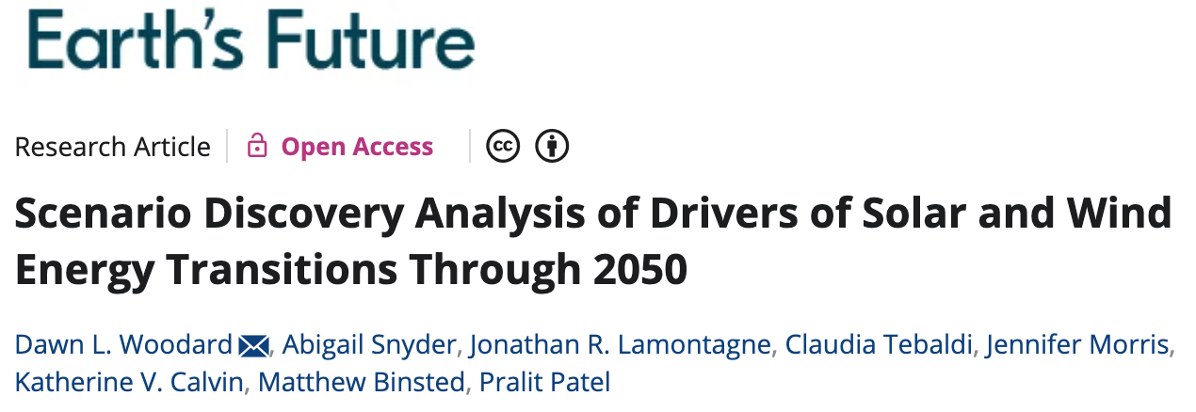
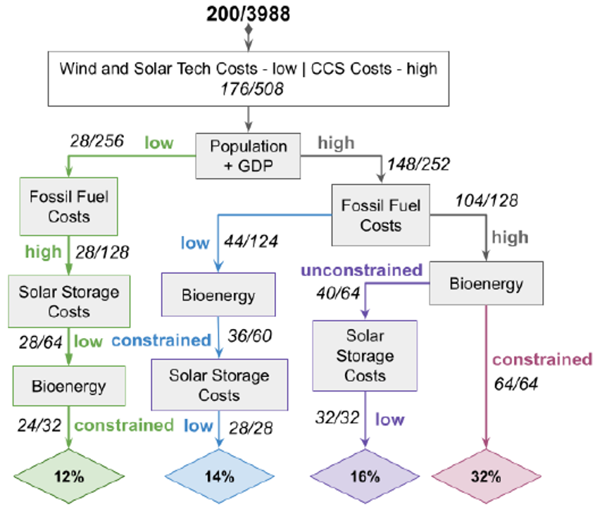
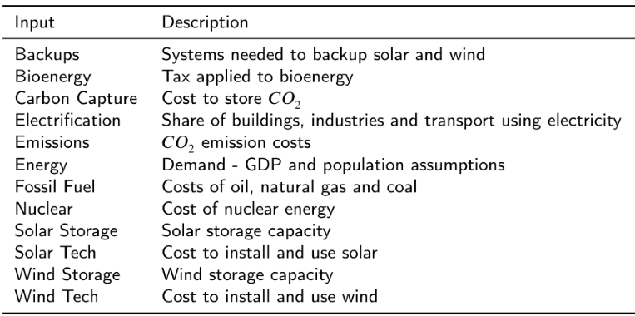
Woodard et al
Ranged over high and low values for 12 expert identified relevant drivers = 4096 GCAM runs:
Using SD, identified four paths to energy sectors with high wind & solar adoption globally. Each pathway has its own consequences for different sectors in different regions (bottom panel).

Slide 9
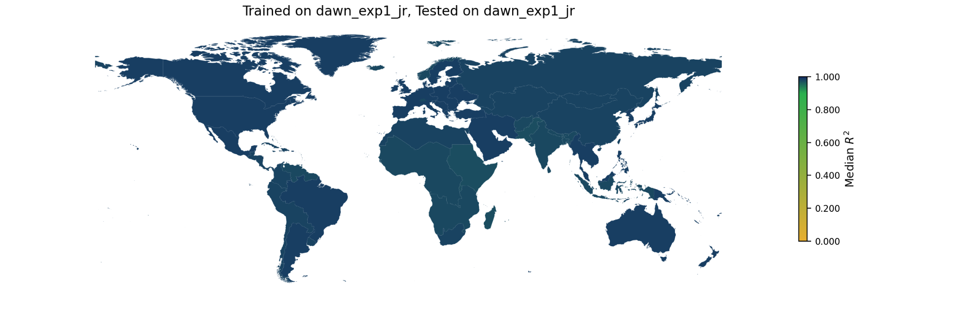
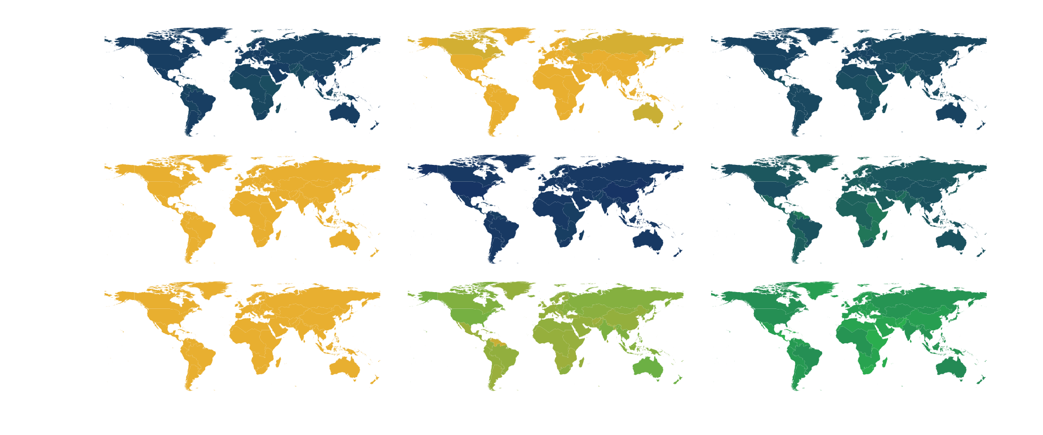
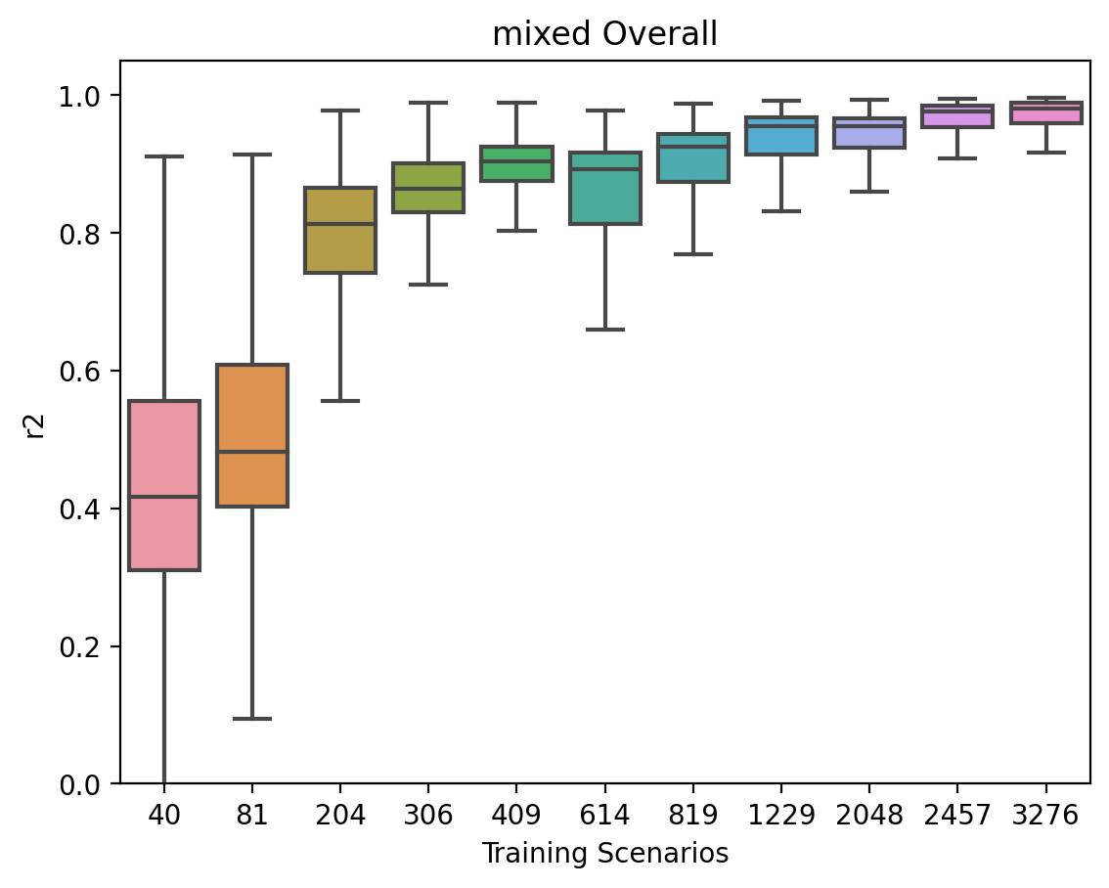
Using the Woodard et al ensemble of 4096 runs, training DNN over different subsets led to:
Trained On
Identify ideal sampling strategy for training ensembles (Mixed, explicitly including some hi/lo boundary values as in the Woodard experiment, as well as random sampling from the interior)
Woodard
Random
Mixed
Woodard
Evaluated On
Random
Highlight that smaller ensemble size sufficient to train the emulator (800 instead of 4000)
Mixed
Do it for 23 outputs across 32 GCAM regions covering economic and physical quantities for energy, water, and land, out to 2100: Outputs have more than 23k entries to inputs with 12.
The emulator features the same sensitivities as GCAM, meaning we can start thinking about derivative-based measures more broadly.
Notes:
Second animation: so this isn’t a trivial regression, we gave the emulator a really hard task for training. It works well because even though GCAM is quite nonlinear, it is overall pretty continuous.

