Slide 1
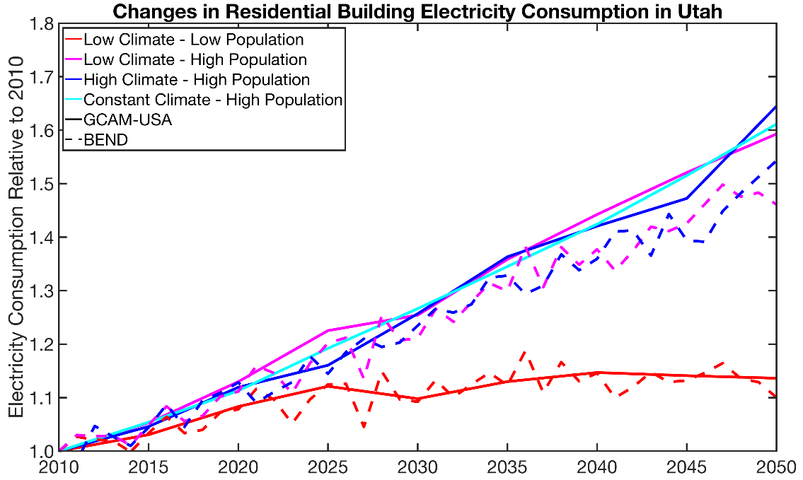
Simulating Future Building Electricity Consumption Under Climate and Population Change
Objective
Explore the impact of model structure on the relative importance of future climate and population change projections on the consumption of electricity by residential and commercial buildings in the western U.S.
Approach
Two models, Pacific Northwest National Laboratory’s (PNNL) GCAM-USA and BEND models, that simulate building electricity consumption in very different ways, were used to determine the generalizability of the findings.
Climate and population change scenarios were constructed for uniform implementation in both models.
Impact
Population change will likely have a larger impact on building electricity consumption than projected changes in climate.
Differences in how the two models incorporate future changes in the energy efficiency of buildings cause differences in their final projections of electricity consumption.
Quantifying the consistency between models demonstrates one approach to link models across scales.
PNNL’s BEND and GCAM-USA models project largely consistent changes in state-level annual building electricity consumption under climate and population change despite their markedly different approaches to modeling building electricity consumption.
C.D. Burleyson, et al. “Future western U.S. building electricity consumption in response to climate and population drivers: A comparative study of the impact of model structure.” Energy 208, 118312 (2020). [DOI:10.1016/j.energy.2020.118312]
Notes:
http://www.pnnl.gov/science/highlights/highlights.asp?division=749

