Slide 1
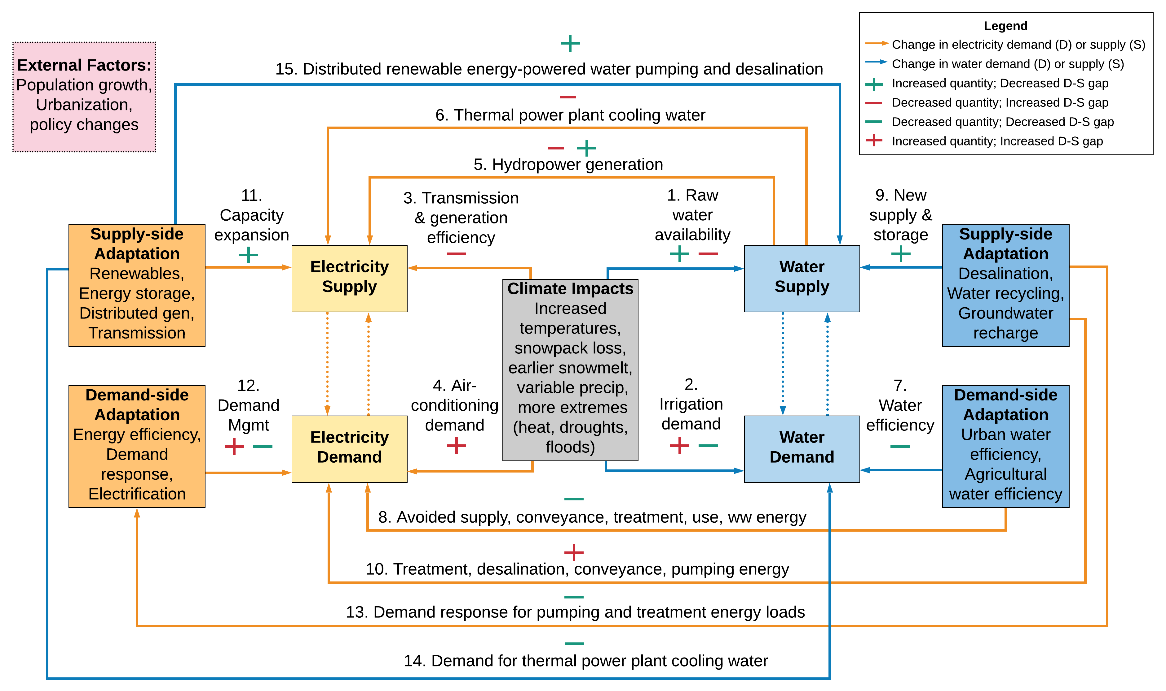
Evaluating cross-sectoral impacts of climate change and adaptations on the energy-water nexus: A framework and California case study
The paper develops a generalized framework and CA case study identifying complex ways that stressors such as climate change may affect coupled electricity and water systems, adaptation strategies to balance supplies and demands, and their feedbacks.
California results show that under the highest projected water shortage, the energy demand of certain water adaptations could double the direct impact of climate change on the electricity system’s resource needs.
Electricity-water Nexus Climate Change Adaptation Framework
We synthesize the range of climate impacts to California’s individual water and electricity supply and demand components from existing studies for the end-century, estimate the aggregate best- and worst-case effect on both sectors’ annual resource balances, and calculate the energy consumption or savings of different water adaptation strategies that could fill a worst-case water shortage.
Szinai, J.K., Deshmukh, R., Kammen, D.M., & Jones, A.D. Evaluating cross-sectoral impacts of climate change and adaptations on the energy-water nexus: A framework and California case study. Environ. Res. Lett. (2020) doi: 10.1088/1748-9326/abc-378.

