Slide 1
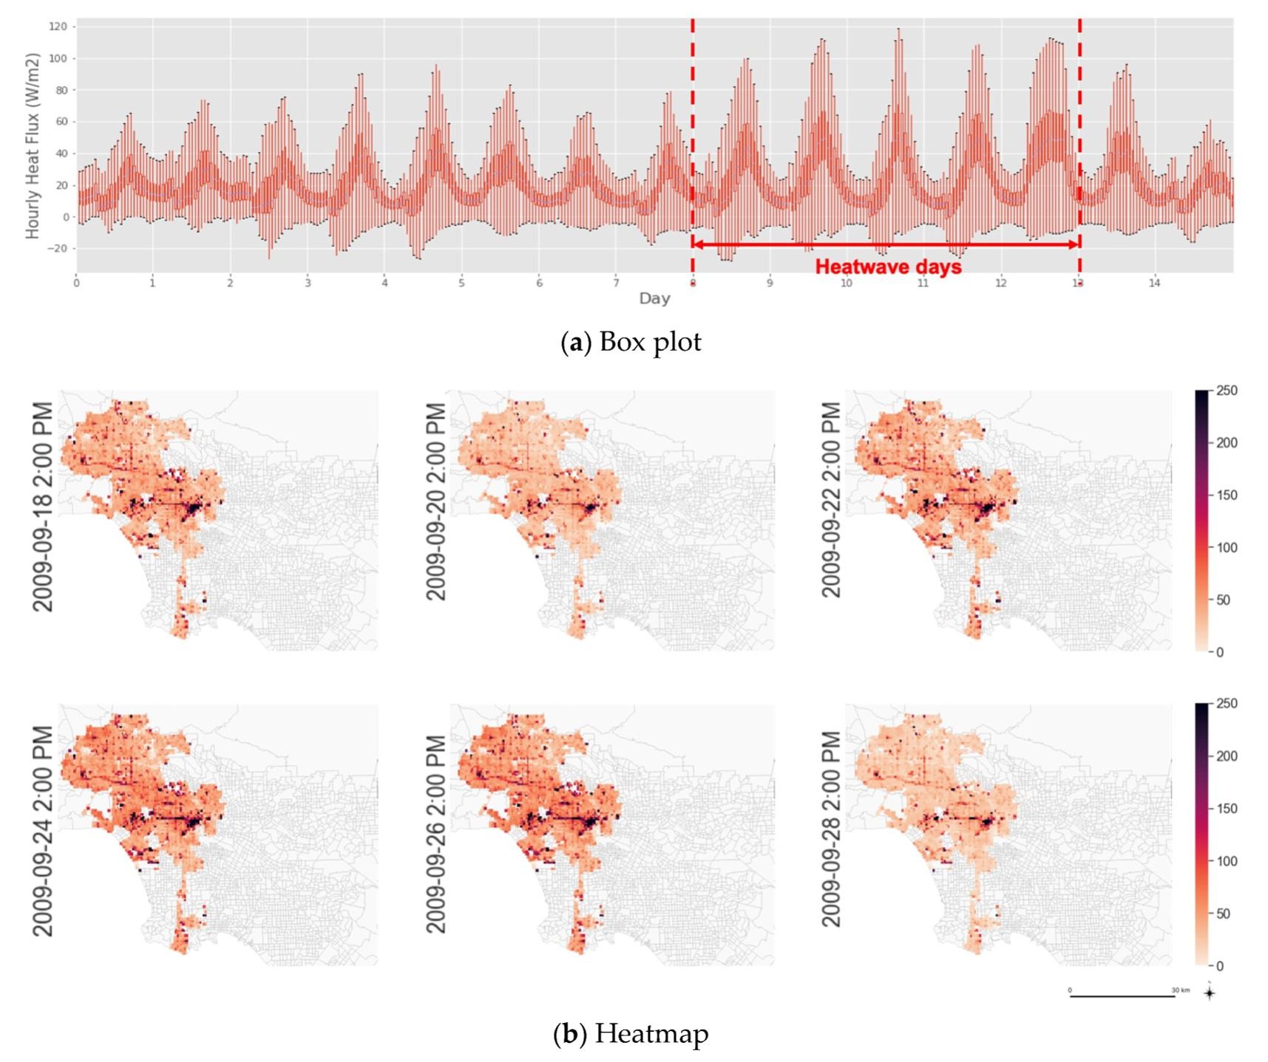
City-Scale Building Anthropogenic Heating during Heat Waves
We developed a bottom-up building heat emission model to investigate the temporal and spatial variations of waste heat fluxes at the city scale during extreme heat events.
The method provides a high-resolution representation of the magnitude and distributions of buildings’ anthropogenic heating profiles under extreme heat, as a fundamental step toward a continued investigation of the feedback between building heat fluxes and urban microclimates.
Spatial and temporal variation in anthropogenic waste heat from buildings during a during a heat wave in Los Angeles.
We developed a coupled-simulation approach to quantify these effects, mapping urban environmental data generated by the mesoscale Weather Research and Forecasting (WRF) coupled to Urban Canopy Model (UCM) to urban building energy models (UBEM).
We generated grid-level building heat emission profiles and aggregated them using prototype building energy models informed by spatially disaggregated urban land use and urban building density data.
We analyzed the surge in city-scale building heat emission and energy use during the extreme heat event.
Citation: Luo, X.; Vahmani, P.; Hong, T.; Jones, A. City-Scale Building Anthropogenic Heating during Heat Waves. Atmosphere 2020, 11, 1206. doi:10.3390/atmos11111206.

