Slide 1
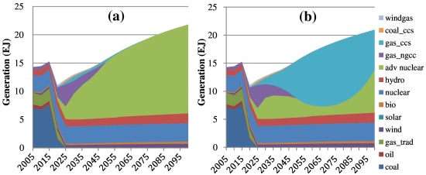
More realistic simulation of new energy technology penetration
Objective: Devise strategy to represent the penetration of new energy technologies within a global energy-economic model, assuming that technology penetration rates and constraints depend on economic incentives.
Findings: Consistent with a large body of economic theory, modeling approach leads to a set of results that is consistent with observation.
Impact: This new capability could enable more accurate projections of the likely contribution of new technologies to the future energy mix and thus improve multi-sector risk assessment.
Electricity mix under an energy sector transformation scenario when all advanced technologies are available: (a) advanced nuclear costs 1.47 times the cost of conventional coal, and (b) advanced nuclear costs 1.55 times the cost of conventional coal.
Morris, J. F., Reilly, J. M., & Chen, Y.-H. H. (2019). Advanced technologies in energy-economy models for climate change assessment. Energy Economics, 80, 476-490. https://doi.org/10.1016/j.eneco.2019.01.034

