Slide 1
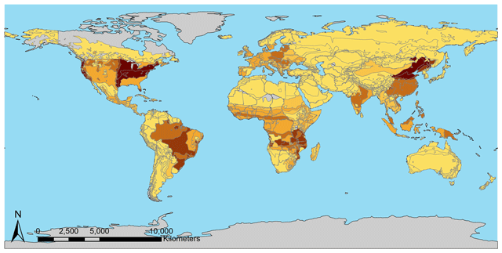
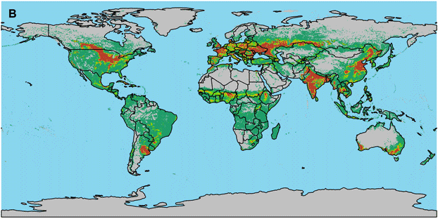
Demeter – A Land Use and Land Cover Change Disaggregation Model
Objective
Create a seamless and repeatable procedure to disaggregate regional allocation and future projections of land into multiple resolutions of gridded data used by Earth system and global hydrologic models
Approach
Use input resolution of the observational data to drive output resolution of the disaggregated data
Build a flexible, user-defined input matrix structure to facilitate custom land transitions and specifications, and uncertainty characterization
Include an extensible input-output module to accommodate a wide variety of use cases
Impact
A well-documented, open-source community model, Demeter uses a common scale-independent methodology to accommodate a variety of Earth system modeling research
GCAM cropland by subregion
Disaggregated gridded product
The Demeter model disaggregates regional allocation and future projections of land into multiple resolutions of gridded land use and land cover representations to advance the science of multi-sector, multi-scale research.
Vernon, C. R., Le Page, Y., Chen, M., Huang, M., Calvin, K. V., Kraucunas, I. P., & Braun, C. J. (2018). Demeter – A Land Use and Land Cover Change Disaggregation Model. Journal of Open Research Software. https://doi.org/10.5334/jors.208

