Slide 1
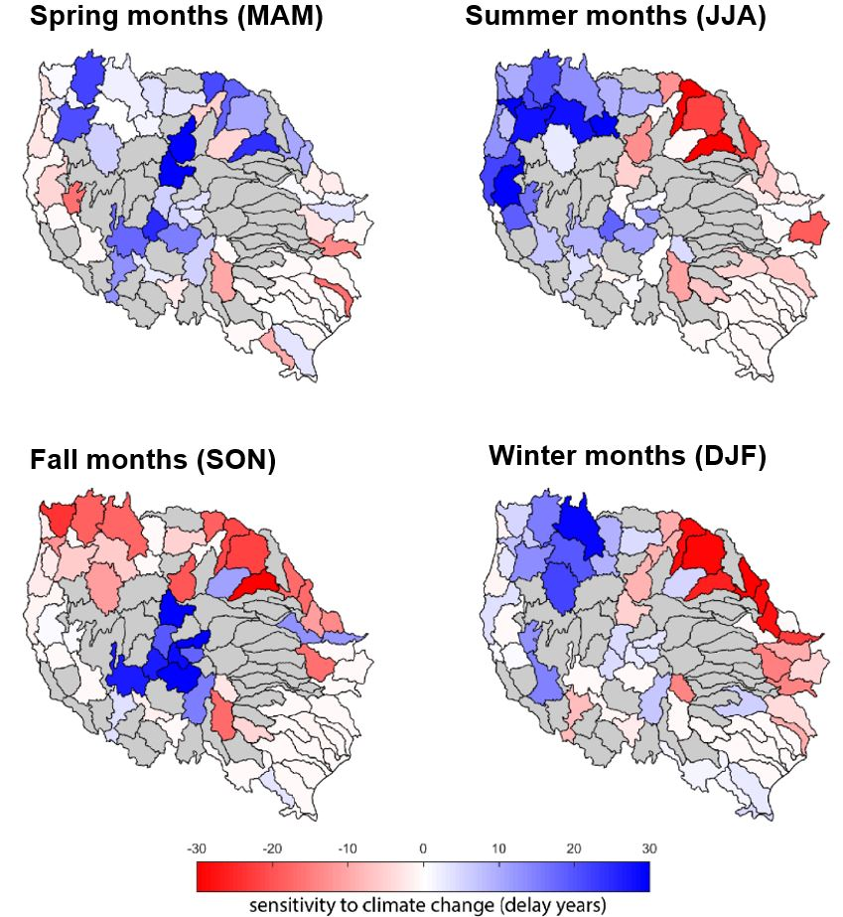
Water Management Influences Long-Term Changes in River Flows
Objective
Evaluate whether regulated river flow is more sensitive to Earth system change than natural flow in the western United States across seasons.
Approach
Define emergence of change as a significant shift in cumulative distribution functions (CDFs) of monthly and annual flow between the historical and future periods.
Assess the emergence of change in regulated and natural flow regimes across the western United States and evaluate the regional and seasonal differences.
Impact
Water management tends to reduce the magnitude of the response of natural flow regimes to climate change. However, the emergence of this smaller change in regulated flow regimes might be evident earlier in 40% of the watersheds.
The results improve our understanding of how human systems affect the natural systems’ response to Earth system change.
The research provides insight for human-Earth system modeling efforts on the scales of water-management representation needed to understand water-energy-land dynamics.
Difference in seasonal emergence of change in flow regimes over the western U.S. for the RCP 8.5 scenario. Blue (positive) indicates that regulated flow is less sensitive to Earth system change than natural flow (change emerges later, even if smaller).
Zhou T, N Voisin, G Leng, M Huang, & I Kraucunas. "Sensitivity of Regulated Flow Regimes to Climate Change in the Western United States." Journal of Hydrometeorology 19, 3 (2018). DOI: 10.1175/JHM-D-17-0095.1
Notes:
http://www.pnnl.gov/science/highlights/highlights.asp?division=749

