Slide 1
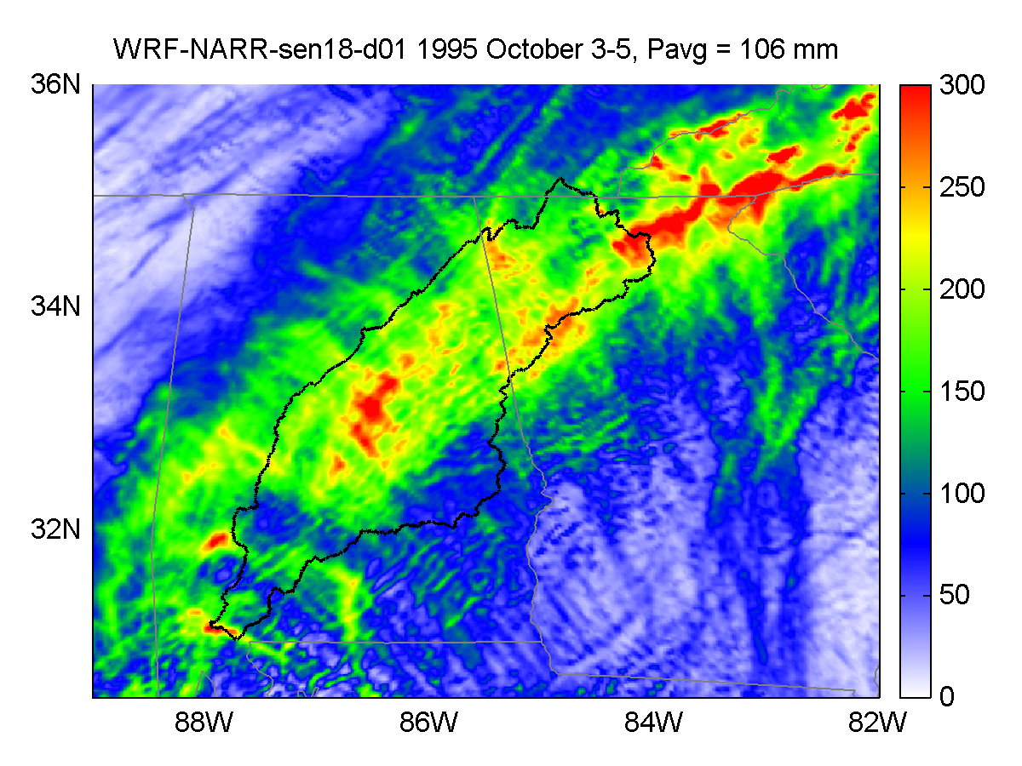
Understanding the Effects of Climate on Probable Maximum Precipitation and Flood
Objective
Understand how probable maximum precipitation and flood (PMP and PMF) will change in future climate and land use land cover (LULC) conditions.
Approach
Establish a numerical modeling framework to simulate depth-area-duration relationships of current and future PMP events.
An increase in the deterministic probable maximum precipitation (PMP) storm upper bound in a warming environment is projected through two different modeling approaches.
Impact
PMP is the largest rainfall depth that could physically occur under a series of adverse atmospheric conditions. It is the design standard of highly important energy-water infrastructures such as dams and nuclear power plants. The increase of PMP has significant implication on our energy-water security.
Simulation of extreme precipitation event over the Alabama-Coosa-Tallapoosa River Basin for October 3-5, 1995.
Rastogi, D., Kao, S.-C., Ashfaq, M., Mei, R., Kabela, E. D., Gangrade, S., Naz, B. S., Preston, B. L., Singh, N., & Ananthraraj, V. G. (2017). Effects of climate change on probable maximum precipitation: A sensitivity study over the Alabama-Coosa-Tallapoosa River Basin. Journal of Geophysical Research: Atmospheres, 122(9), 4808-4828. https://doi.org/10.1002/2016jd026001

